Slide 1
Cool ID Cases
Mark E. Dowell, MD FACP
Rocky Mountain Infectious Diseases

Slide 2
Is it Appropriate to Blame the Catholic Church?
A 70 year old male with a history of cardiac stenting presented on 6/15/2017 with progressive left cheek swelling. It began as a nodule. He was not systemically ill. Initial evaluation led to the diagnosis of right facial cellulitis (normal labs). He was given ceftriaxone 1gm IM and oral clindamycin.

Slide 3
On 6/30/2017, there was no change and RMID evaluates him on 7/3/2017. We discover that he drives heavy equipment 12 hours a day with sun exposure to that side. We note that patient has 2 scaly right leg lesions, asymptomatic, and complains of right toe numbness. He is placed on Augmentin plus amoxicillin.

Slide 4
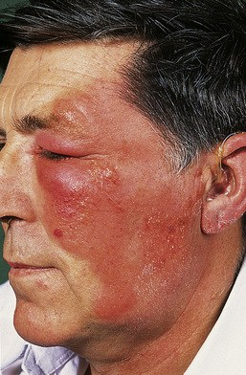

Slide 5
Having nothing better to do, we perform a punch biopsy of a leg lesion. The antibiotics do not help. He suddenly is admitted with an AMI. We see him in the hospital and place him on clarithromycin plus a short course of steroids that helps some.

Slide 6
The skin biopsy results returned during all of this. It was subsequently sent out for consultation.
  Few lymphocytes in epidermis.
  Epithelioid granulomas with patchy lymphocytes in dermis.
  Positive AFB smear. Granulomas surrounding nerve bundles.

Slide 7
We sent him immediately for biopsy of his right cheek. “Many AFB”.

Slide 8
Leprosy (Mycobacterium leprae)
Discovered before MTB: 1873
Cannot grow in lab on media
2,000,000 cases WORLDWIDE
Most new cases: South and East Asia.

Slide 9
Leprosy
The most common complication is:
  A. Peripheral nerve damage
  B. Facial deformity
  C. Skeletal damage
  D. Cardiomyopathy
  E. Liver cirrhosis

Slide 10
We began dapsone plus rifampin and contacted the National Hansen’s Disease Program in Louisiana. They requested the skin biopsy tissue blocks for probe analysis. The probe confirmed the infection and documented the genotype seen in Asia.

Slide 11
Shortly after treatment initiation, the patient developed flu-like symptoms, temperatures to 102º and was quite ill.
At their recommendation:
  D/C Rifampin.
  Continue dapsone.
  Prednisone 40mg daily x 5 days.
  Minocycline 100mg BID x 2 weeks.

Slide 12
Our Patient
Borderline lepromatous leprosy
Had reversal reaction → lepromatous phase.
Developed brisk systemic response to initiation of rifampin/dapsone (rifampin main culprit)
  Main nerve involvement:
    Intermediate dorsal cutaneous branch of superficial right peroneal nerve (numbness toes 3-5).

Slide 13
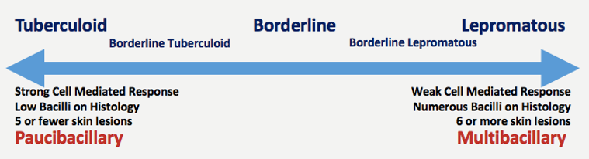
Leprosy

Slide 14
The patient spent the first 20 years of his life in Indonesia. As a boy, he was required to visit leper colonies on a regular basis, delivering food and assisting in activities.
We connected the dots and clinically diagnosed :
  Mycobacterium leprae infection.

Slide 15
Current regimen (12-24 months)
  Levofloxacin 500mg monthly
  Methotrexate 10mg monthly
  Clofazimine 100mg BID
  Rifampin 600mg monthly
  Prednisone PRN with rifampin
  Dapsone 100mg daily

Slide 16
He is steadily improving.

Slide 17
Within 2 months of diagnosis: he developed medically-treated acute appendicitis → mild C.diff colitis.
A great year to be sure !!!

Slide 18
Leprosy
USA
6,500 cases/3,300 of which require treatment.
150 new cases annually.
3,000 cases managed by national clinics.
300 cases managed by private sector.
2/3 cases in people who have lived or worked in endemic areas: Asia, Africa, South America.
1/3 no history of travel to these areas.

Slide 19
Leprosy
Arkansas
Louisiana
Texas
California
Florida
New York
USA
72 % Cases Managed

Slide 21
Leprosy
Most people are genetically protected from infection.
Human to human spread via respiratory droplets, usually with prolonged or repeated exposure.
Of the 1/3 with no travel history, the majority of cases occur in Louisiana and Texas.
WHY?

Slide 22
The Nine-Banded Armadillo

Slide 23
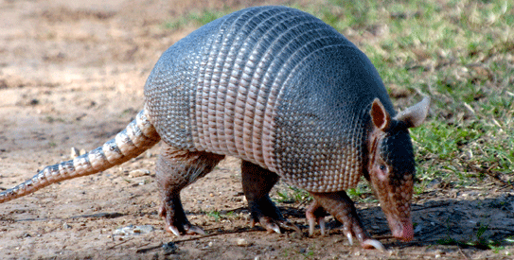
A Texas Rat

Slide 24
The only known reservoirs are humans and this species of armadillo.
Armadillos only found in Western hemisphere.
Eastern armadillos do not carry the organism.
The prevalence of this mycobacterium in the aforementioned armadillos is 20%.

Slide 25
Probable Zoonotic Leprosy in the Southern United States.
Turman, RW et al N Engl J Med 2011; 364: 1626-1633

Slide 26
Captured 33 armadillos in 5 southern states.
Studied 50 infected humans.
    39/50 humans lived in armadillo-endemic areas.
    29/39 no history foreign residence.

Slide 27
Performed whole-genome sequencing and subsequent genotyping.
Utilized reference strains: Philippines, Brazil
Armadillo genotype unique.

Slide 28
A high % of unrelated leprosy cases in southern US involve infection with identical genotype seen in armadillos.

Slide 29
Able to obtain armadillo exposure history in 15 patients:
  8 exposure
  7 no exposure
  9/15 armadillo strain
  Odds ratio 4.0

Slide 30


