Slide 1
The CHF (Congestive Heart Failure) Clinic: Its Role in Completing What was Started in the Hospital
Adrian Fluture, MD, FACC, FSCAI
Director Regional Myocardial Infarction Care, Wyoming Medical Center.
Heart Failure Management Program.
Frontiers in Primary Care - Casper, WY, 4/21/2018

Slide 2
About this lecture
Goal:
Improving quality of care in CHF patients.
Reducing readmissions → improving patient’s quality of life.
Quality of scientific data available:
Mostly observational studies,
Small scale RCTs,
Controversies and conflicting data extist.

Slide 3
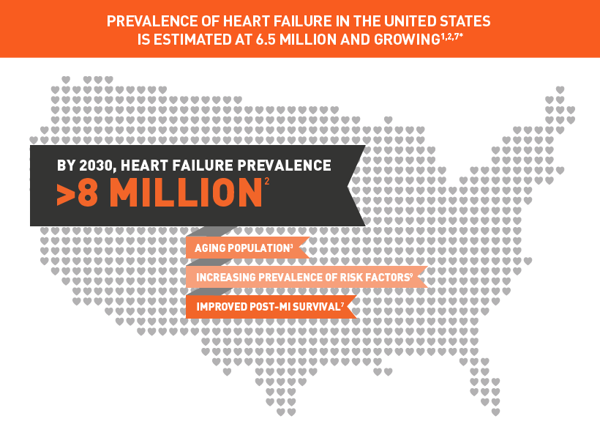
CHF – magnitude of this problem

Slide 4
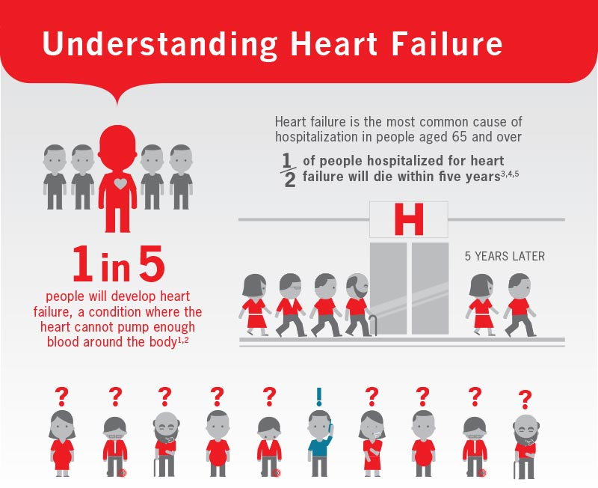
CHF – magnitude of this problem
Lifetime risk of HF (age 45-95): 20-45%

Slide 5
Reducing readmissions
Avoiding the preventable readmissions
Possible remedies suggested by research → avoiding:
Therapeutic errors and adverse drug events (med-recs…);
Lack of goals of care discussions;
Premature discharge;
Failed hand-offs;
Inadequate post discharge support;
Insufficient follow-up;
Nosocomial infections, patient falls etc.
Auerbach AD, JAMA Intern Med 2016;176:484

Slide 6
What do we do differently ?
Working together for our patient’s benefits for more than 30 years
Advancements in Heart Failure treatment quality
since 2016 – new program

Slide 7
What is different ?
Early recognition
Early treatment
Intensive education (incl. teach-back) on:
Disease
Treatment
Self-management after discharge
Medications, symptoms, weight, diet
What to do if worsening after discharge
Adequate discharge package

Slide 8
Cardiology Involvement may Improve CHF Outcomes
Adrian Fluture, MD, FACC, FSCAI
Outpatient and inpatient settings (observational studies).
Ansari M, JACC 2003;41:62.
Cardiology care → independent predictor of a lower risk for [death+hospitalizations]
(HR= 0.62, [0.42, 0.93], p = 0.02);
Foody JM, Am J Med. 2005;118:1120
Cardiology care → lower 30 day mortality
(vs. FP - RR = 1.31; 95% CI: 1.15 to 1.49; P<0.001).

Slide 9
Handling Volume Excess – Key Concept
Acute CHF – the fluid input/output balance
Input
Besides neurohumoral / preload – afterload treatment
Output

Slide 10
Key Concept: Weight Reduction in CHF
When to D/C the CHF patient ?
Weight
congestion
“euvolemic weight”
Time

Slide 11
Key Concept: Weight Reduction in CHF
Barsuk JH, Congestive Heart Fail 2013;19:53
More weight reduction
= less readmissions: OR=0.46, 95%[0.22-0.95];
= Trend towards increased LOS (length of stay): p=0.097.
Inverse relationship LOS and readmissions (Heidenreich PA, JACC 2010;56:362);
Proceeding this way may actually result in cost savings.

Slide 12
Salt (NaCl) - Sodium (Na) Restriction
ACC/AHA – 2013 HF guidelines.
Conflicting information regarding Na intake target
Available literature (time to hospitalization +/- death):
2-3g/d better than >3g/d
Song EK, Eur Cardiovasc Nurs 2014;13:541
Lennie TA, J Card Fail 2011;17:325
2-3g/d better than <2g/d
Lennie TA, J Card Fail 2011;17:325

Slide 13
Reducing readmissions: Key concept
A Continuum:
Adequate treatment in hospital:
Adequate med. treatment (incl. LOS);
Adequate patient education;
Adequate discharge (handoff).
Adequate outpatient treatment:
Adequate med. treatment;
Assessing med. compliance;
Adequate patient self-care.

Slide 14
Transition to home
The CHF patient at WMC.
D/C order set and MedRec (also admission MedRec);
Makes sure patient D/C’ed on adequate meds!
Salt (2.5-3g) /fluid (1.5-1.7l) restriction / diet recommendations
The D/C package → what is truly needed?
The personalized cover page
When to f/u? Who to call? (e.g.: NH patients etc).
The weight chart !!!
The stoplight page
What to do when worsening
Explanations of medication need → personalized, …

Slide 15
Adrian Fluture, MD, FACC, FSCAI
Transition to euvolemic status
congestion
“euvolemic weight”
Day #2 Post D/C –
Compliance:
Phone call (NAVIGATOR RN) targeting:
Symptoms
Weight change
Medication compliance (Purchased? Taken? Side effects?)
HHA support?
1 day before clinical encounter:
BMP draw
≤ 7 days post D/C -
Congest. status:
WCPS office encounter*:
Hx/PEx
ΔWt, I/O
BMP
Adjust diuresis
Document “euvolemic weight” if reached.
Start medication up-titration (HFrEF)
Further appointments
Medications up-titration for HFrEF

Slide 16
The outpatient follow-up
B. The CHF patient after D/C .
The 48h phone call:
WMC: Wt? meds bought? Taken? Salt/fluid intake?
7th day = clinical encounter, preceded by 5th day labs:
Midlevel or MD;
Concept: as this were a f/u visit on the hospital floor.
14th day = phone call:
WCPS RN
21st day = clinical encounter, preceded by labs:
Midlevel or MD (similar to 7th day encounter).
28th day = phone call:
WCPS RN
42nd day (6 weeks):
Preferably MD

Slide 17
The Clinical Encounter
I. Subjective:
DOE degree (blocks, flights)? Sleep? Edema? dizzy/orthostatic?
Salt (~2.5-3g Na/24h), fluid intake (~1.5-1.7l/24h).
Meds compliance?
Undesired meds? (NSAIDs, non-dihydropyridines, sotalol (EF<40%), thiazolinidinediones, cilostazole etc).
II. Objective:
BP, pulse pressure, HR, orthostatics, Wt (ΔWt),
Correct JVP assessment, lung auscultation, edema, ascites?
III. Labs check!

Slide 18
Obsessed with weight / fluid status
Adrian Fluture, MD, FACC, FSCAI
Admission
During Tx
At discharge
Euvolemic status
Office f/u
Weight needs documented

Slide 19
Additional Selected References
Dudas V, Am J Med 2001;111:26S.
Stewart S, Arch Intern Med 1998;158:1067.
Jack BW, Ann Inrern Med 2009;140:178.
Stauffer BD, Arch Intern Med 2011;171:1238.
Mueller SK, Arch Inern Med 2012;172:1057.
Schilinger D, Arch Intern Med 2003;163:83.
Hesselink G, Arch Intern Med 2012;157:417.
Ansari M, JACC 2003;41:62.
Galbreath AD;Circulation 2004;110:3518.
Lindenfeld J, J Card Fail 2010;16;e1
Foody JM, Am J Med 2005;118:120
Jong P, Circulation 2003108;184
ACC/AHA CHF guidelines 2013
Verbrugge FH, JACC 2015;65:480.
Hussain-Syed F, JACC 2015;65:2433.
Verbrugge FH, Cardiorenal Med 2014;4:176.
Ewy, Ann Int Med 1988;109:456.
Drazner MH, NEJM 2001;345574

Slide 20
Thank you for listening !

