Slide 1
Superficial Venous Insufficiency
Charles W. Bowkley III, MD
Casper Medical Imaging

Slide 2
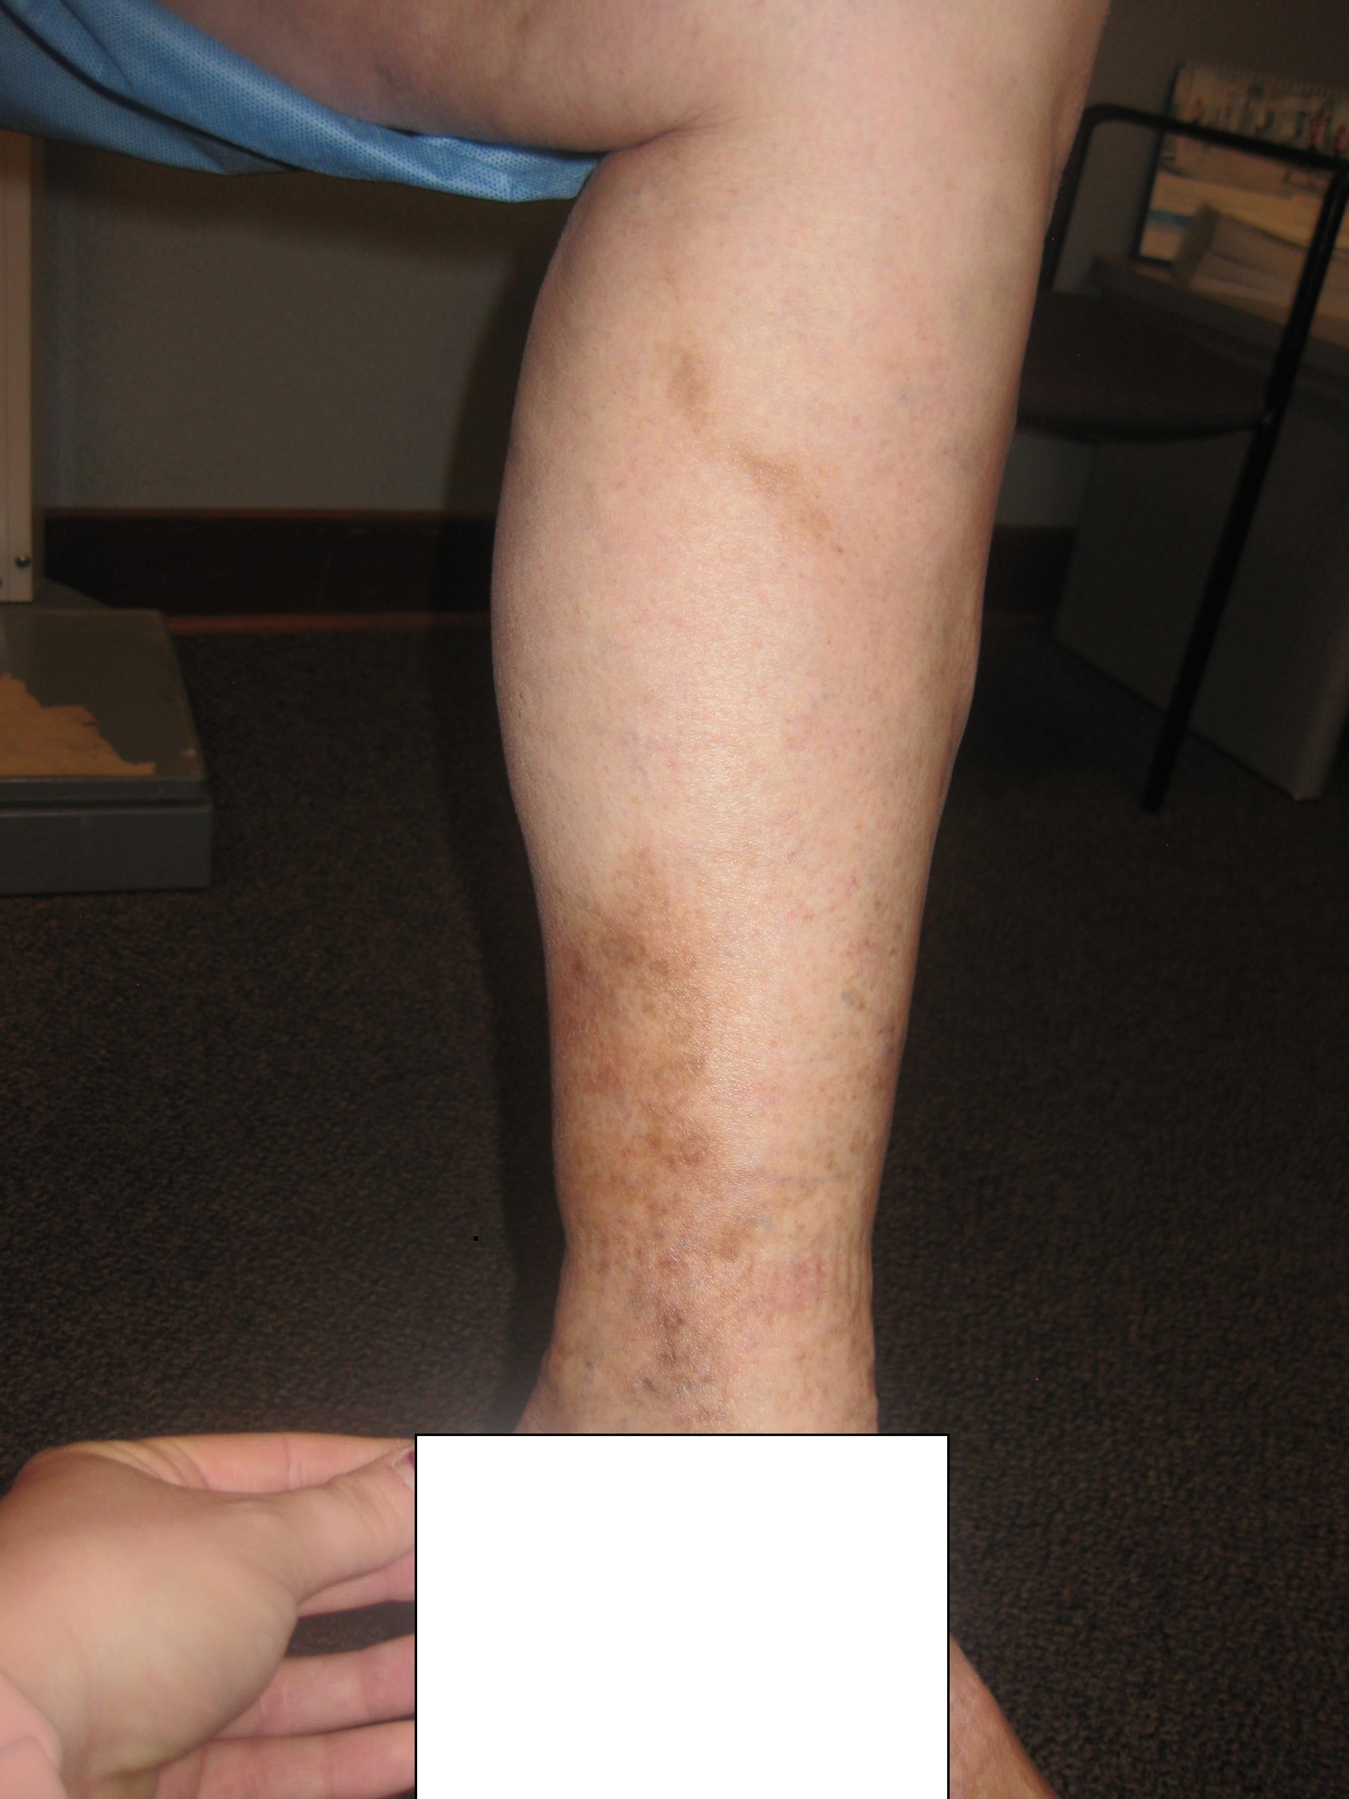
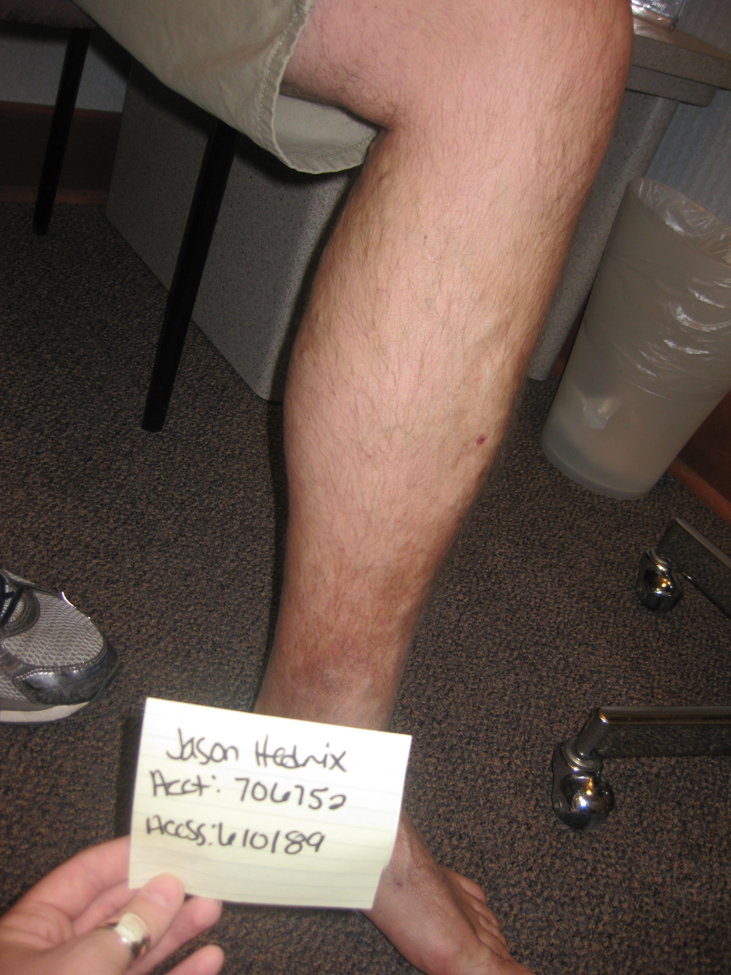
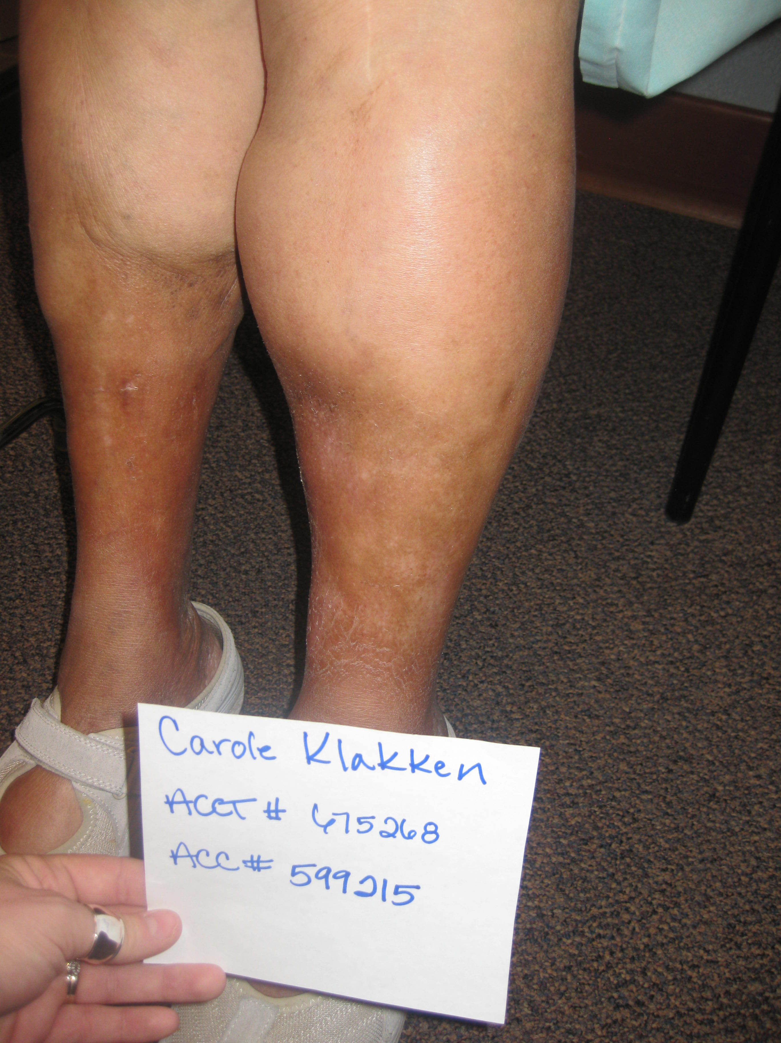
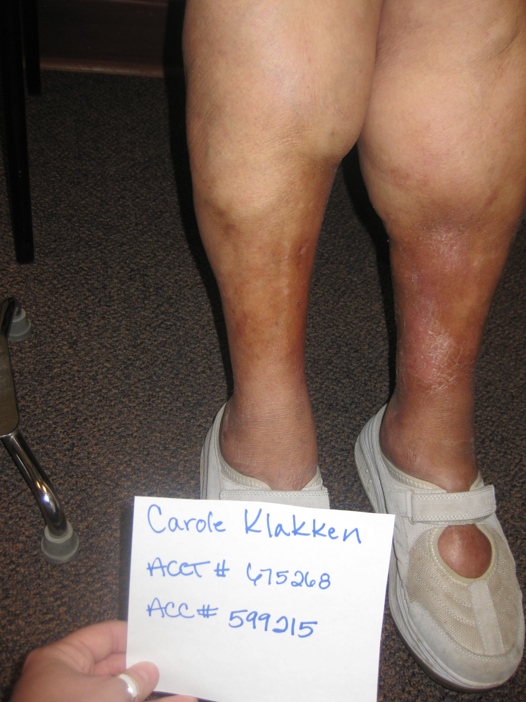

Slide 3
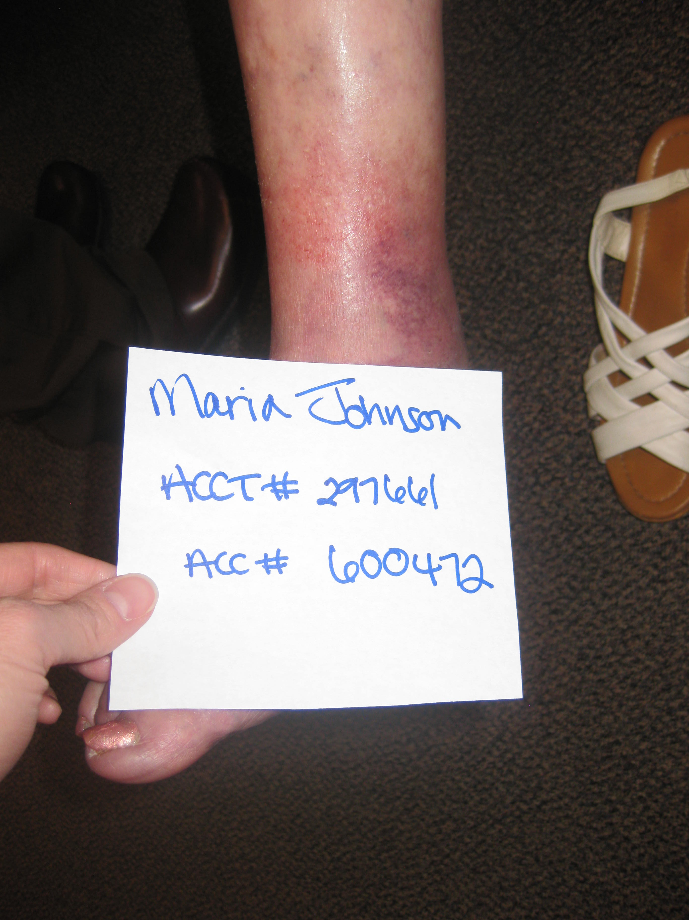
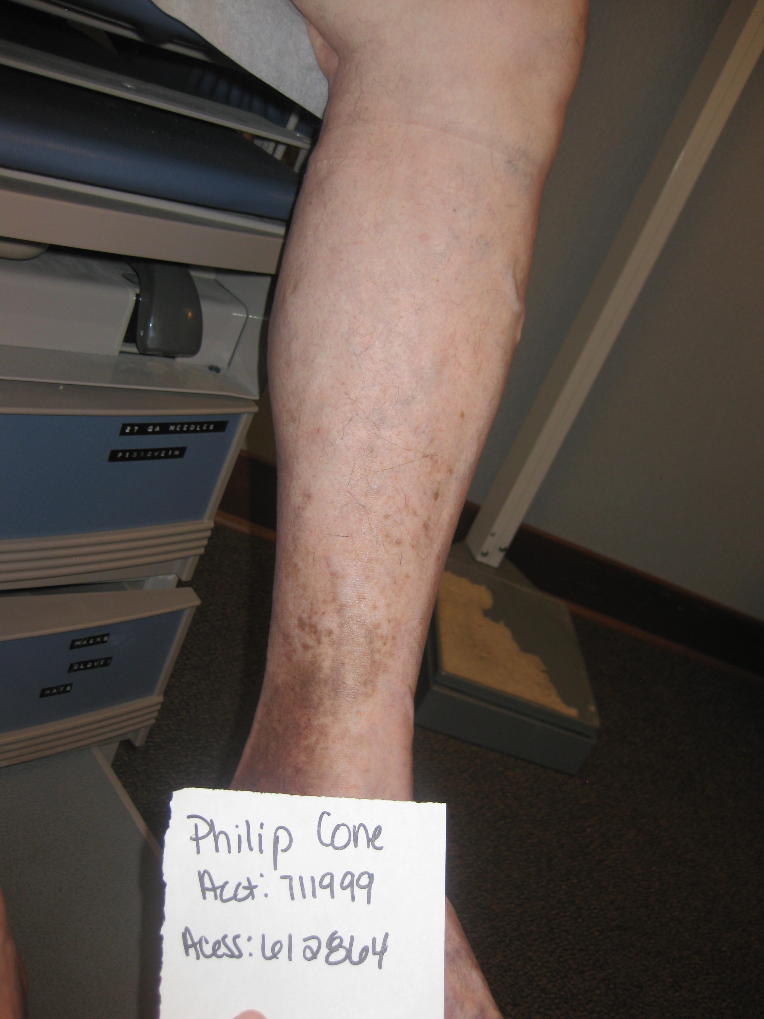

Slide 4
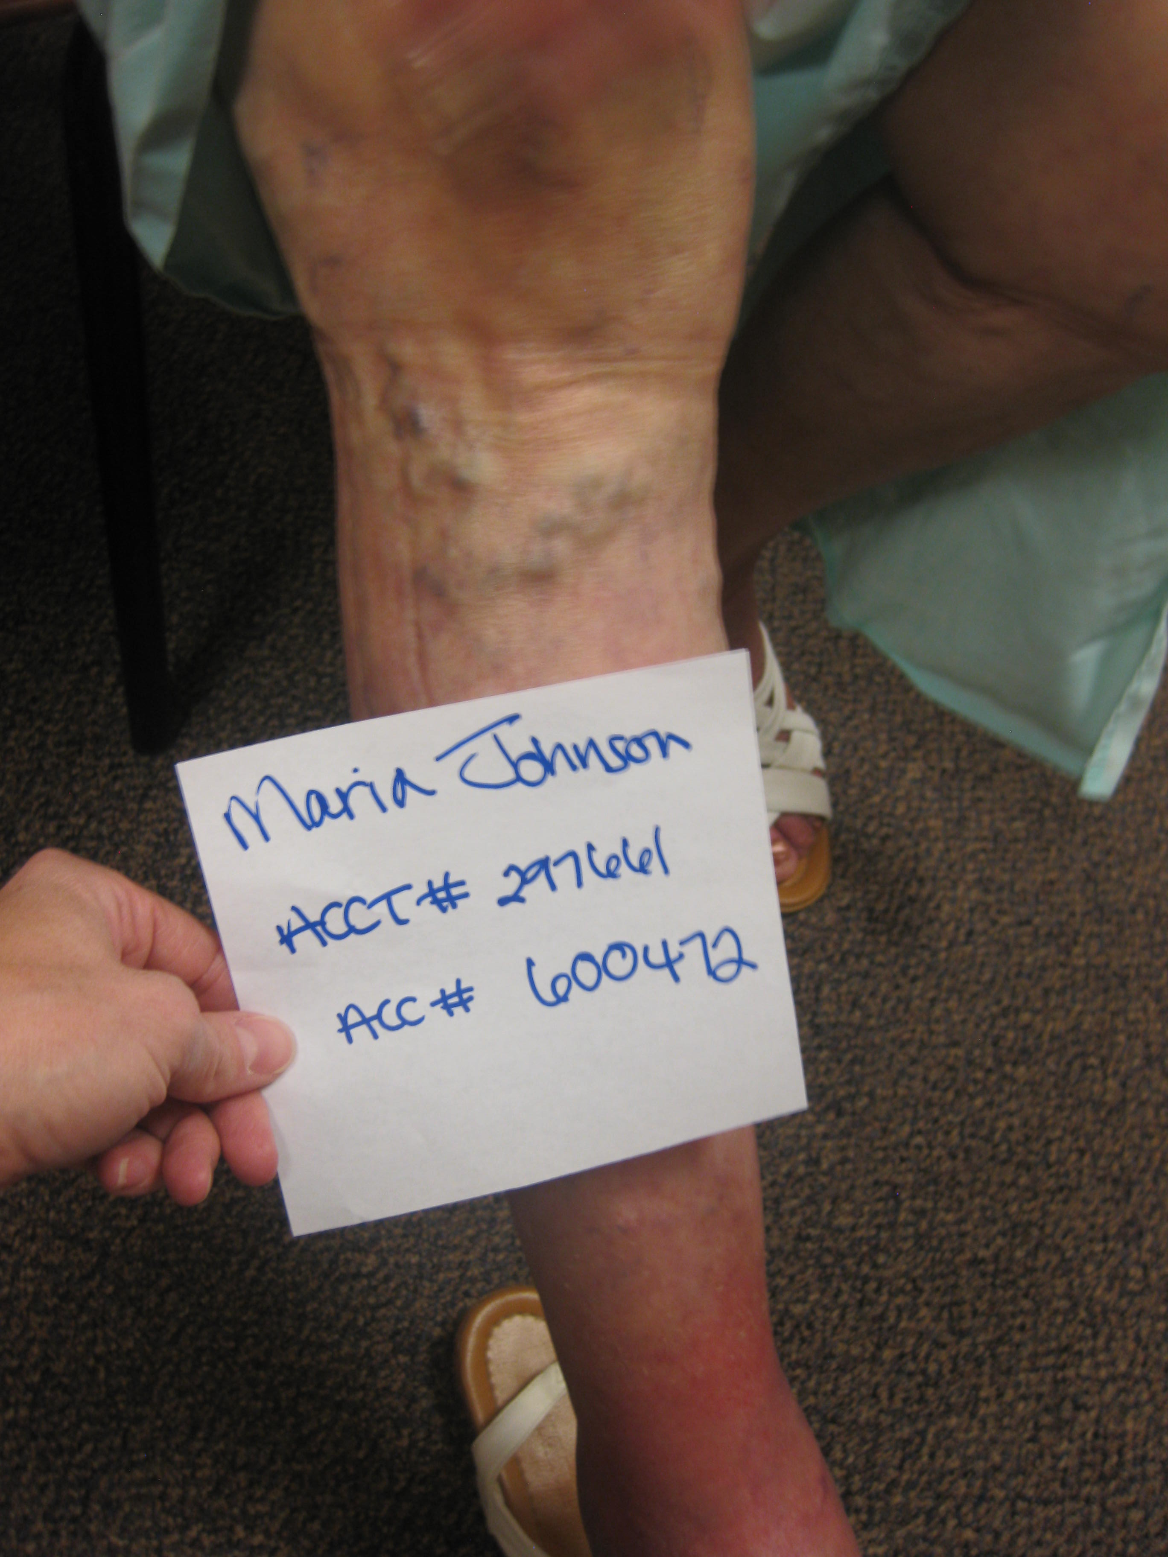

Slide 5
Epidemiology
Female : Male = 3.5 : 1
25% women
15% men
100 - 150 million US and Europe
7th most common medical referral
Most common vascular disease

Slide 6
Wyoming Stats
Population (2016): 585, 501
% 18-65 YO: 391K
% Female: 48.9 (48K)
% Male: 51.1 (30K)

Slide 7
Epidemiology
Risk Factors
Family history
Female
Pregnancy
Age
Obesity
Prolonged standing

Slide 8
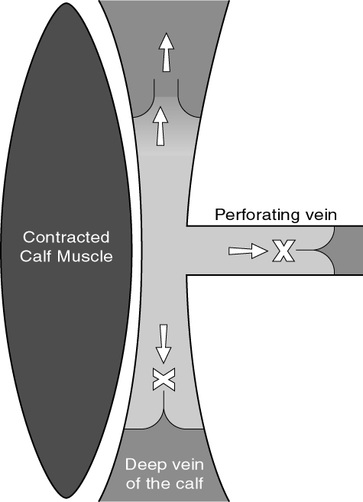
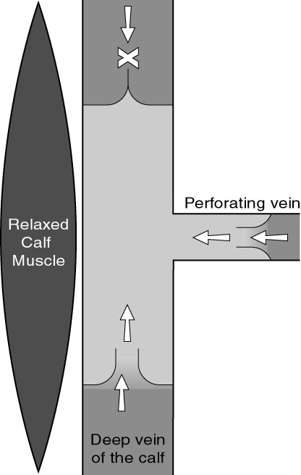
Physiology
Lower extremity veins-dual system
Deep, superficial, perforators

Slide 9
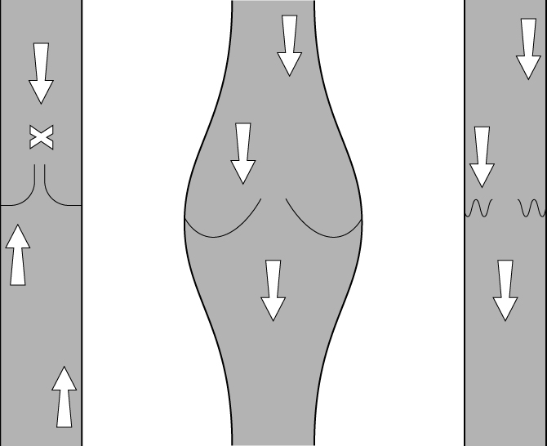
Pathophysiology
Valvular Incompetence
Post-traumatic
Phlebitis
Familial
Thrombosis
Wall Abnormalities
Hormones
Volume

Slide 10
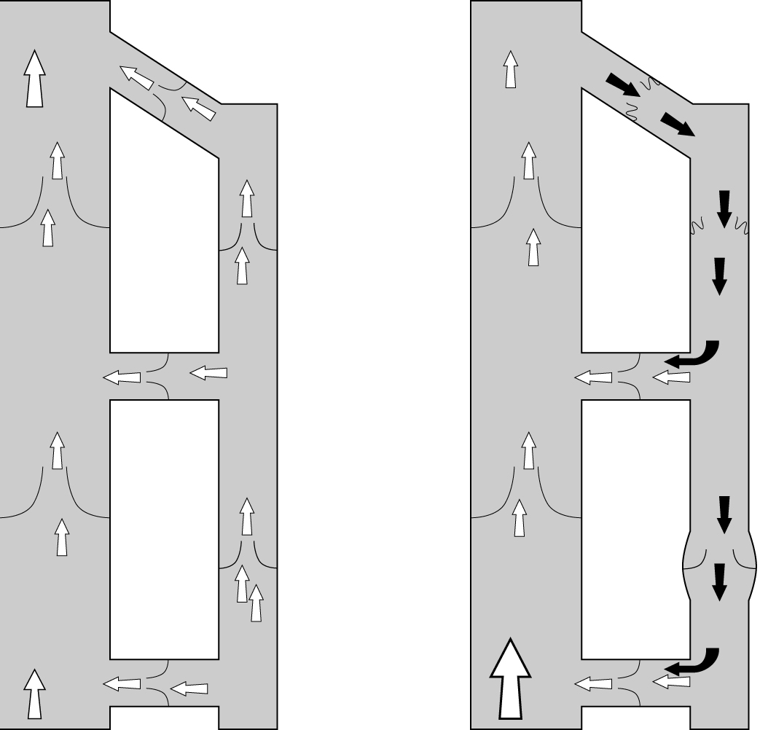
Valvular Incompetence
Saphenofemoral Junction
Reflux
Domino effect
* Not always the case

Slide 11
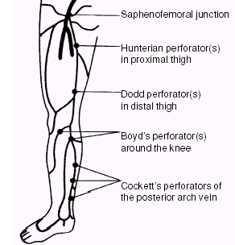
Superficial Veins: anatomy
Three main branches
Great Saphenous Vein (GSV)
Small Saphenous Vein (SSV)
Lateral Venous System
(Perforators)

Slide 12
Clinical Manifestations
Pain
Swelling
Tiredness / Heaviness
Telangiectasia / Spider veins
Hyperpigmentation
Visible ‘rope-like’ varicosities
CEAP Classification

Slide 13
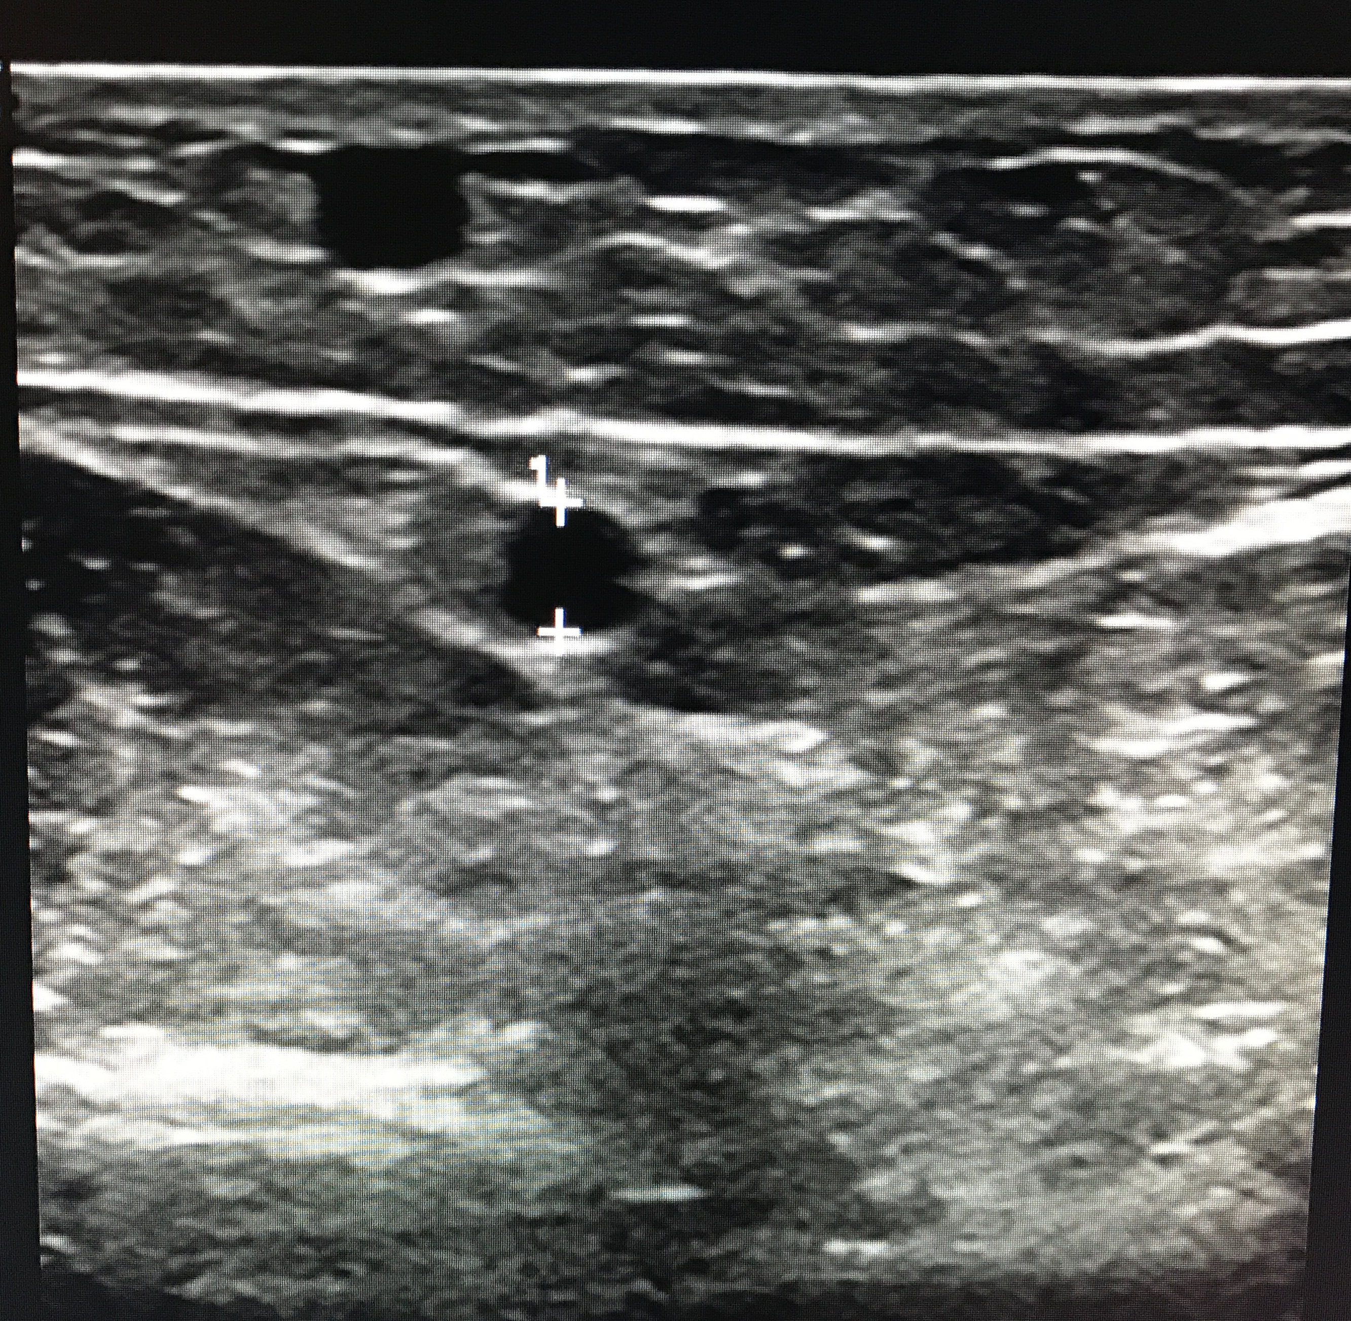
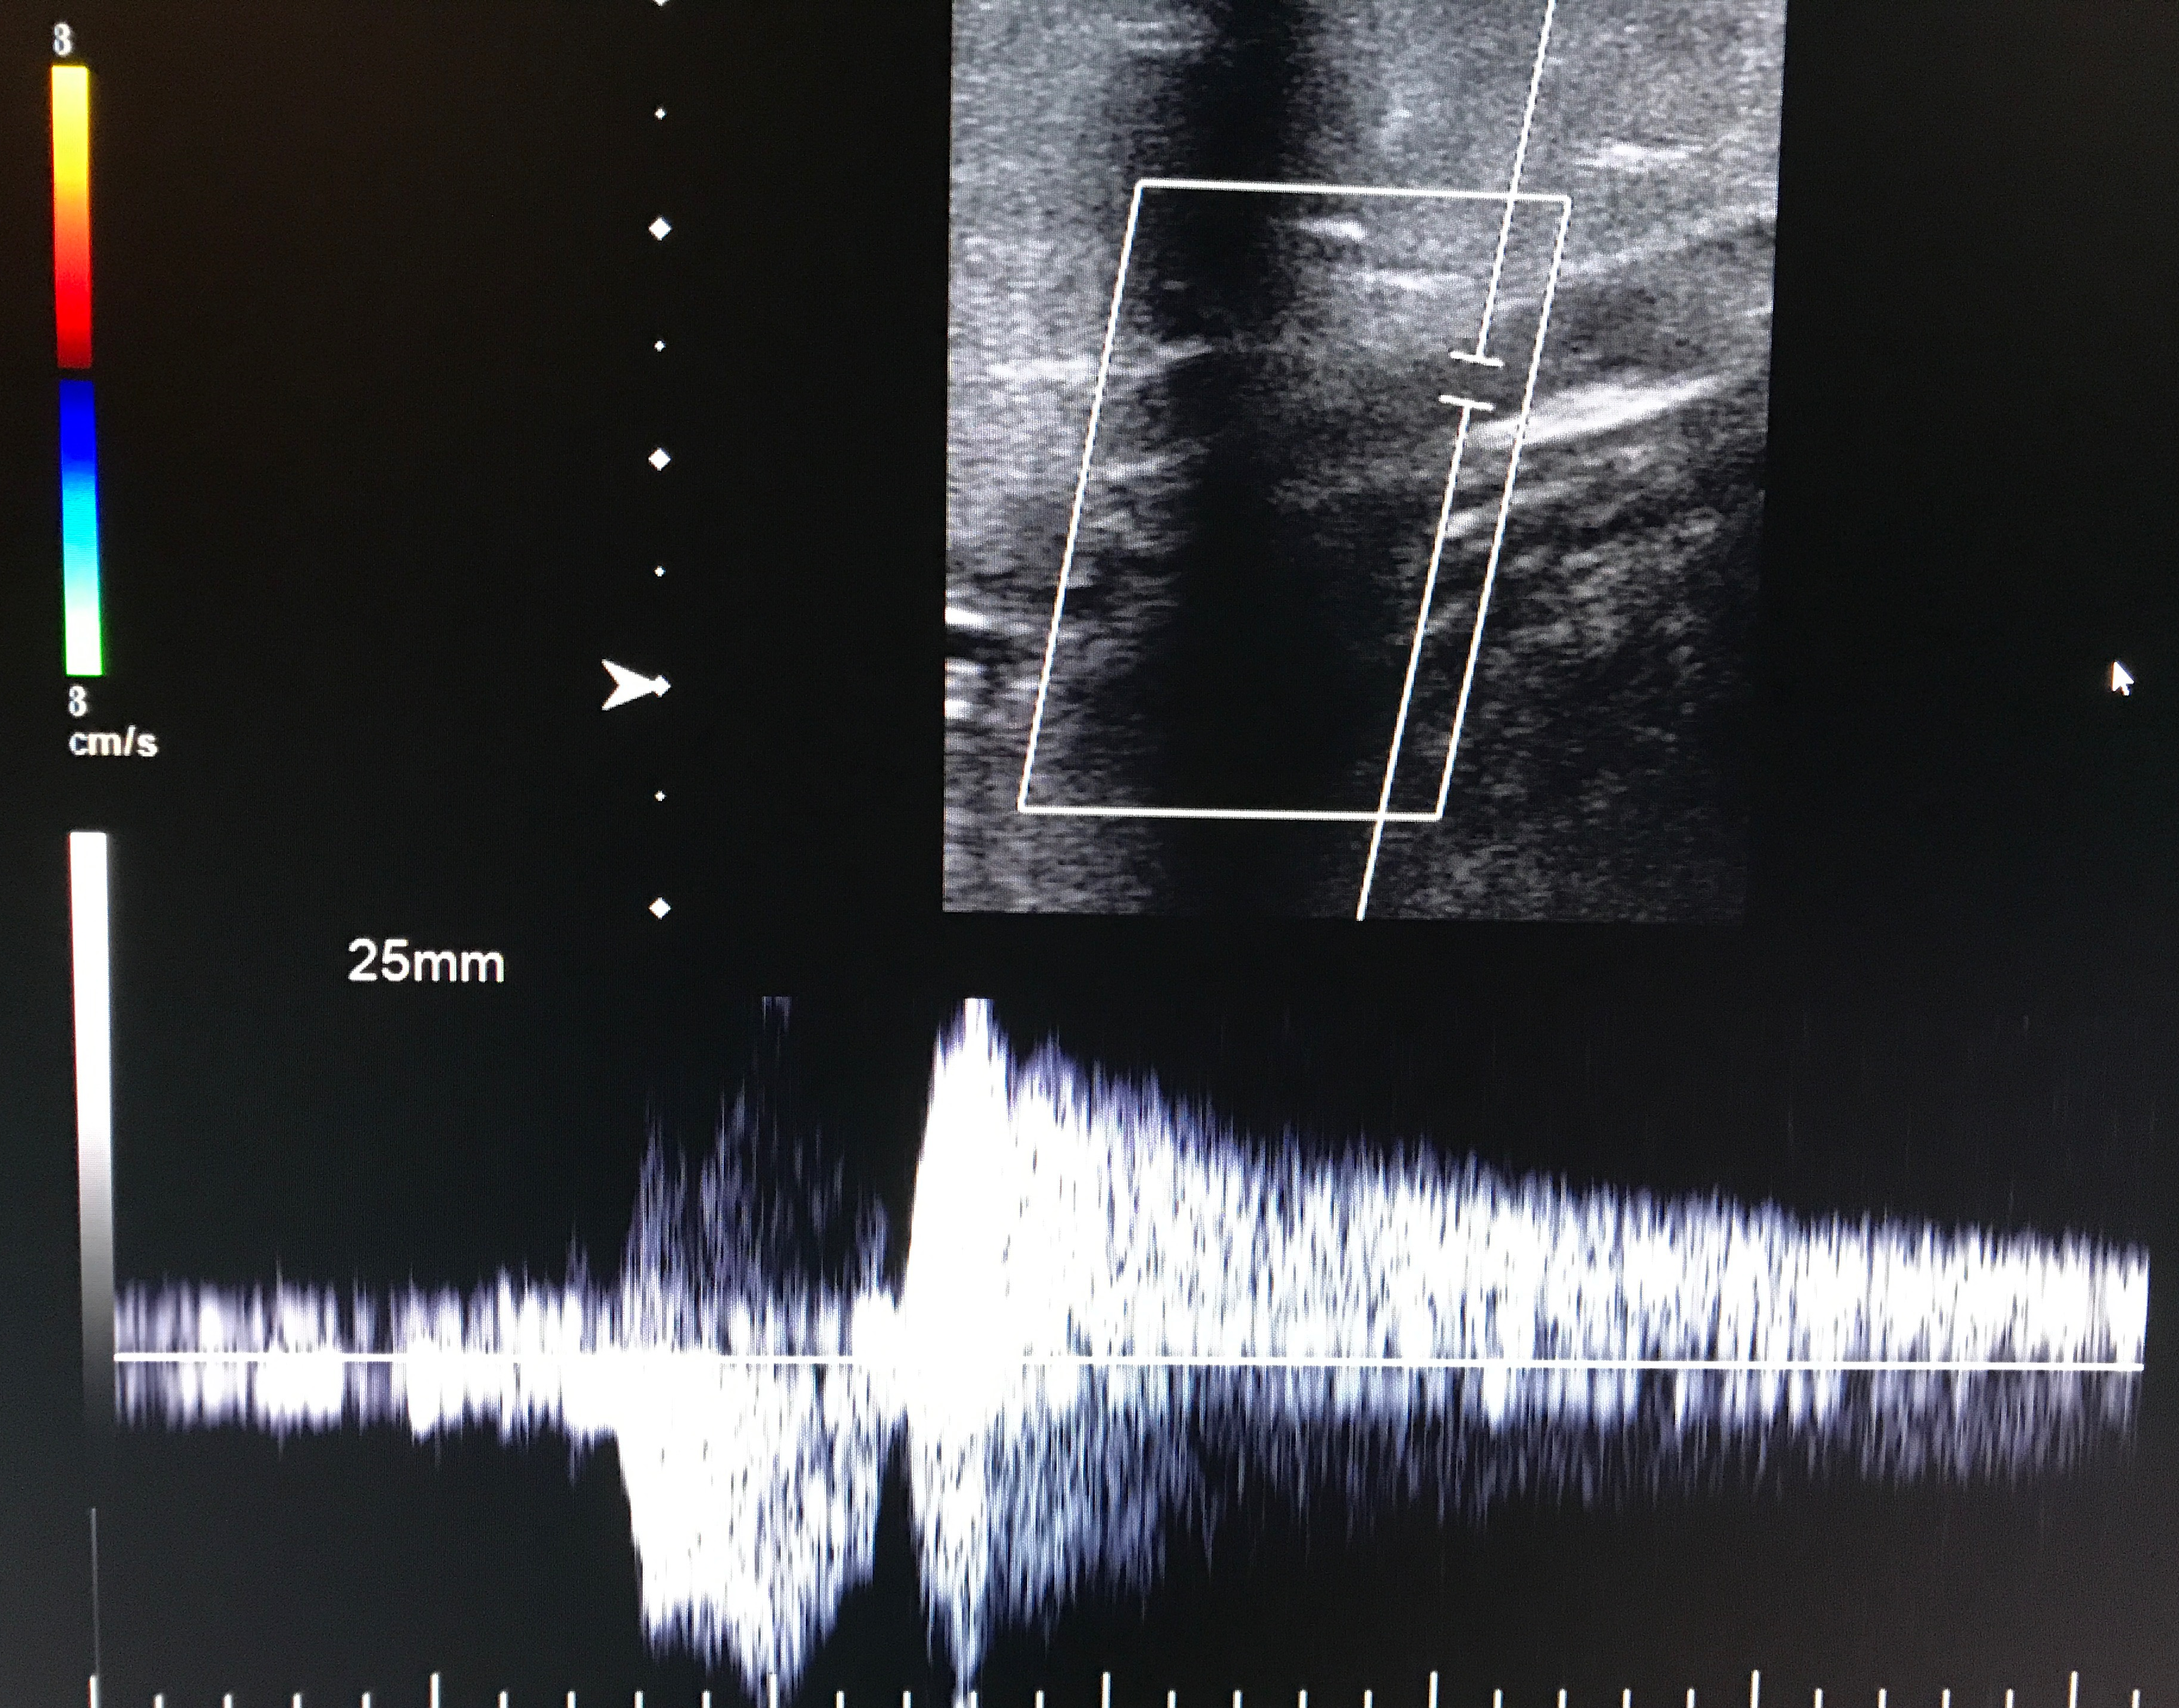
Imaging
Color-duplex sonography
Venography
MRV

Slide 14
Treatment Alternatives
Conservative Management
Injection Sclerotherapy
Traditional Surgical Treatment
Endovenous Ablation

Slide 15
Conservative Management
Rationale
Palliation
Disadvantages
Treat indefinitely
Very low compliance

Slide 16
Injection Sclerotherapy
Rationale
Chemical irritation of intima
Compression
Granulation and fibrotic cord
Disadvantages
Complications
Lengthy course of treatment
Inadequate for most axial reflux
Recurrence

Slide 17
Injection Sclerotherapy
Fegan (1964)
4-8yr , n=1172 : 83% “excellent to good”
25% “relapse”
Kanter (1996)
n=272, color-duplex monitoring
27% 2 year clinical recurrence
Min & Navarro (2000)
50pts; 0% color-duplex flow 1wk, 2mos, 12mos
Transcatheter GSV ablation

Slide 18
Ambulatory Phlebectomy
Rationale
Adjunctive/Cosmesis
Remove varicosities, disconnect perforators
Advantage: Short course therapy
Disadvantages
Bruising, Blister formation , Slough
Thrombophlebitis, Parasthesia
Does not address truncal reflux

Slide 19
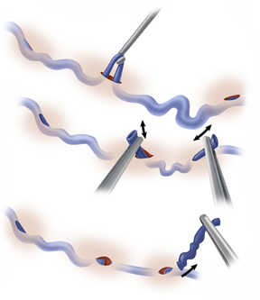
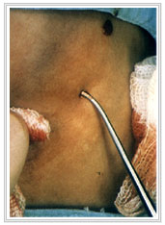
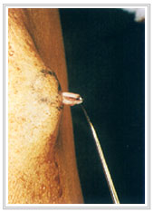
Ambulatory Phlebectomy

Slide 20
Ligation & Stripping
“Gold Standard”
Rationale-Comprehensive
Hydrostatic-saphenous reflux
Hydrodynamic-perforating reflux
Varicose segments

Slide 21
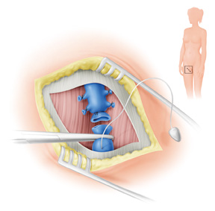
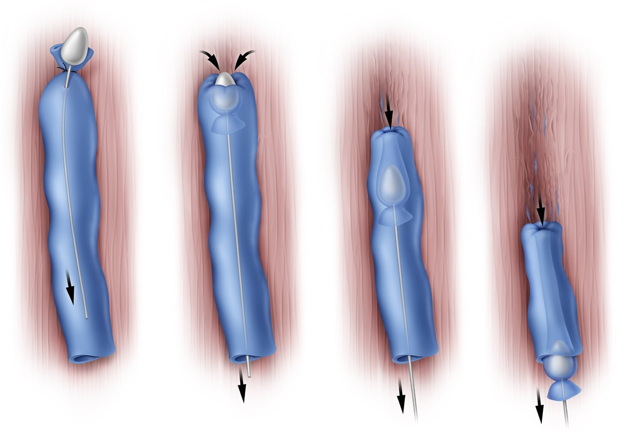
Ligation & Stripping
High Ligation
Stripping

Slide 22
Ligation & Stripping
Advantages
Most durable of surgical options
Improved QOL vs. conservative management
Disadvantages
Perioperative morbidity high
Recurrence rate high

Slide 23
Ligation & Stripping
Mackay(1995)
65.8% bruising, pain, numbness
>33% consulted GP post-op
50% further management required
Tolins(1983)
85% “good to excellent” 49% supplemental
Sarin (1992)
18% recurrence (45% high ligation)
Dwerryhouse (1999)
29% recurrence (71% high ligation)

Slide 24
Ligation & Stripping
Disadvantages
HIGH periprocedural complication rate
65.8% bruising, pain, numbness
>33% consulted GP post-op
50% further management required
HIGH Recurrence rate
Patients often compare discomfort to Childbirth

Slide 25
Endovenous Approaches
Radiofrequency Ablation
Laser Ablation

Slide 26
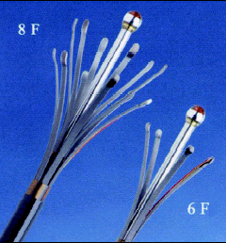
Radiofrequency Ablation
RF Effect and rationale
Resistive heat → endothelial damage
Acute contraction and Fibrotic Cord

Slide 27
RF Ablation
Advantage: Results
Kabnick (2001 J Phleb) multicenter registry
90% reflux-free at 2 years
Pichot (2000 J End Th)
94% treated veins invisible at 2 years
Rautio et al (2002)
Randomized,controlled comparison vs. Stripping
Pain, convalescent time, cost
Lurie et al (2003 JVS)
significant QOL improvement vs HL&S

Slide 28
RF Ablation
Disadvantages
Vein SIZE LIMITED (Historical)
Paresthesia (11%, Rosenblatt; 2003)
DVT/PE
Skin burn (1-2%)
Shallow learning-curve (Sybrandy; 2002)
23% early complication rate

Slide 29
Laser Ablation
Treatment Aims:
Eliminate source of reflux
Ablate incompetent venous segments

Slide 30
Laser Ablation
Rationale
Selective photothermolysis
Blood = chromophore
Wavelength and Pulse duration

Slide 31
Laser Ablation
Minimal exclusion criteria
Concomitant peripheral arterial disease
Inability to ambulate
Deep venous thrombosis
Pregnancy
General poor health

Slide 32
Laser Ablation
Pre-procedural evaluation
Documentation of symptoms
Focused physical
Color Duplex Ultrasound

Slide 33
Duplex Ultrasound
Critical Elements
Patient standing
Adequate compression @ calf
Examine the entirety of the veins

Slide 34
Duplex Ultrasound
Technical Elements
Greater than ½ second of reflux
Document where varices arise
Document direction of perforators

Slide 35
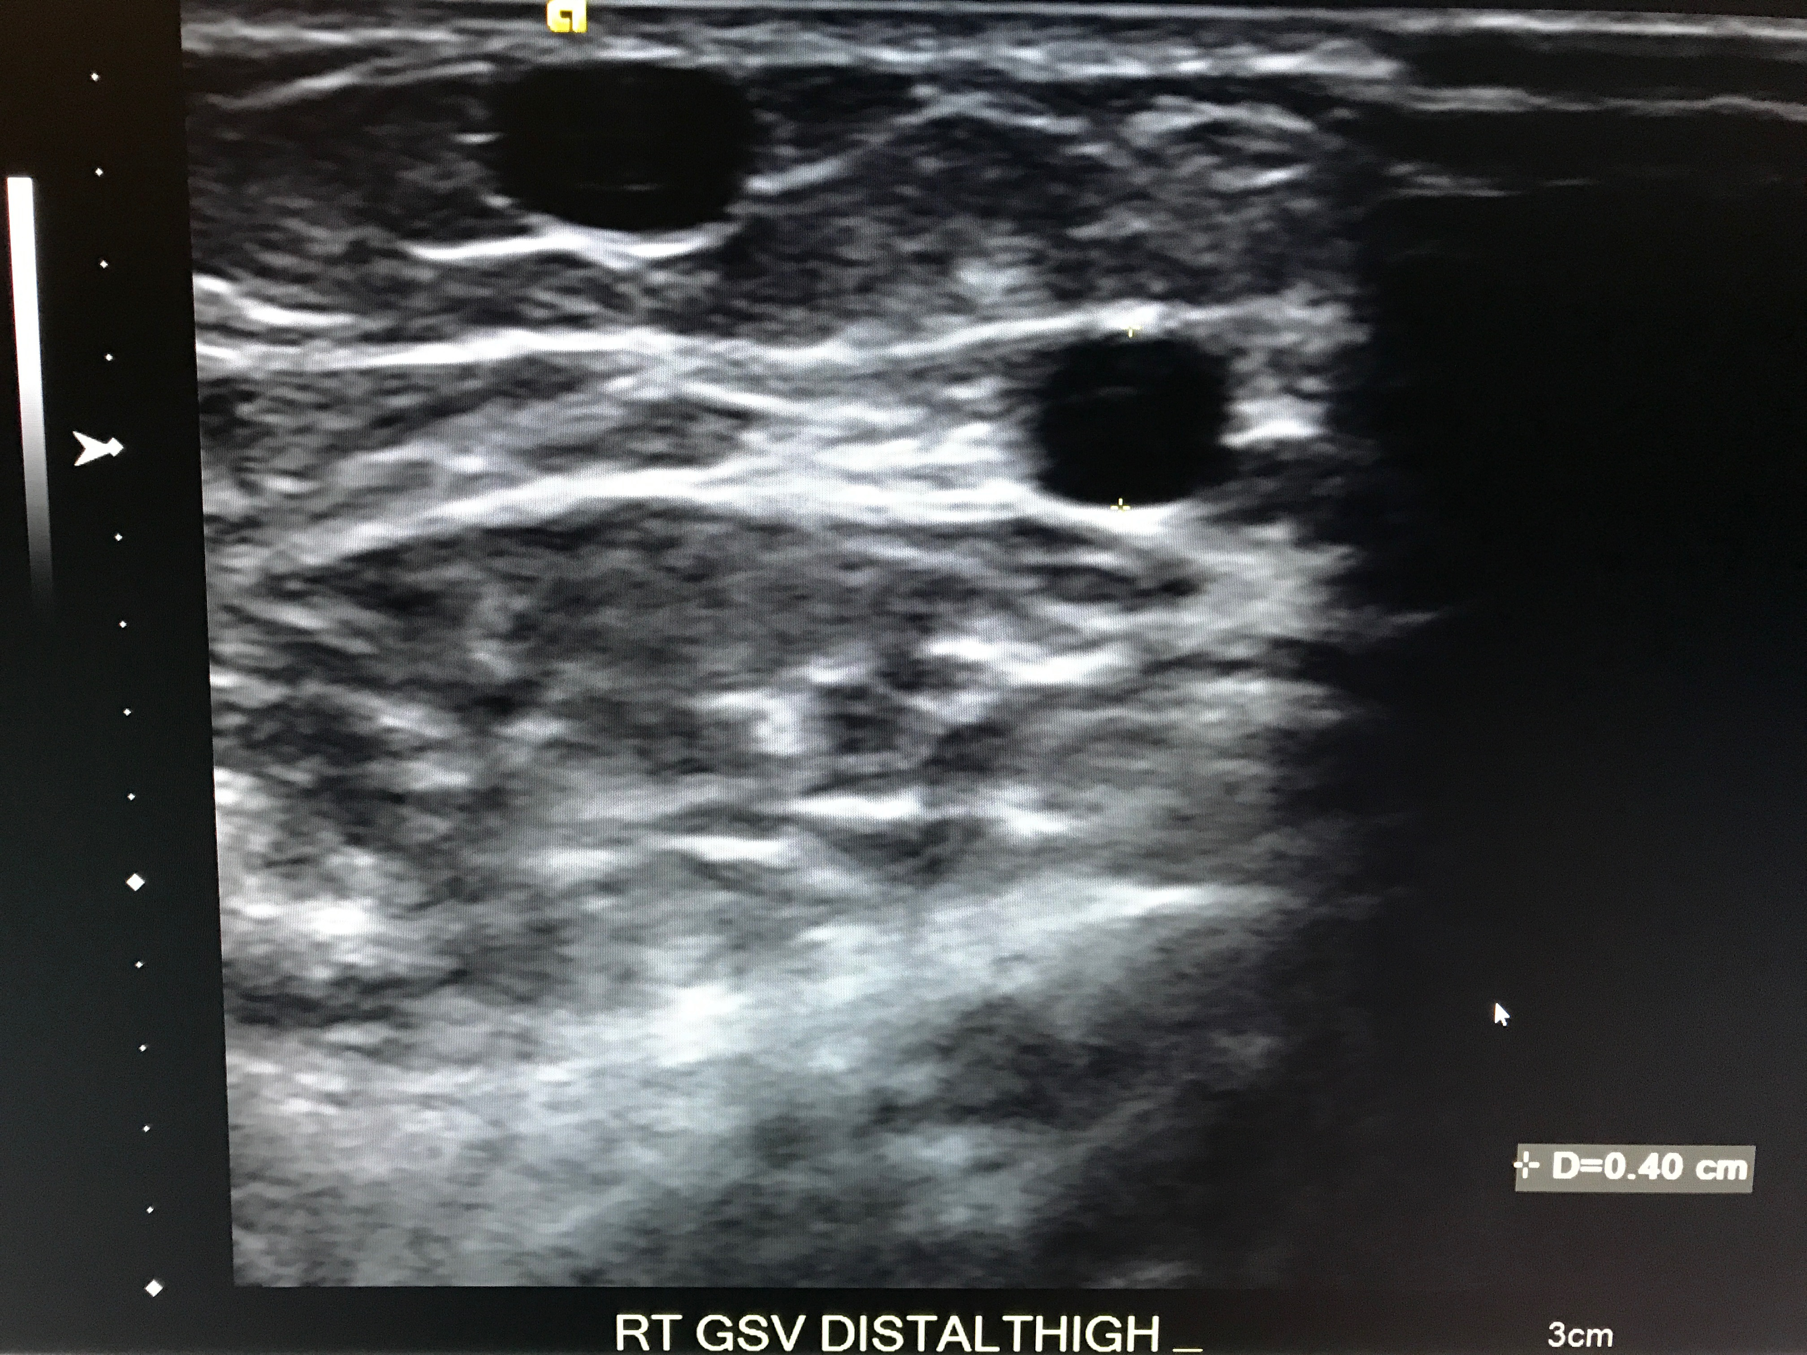
Duplex Ultrasound - Case

Slide 36
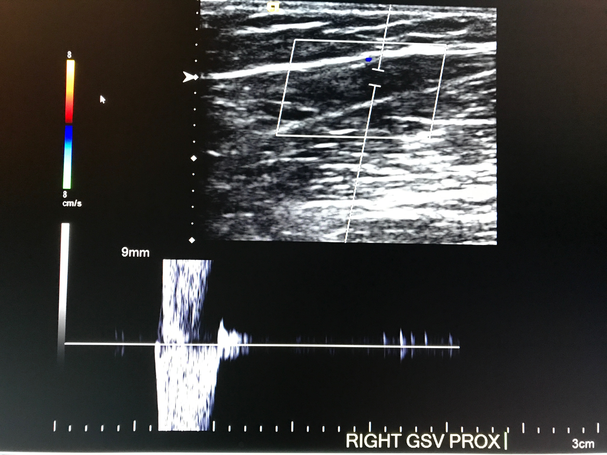
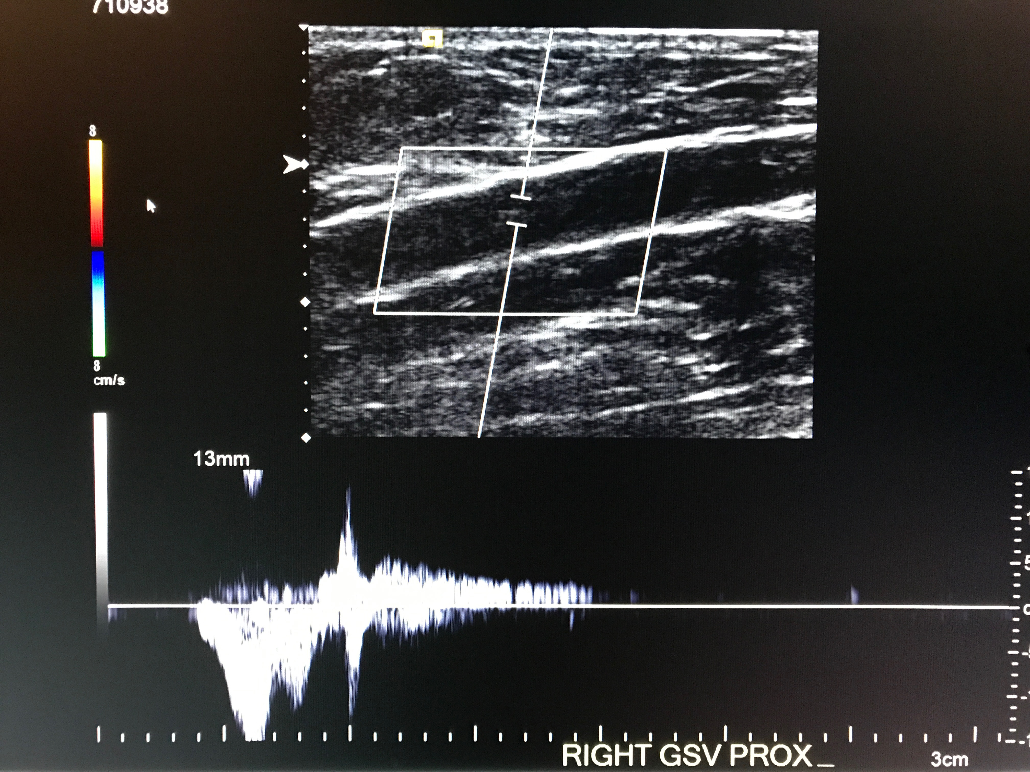
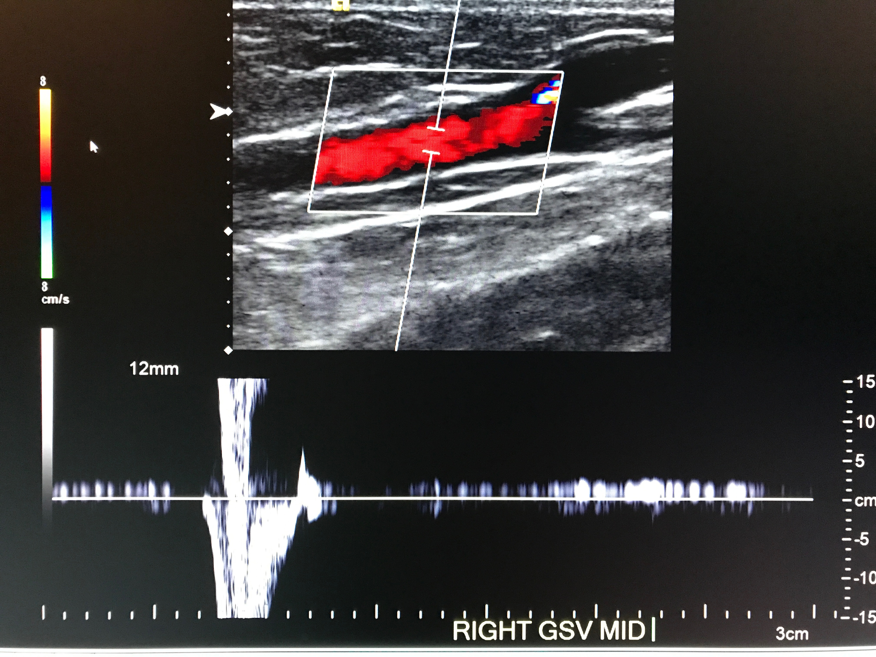
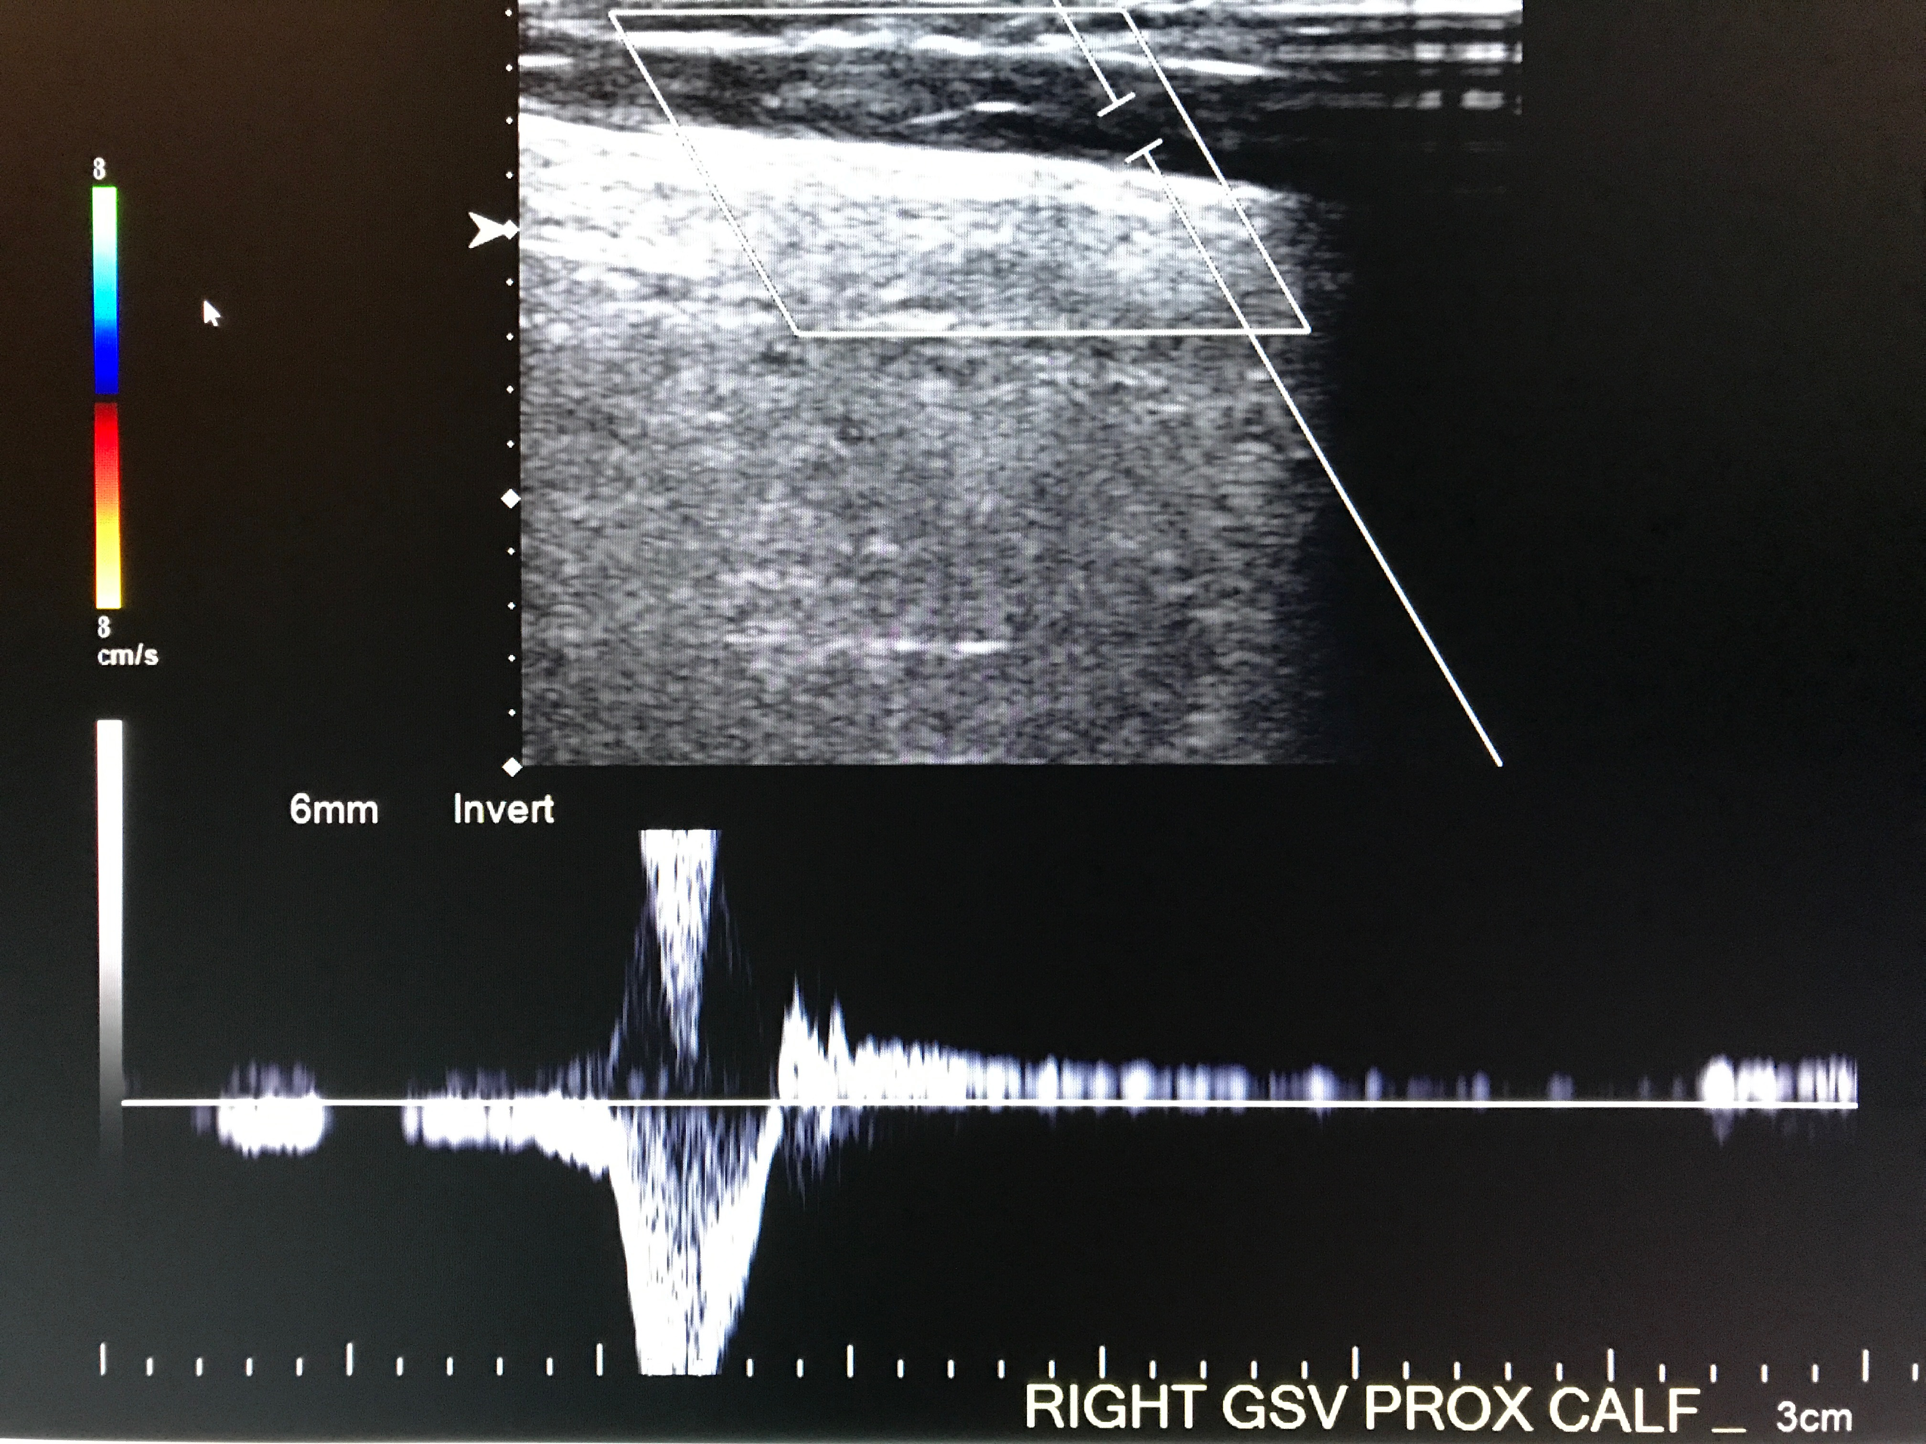
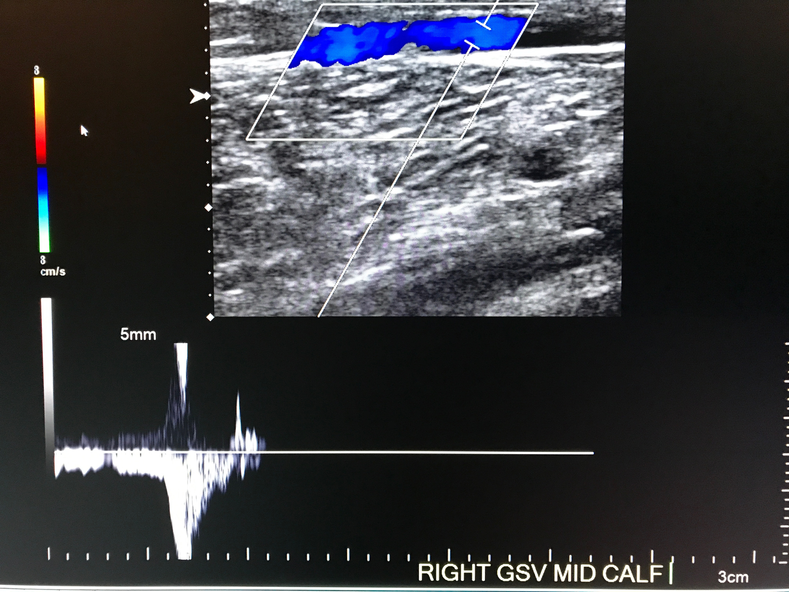
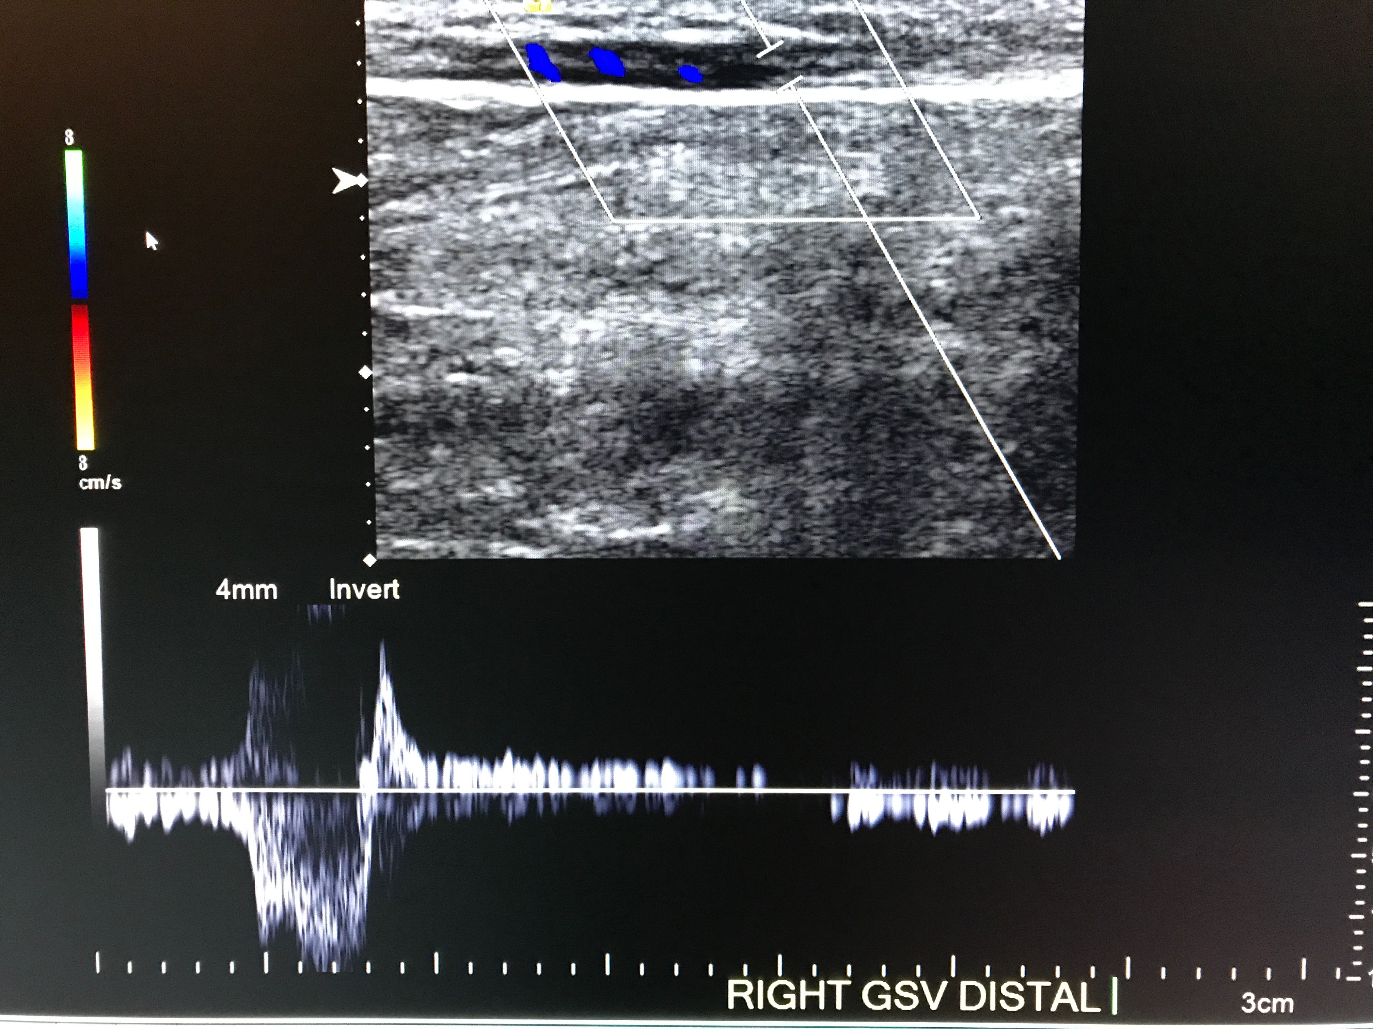
Duplex Ultrasound - Case

Slide 37
Laser Ablation
Technique
Ultrasound guidance
Local and “tumescent” anesthesia
5F sheath access (1.67mm)
600 micron laser fiber
Laser glasses

Slide 38
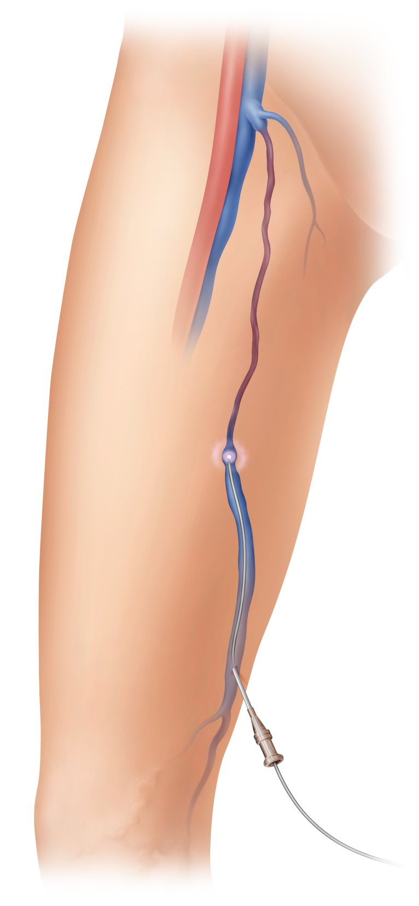
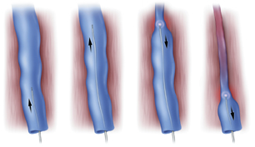
Laser Ablation

Slide 39
Laser Ablation
Post-procedural care
Compression stocking
20 minute walk
Resume normal activities
OTC analgesics for any pain

Slide 40
Follow-up
Color-duplex evaluation
Six weeks with clinical evaluation
Adjunctive treatment

Slide 41
Laser Ablation
Complications: Essentially NONE
Transient “tightness” 92%
Access site bruising 24%
Paresthesia
Infection
DVT

Slide 42
Laser Ablation
Min (2004)
499 limbs
98% technical success
<7% recurrence at 3 years
Zimmet et al (2003)
40 LSV, 51 anterolateral varicosities
95% and 96% occlusion 2 years

Slide 43
Laser Ablation
Pooled Results (EVLT registry)
> 3000 GSV
28 month follow-up
> 97% continued occlusion
Bruising, mild/moderate tenderness, “tightness”

Slide 44
Laser Ablation
Advantages
No vein size limitation
Outpatient procedure
Local anesthesia
Non-scarring/access site size (<2mm)
Minimal recovery
Costs and recurrence < Surgery

Slide 45
Summary
Common
Cost substantial
Multifactorial
Symptomatic & morbid
Multiple treatment options
Intervention cost-effective & improves quality of life

Slide 46
THANK YOU
Please call !
307-232-5054 (Brianne)
307-232-5043 (Jennifer RN)
401-440-9058 (CB3)
All referrals welcome !

