Slide 1
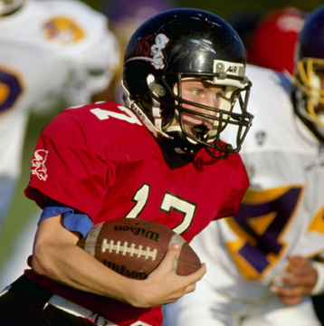
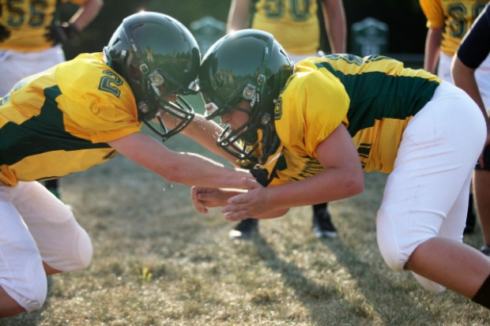
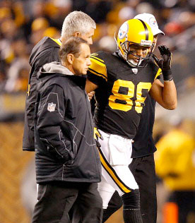
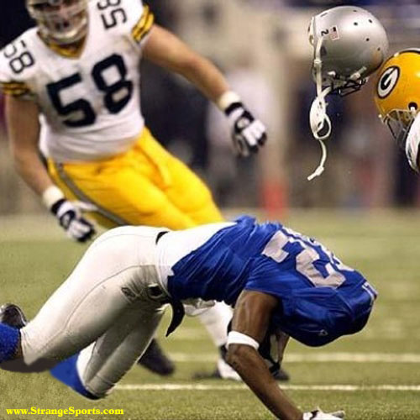
Concussions, PTSD, and CTE:
Past, Present and Future
Joseph C. Maroon, MD,FACS
Vice Chairman and Professor of Neurosurgery
Heindl Scholar of Neuroscience
University of Pittsburgh Medical Center
Team Neurosurgeon Pittsburgh Steelers
Jeff Bost, PAC
Clinical Instructor, Depart. of Neurosurgery
University of Pittsburgh Medical Center
Clinical Associate Professor, Chatham University
Frontiers April 20, 2018
Notes:
1

Slide 2
W. Lee Warren, MD
Neurosurgeon

Slide 3
Conflicts of Interest
Dr Joseph Maroon
University of Pittsburgh Medical Center
National Football League
Pittsburgh Steelers Football Club
World Wrestling Entertainment Corporation
ImPACT Applications, INC (Immediate Post Concussion Assessment and Cognitive Testing)

Slide 4
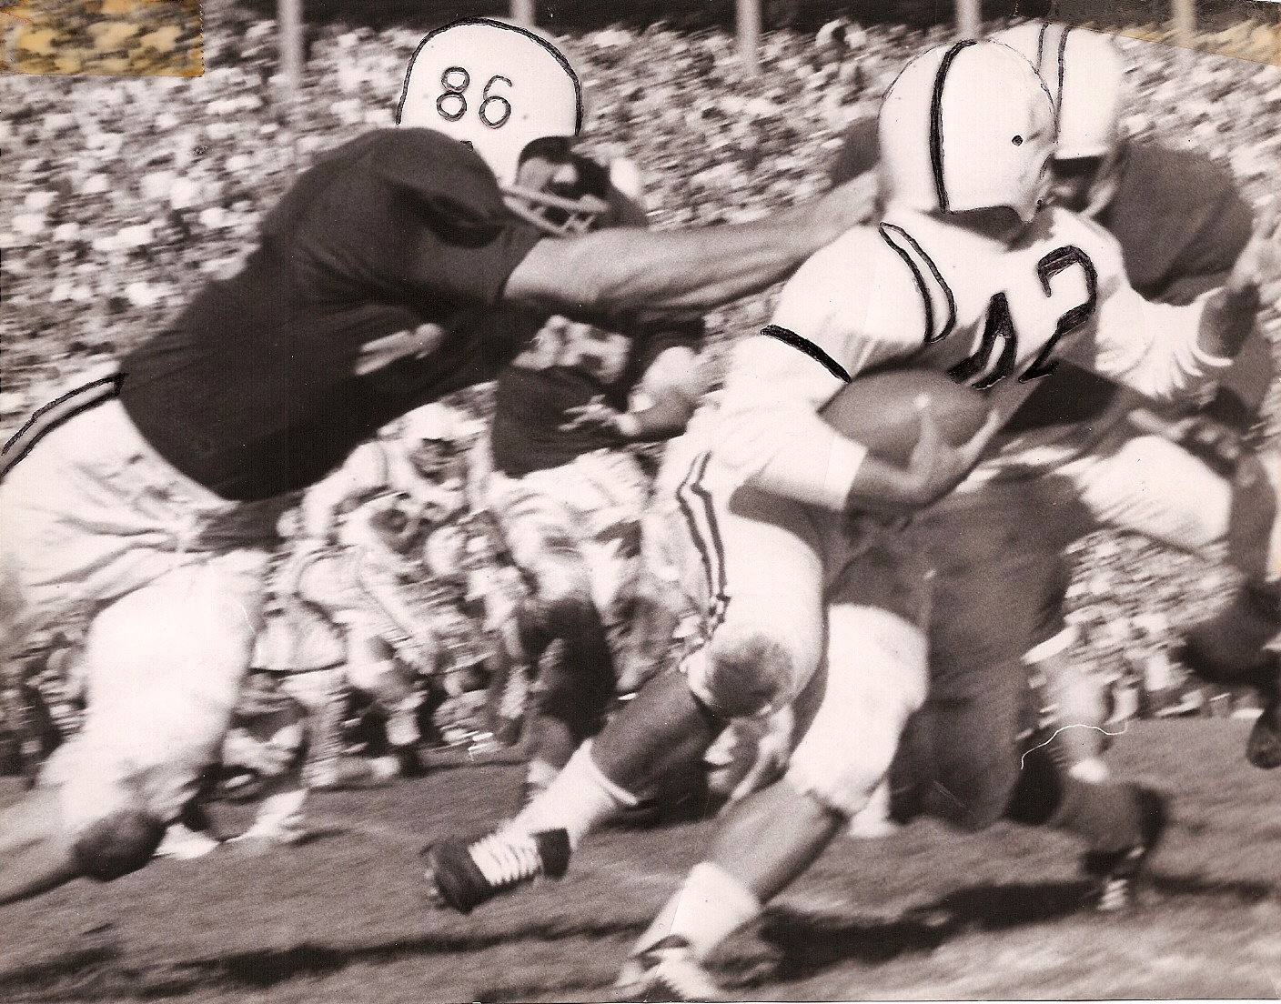

Slide 5
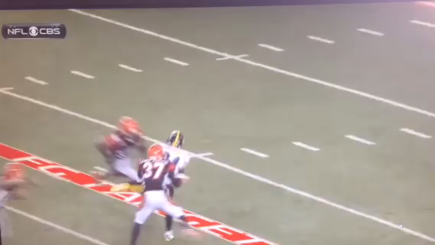

Slide 6
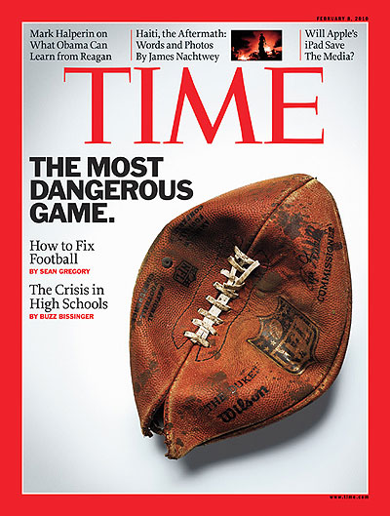
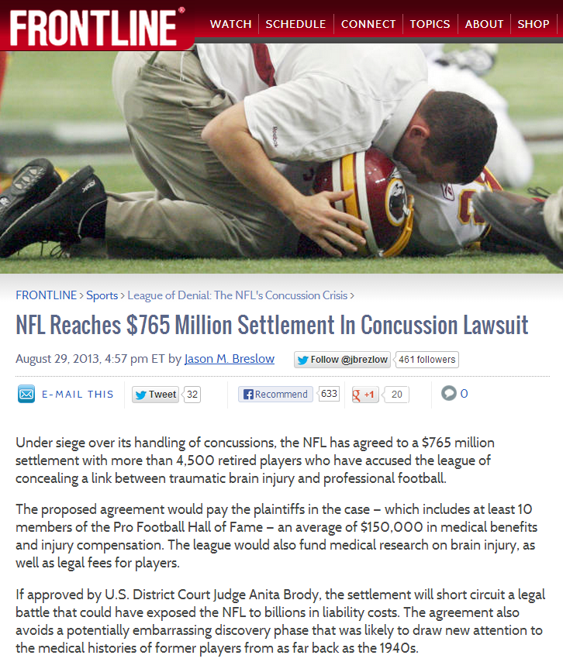
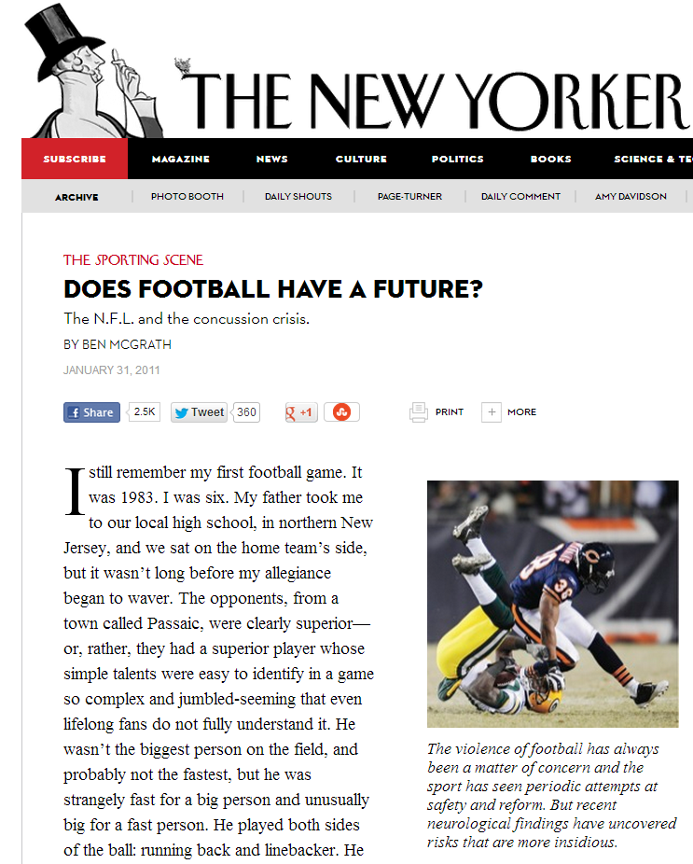
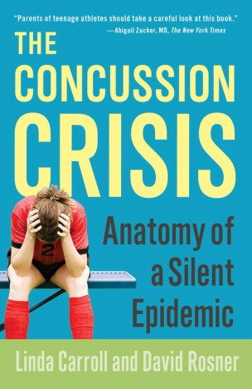
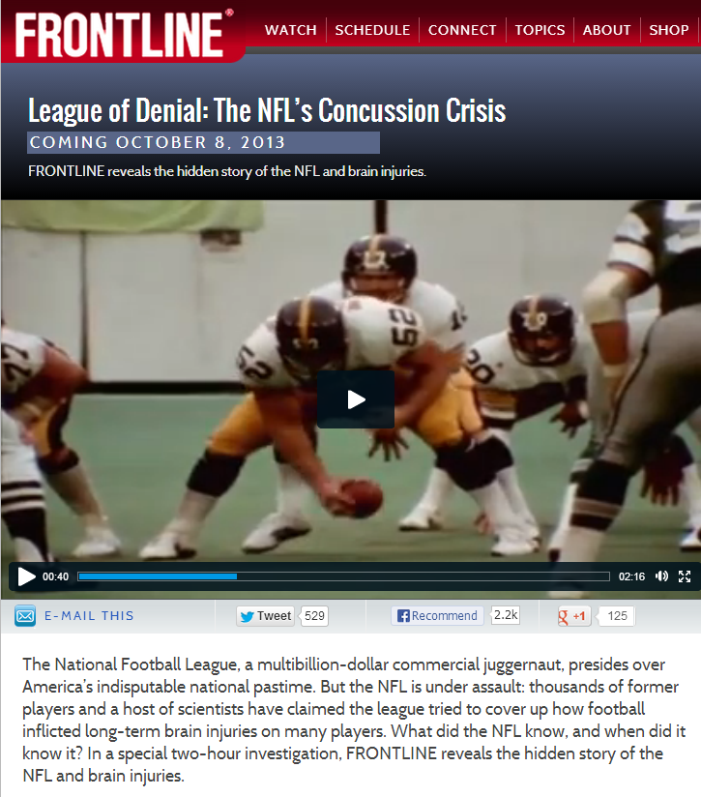

Slide 7
“Players suffer grave on field injuries, medical doctors prescribe euthanasia for football and politicians make a federal case out of the game.”
“Never before has a football season ended amid such a universal chorus of denunciation of the game. Football is a ‘grave menace’ that merits immediate abolition.”
Football reform by abolition, The Nation, November 30, 437-38.
1905

Slide 8
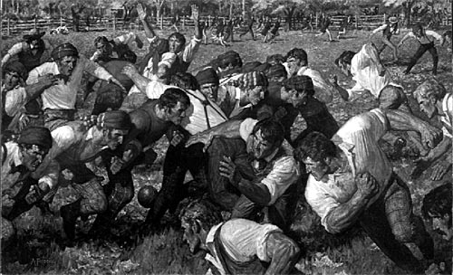
As a result of political pressure football changed dramatically in 1905 forming NCAA
New rules
Officials introduced
Helmets and padding required

Slide 9
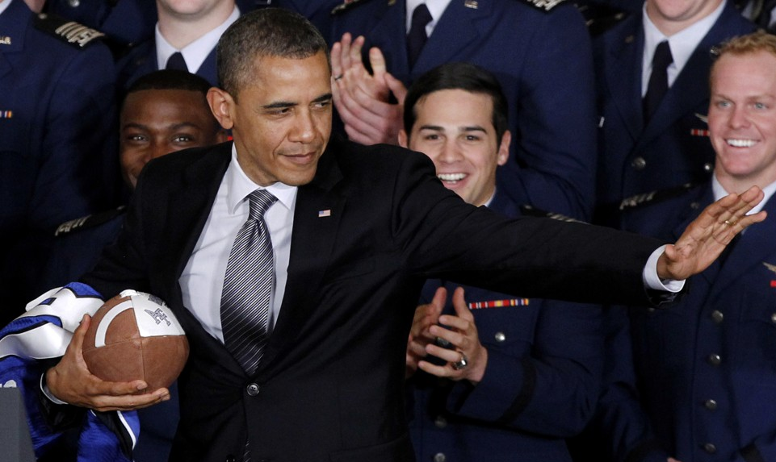
"I'm a big football fan," "but I have to tell you if I had a son, I'd have to think long and hard before I let him play football.“
President Obama

Slide 10
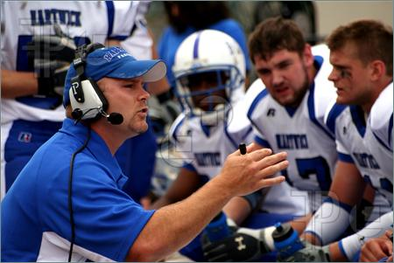
“I love my country, but I have to tell you, I would have to think long and hard before I let my son go into politics!”

Slide 11
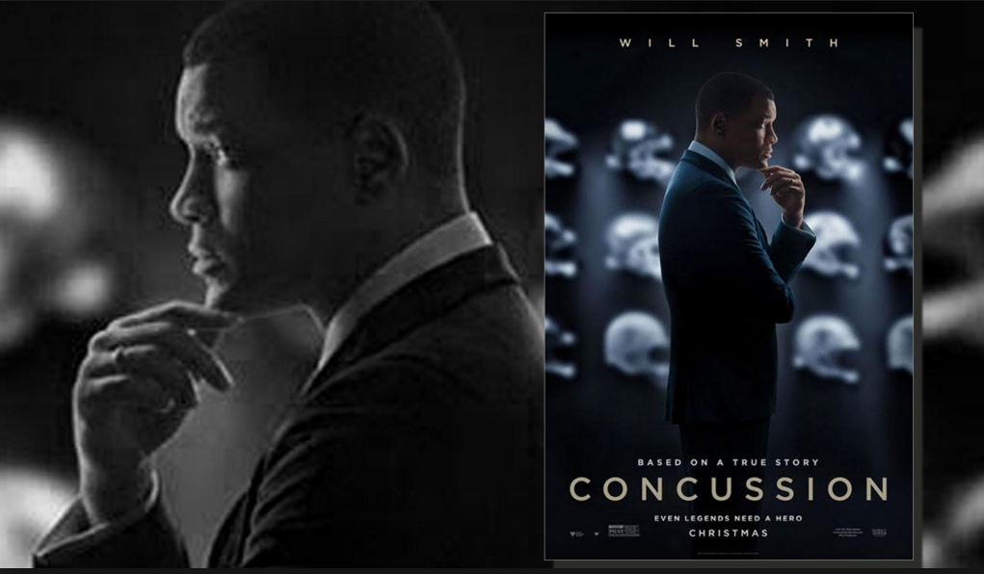
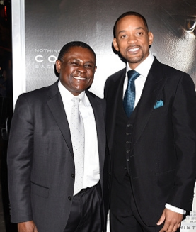

Slide 12
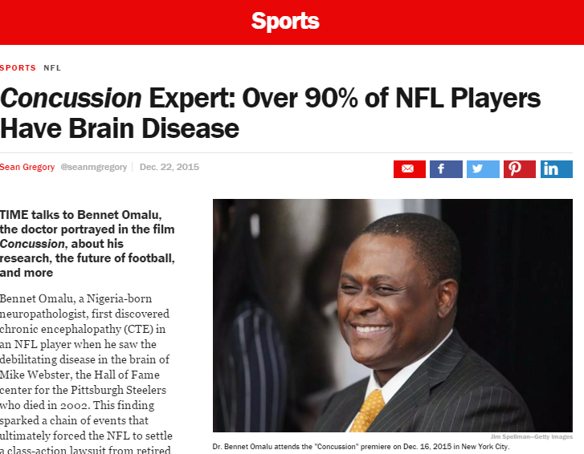
“If any coach asks my son to play football, I’ll sue that coach, and I’ll sue the school”
“The movie is emotionally and spiritually accurate all the way through”

Slide 13
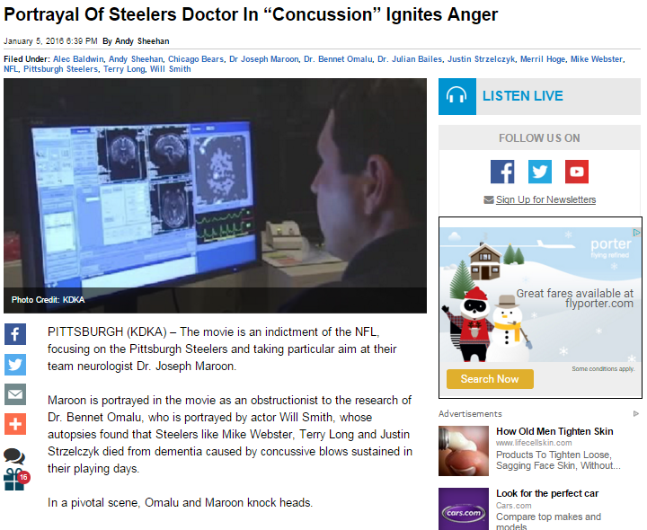
Julian Bailes - “the scene takes liberties with what was a series of meetings, and he says that, in fact, Maroon would be the first to bring it to the league.”
Merrill Hoge - “The guy who drove that to the NFL, was the catalyst to really get it to the NFL and paint the picture for them was Joe Maroon.”

Slide 14
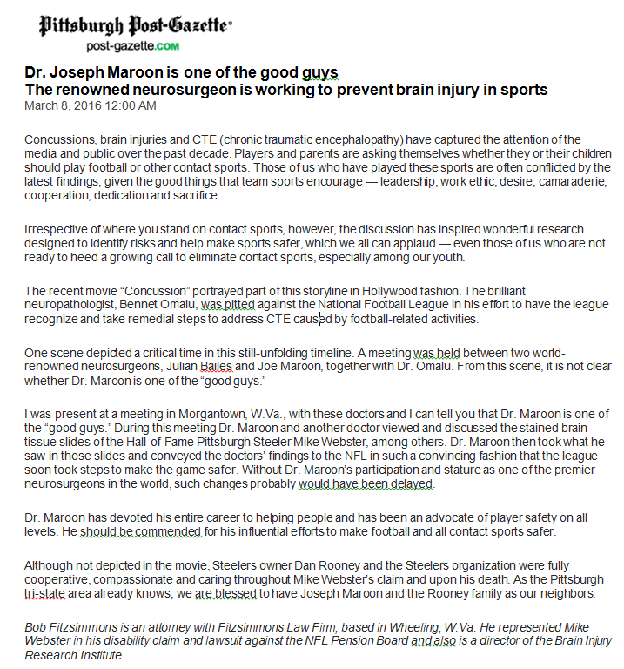
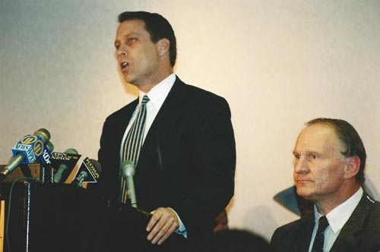
Bob Fitzsimmons is an attorney with Fitzsimmons Law Firm, based in Wheeling, W.Va. He represented Mike Webster in his disability claim and lawsuit against the NFL Pension Board and also is a director of the Brain Injury Research Institute.
“I was present at a meeting in Morgantown, W.Va., with these doctors and I can tell you that Dr. Maroon is one of the “good guys.” During this meeting Dr. Maroon and another doctor viewed and discussed the stained brain-tissue slides of the Hall-of-Fame Pittsburgh Steeler Mike Webster, among others. Dr. Maroon then took what he saw in those slides and conveyed the doctors’ findings to the NFL in such a convincing fashion that the league soon took steps to make the game safer. Without Dr. Maroon’s participation and stature as one of the premier neurosurgeons, such changes probably would have been delayed.”

Slide 15
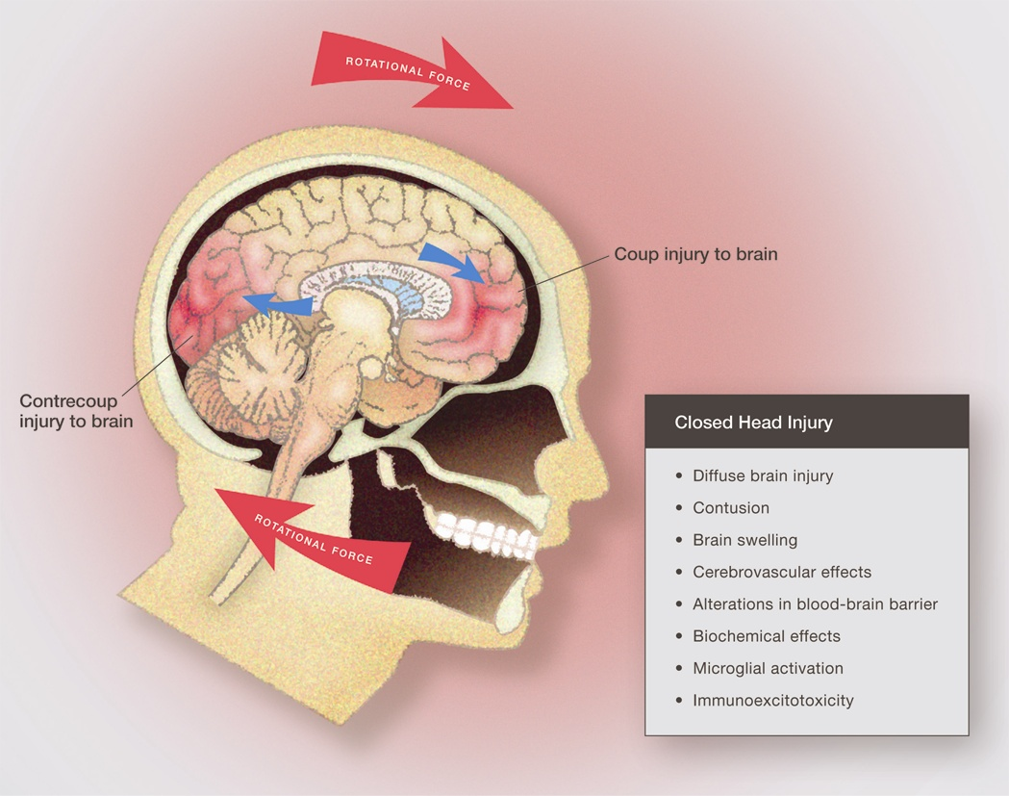
Concussion
Blaylock & Maroon – Surgical Neurology International –2011

Slide 16
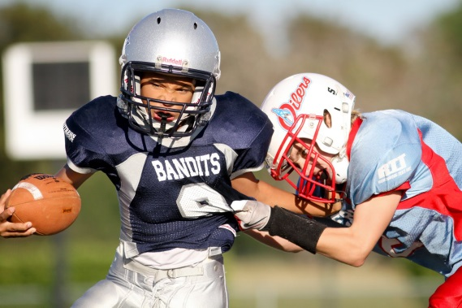
Concussion Facts
~1.6 million to 3.8 million Sport and Recreation concussions / year per CDC
5-10% of athletes per season
<10% have LOC
Football and Wrestling- most common sports concussion risk for males Soccer - most common sport concussion risk for females
78% of concussions occur during games (as opposed to practices)

Slide 17
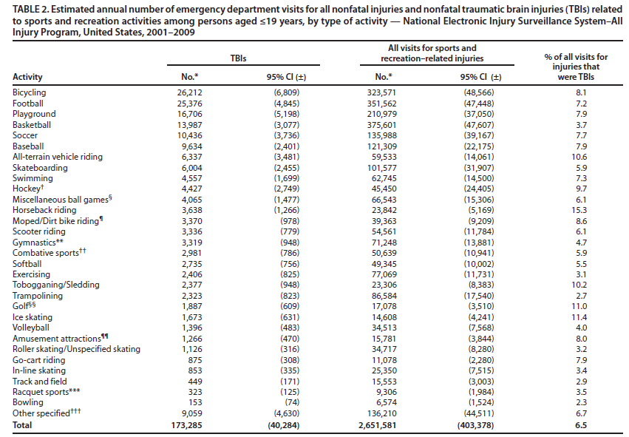
National Injury Survey US 2001 – 2009, < or = 19 yrs
Top 7 TBI % of Injury
ATV 6,337 – 10.6%
Bicycle 26,212 - 8.1%
Baseball 9,634 - 7.9%
Playground 16,706 – 7.9%
Soccer 10,436 - 7.7%
Football 25,376 - 7.2%
Basketball 13,987 - 3.7%

Slide 18
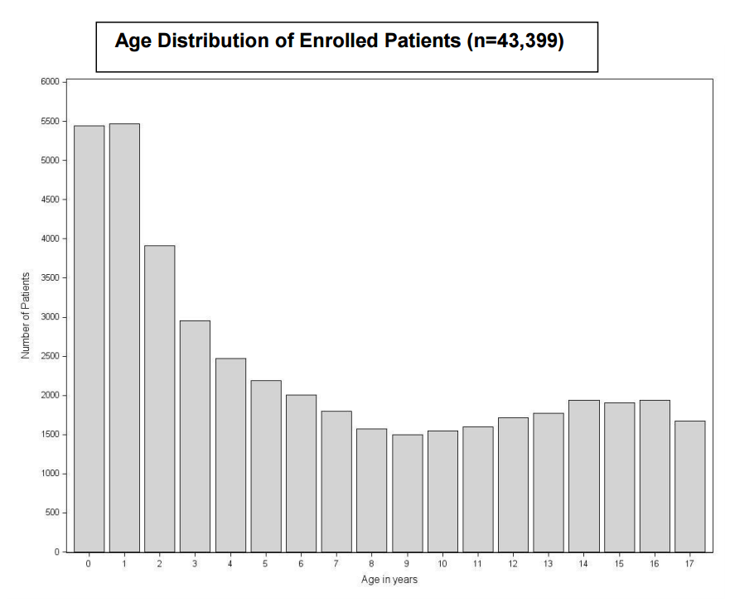
TBI Children Under 12
United States through the Pediatric Emergency Care Applied Research Network (PECARN). 2004 – 2006 Total Subjects 43,399 age 0 to 17
Most Common Cause - Falls
Falls on playgrounds
Falls from bicycles
Falls from scooters and other wheeled devices
≤ 12 y/o
N Engl J Med 2014; 371:1945-1947November 13, 2014DOI: 10.1056/NEJMc1407902

Slide 19
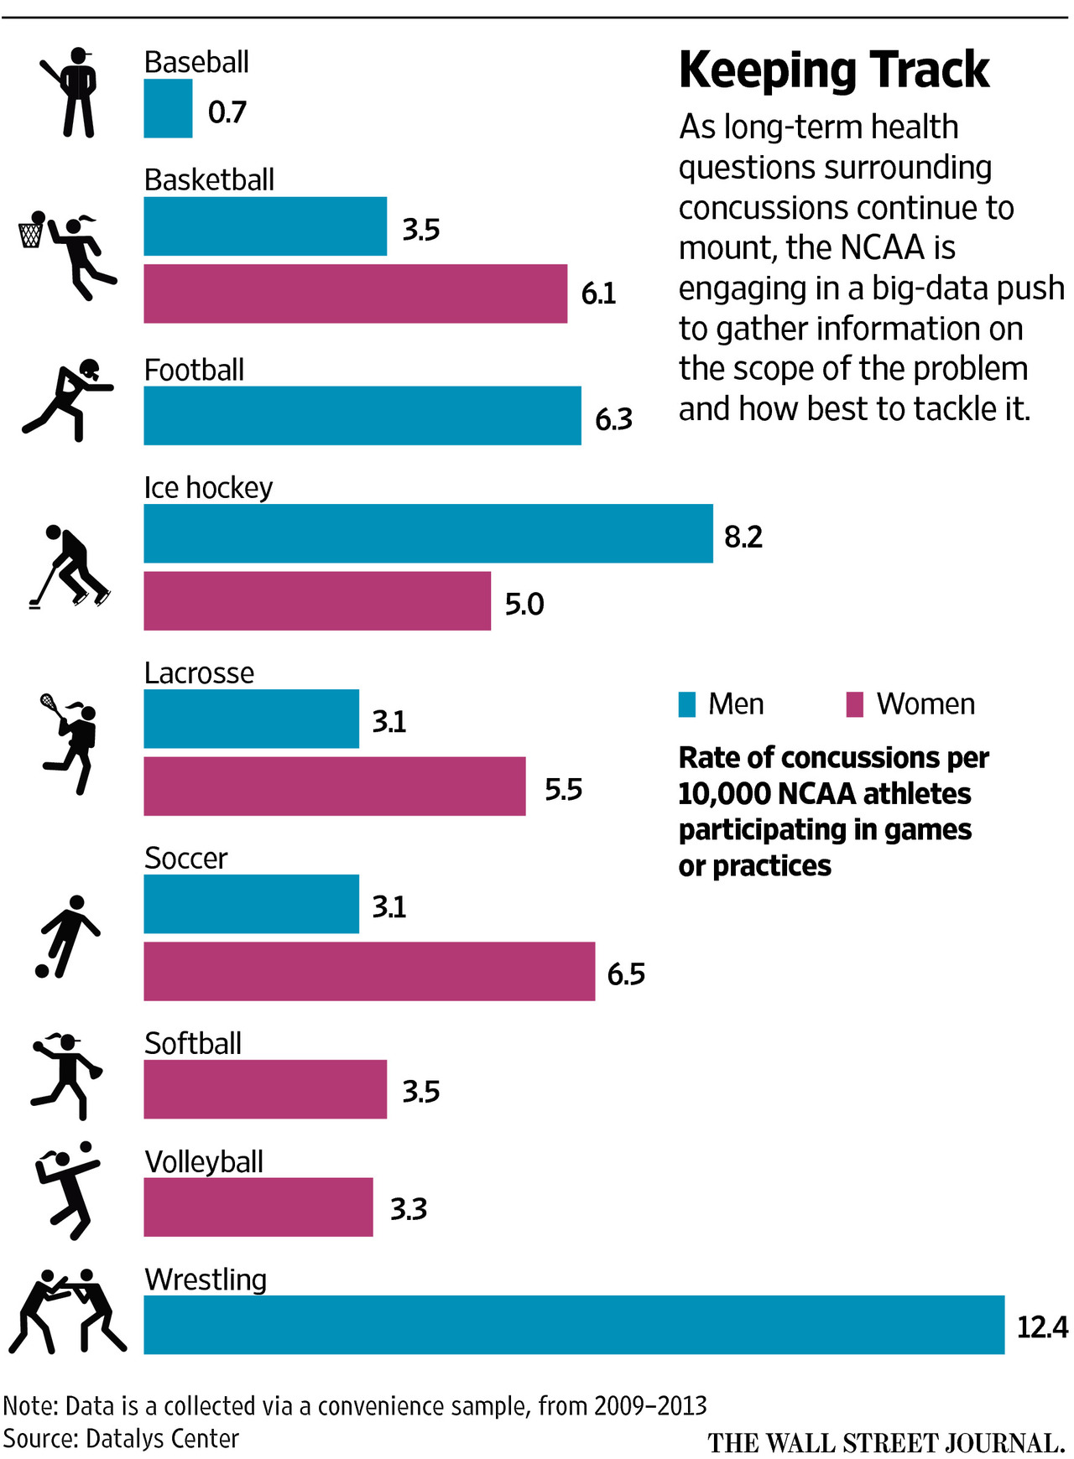
3
2
1

Slide 20
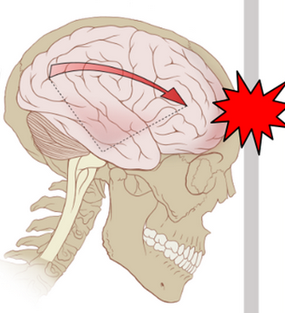
Consequences of Concussion?
Concussion
Loss of Consciousness
Post Concussion Syndrome
Second Impact Syndrome
Post Traumatic Stress Disorder
Chronic Traumatic Encephalopathy
VS.
Complete Return to Normal

Slide 21
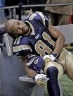
Post-Concussion
Symptom
Groups
EMOTIONAL
More emotional
Sadness
Nervousness
Irritability
PHYSICAL-MIGRAINE
Headaches
Visual Problems
Dizziness
Noise/Light Sensitivity
Nausea
COGNITIVE SYMPTOMS
Attention Problems
Memory dysfunction
“Fogginess”
Fatigue
Cognitive slowing
SLEEP DISTURBANCE
Difficulty falling asleep
Sleeping less than usual
N=327, High School and University
Athletes Within
7 Days of Concussion
(Pardini, Lovell, Collins, et al. 2004)
Notes:
15

Slide 22
Post Concussion Syndrome (PCS)
Symptoms may include:
Chronic headaches
Fatigue
Sleep difficulties
Personality changes (e.g. increased
irritability, emotionality)
Sensitivity to light or noise
Dizziness when standing quickly
Deficits in short-term memory, problem solving and general academic functioning

Slide 23
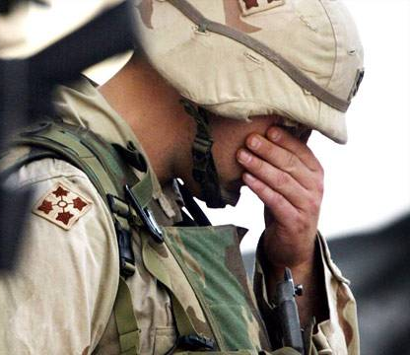
Post-Traumatic Stress Disorder
Symptom Complex:
Traumatic Event
“Flashbacks”
Avoidance
Hyper-responsiveness
Emotional Liability
Autonomic Reactivity
Sleep Disturbance
Notes:
23
15

Slide 24
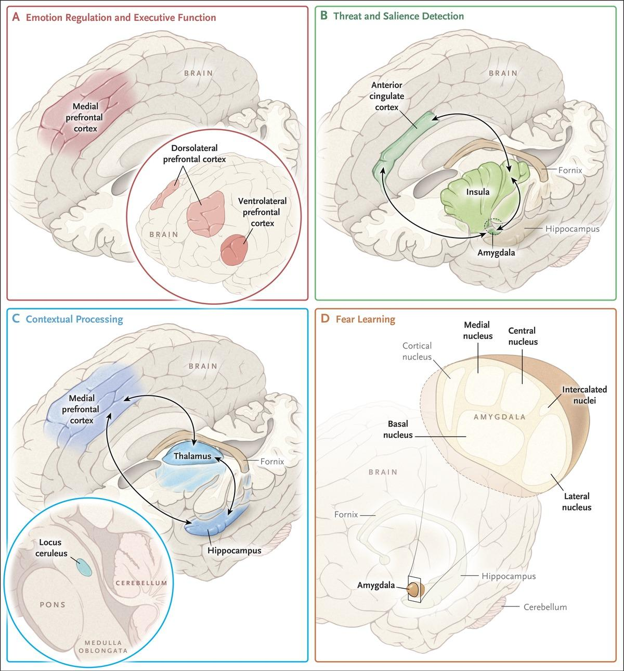
Emotional and Executive Function
Threat and Salience Detection
Contextual Processing
Fear Learning

Slide 25
Incidence of PTSD
Vietnam War - 15% men / 9% of women, immediate (479,000) and ~30% men / 27% women lifetime (1 Mil)
Persian Gulf War - veterans range from 9% to 24%
Iraq War and Afghanistan - ~ 12.5% PTSD
Bartone, P.T. (2000). Hardiness as a resiliency factor for United States forces in the Gulf War. In D. Paton (Ed.), Posttraumatic stress intervention: Challenges, issues, and perspectives (pp. 115-133). Springfield, IL: Charles C. Thomas.
Gray, G.C., Kaiser, K.S., Hawksworth, A.W., Hall, F.W., & Barrett-Connor, E. (1999). Increased postwar symptoms and psychological morbidity among US Navy Gulf War veterans. American Journal of Tropical Medicine and Hygiene, 60, 758-766.
Hoge, C.W., Castro, C.A., Messer, S.C., McGurk, D., Cotting, D.I., & Koffman, R.L. (2004). Combat duty in Iraq and Afghanistan, mental health problems, and barriers to care. New England Journal of Medicine, 351, 13-22.
Kulka, R.A., Schlenger, W.E., Fairbank, J.A., Hough, R.L., Jordan, B. K., Marmar, C.R., & Weiss, D.S. (1990). Trauma and the Vietnam war generation: Report of findings from the National Vietnam Veterans Readjustment Study. New York: Brunner/Mazel.
Perconte, S.T., Wilson, A.T., Pontius, E.B., Dietrick, A.L., & Spiro, K.J. (1993). Psychological and war stress symptoms among deployed and non-deployed reservists following the Persian Gulf War. Military Medicine, 158, 516-521.
Pierce, P.F. (1997). Physical and emotional health of Gulf War veteran women. Aviation, Space, and Environmental Medicine, 68, 317-321.
Stimpson, N.J., Thomas, H.V., Weightman, A.L., Dunstan, F., & Lewis, G. (2003). Psychiatric disorder in veterans of the Persian Gulf War of 1991. British Journal of Psychiatry, 182, 391-403.
Stretch, R.H., Marlowe, D.H., Wright, K.M., Bliese, P.D., Knudson, K.H., & Hoover, C.H. (1996). Post-traumatic stress disorder symptoms among Gulf War veterans. Military Medicine, 161, 407-410.

Slide 26
MTBI(PCS) and PTSD –
Overlapping Conditions?
M. Lovell
mTBI (PCS)
PTSD
Amnesia?
Sleep Issues
Irritability/Anger
Depression
Fatigue
COGNITIVE
ISSUES
Dizziness
Balance Impairment
Headaches
Phonophobia
Photophobia
Visual blurring
Nausea
Traumatic Event
“Flashbacks”
Avoidance
Hyper-responsiveness
Emotional Liability
Autonomic Reactivity
Sleep Disturbance
Shared Symptoms
Notes:
26
15

Slide 27
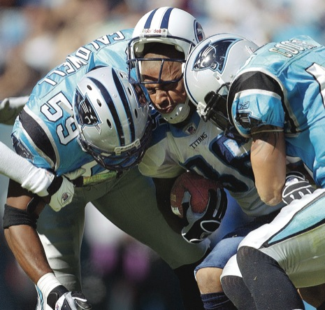
PATHOGENESIS of Concussion, PTSD and CTE
Metabolic
Immunologic
Excitotoxicity

Slide 28
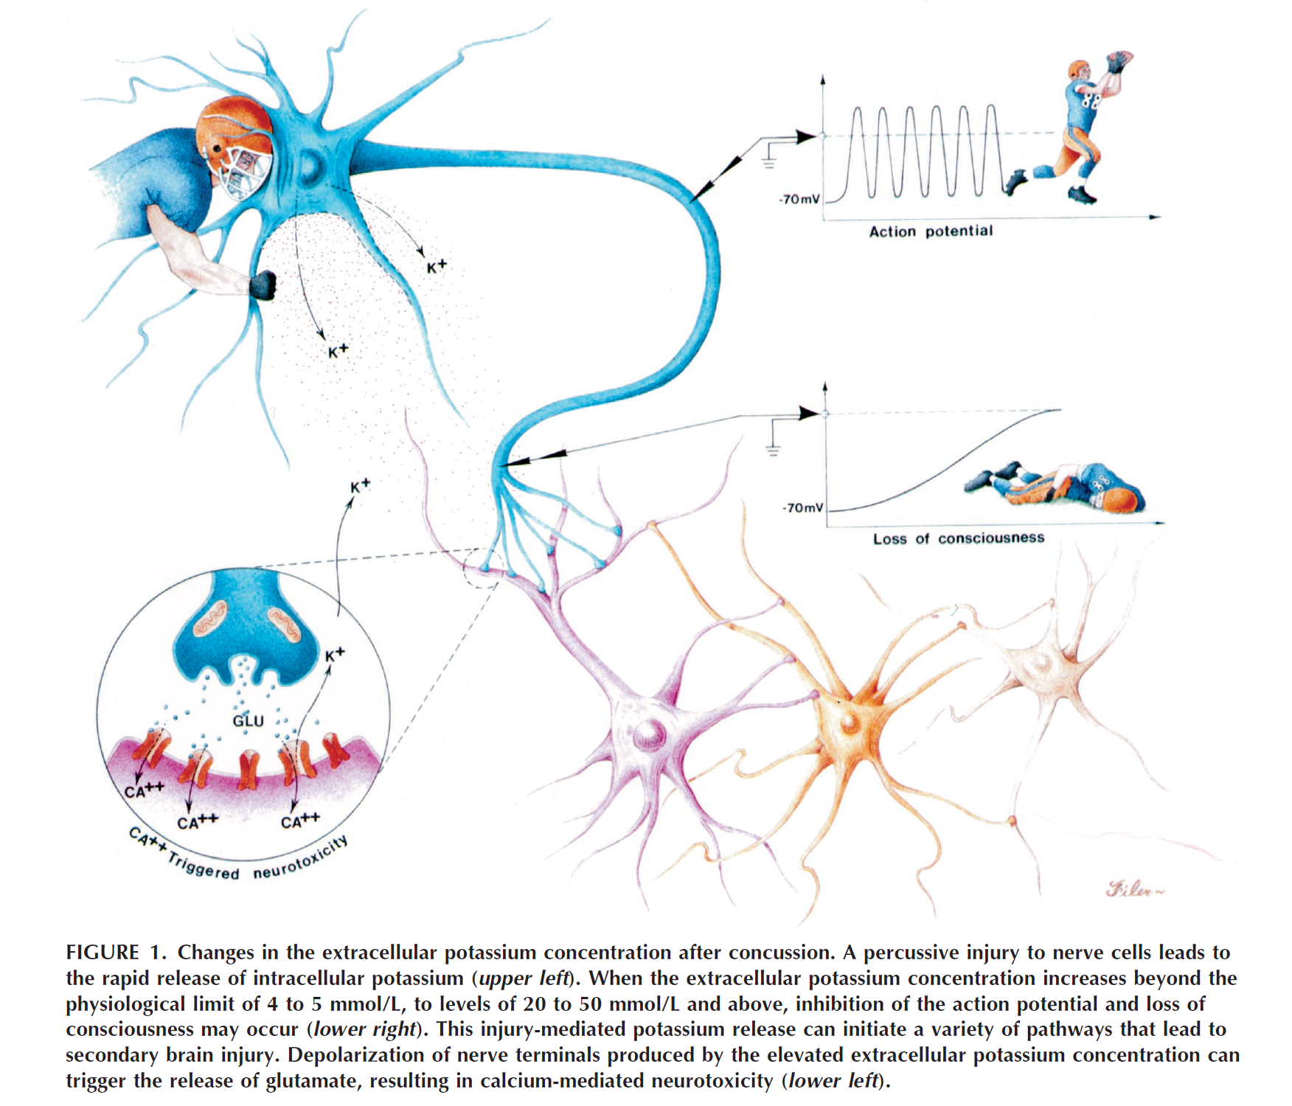

Slide 29
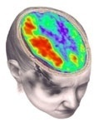
Metabolic “Mismatch”
(Giza & Hovda, 2001)
500
Calcium
400
300
K+
% of normal
200
Glucose
Glutamate
100
50
2
6
12
20
30
6
24
3
6
10
0
minutes
hours
days
Cerebral Blood Flow
29
UCLA Brain Injury Research Center
Notes:
29

Slide 30
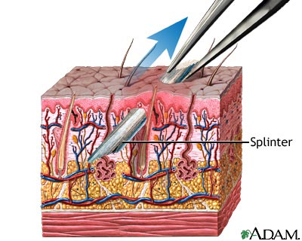
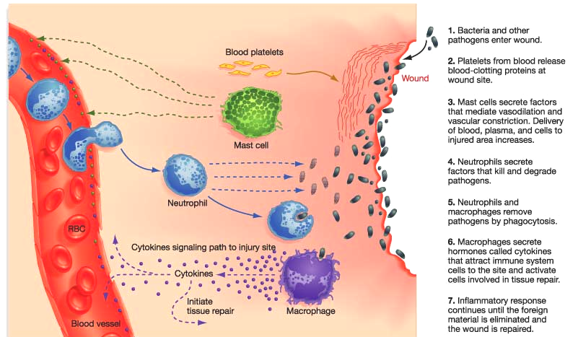
Immunologic (Inflammatory Response)

Slide 31
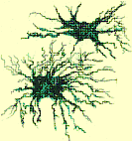
Microglia
Resident Macrophages of CNS
Primary Active Immune Defense CNS
20% of Total Glial Cells
Pro-inflammatory → Neuro-inflammation
Cytokines – IL-1a, IL-1B, IL-6, TNF-a
Chemokines – MCP-1
Proteases – Cathepsins, MMP
Amyloid Precursor Protein –APP
Inflammatory Prostaglandins – PG-1, PG-6

Slide 33
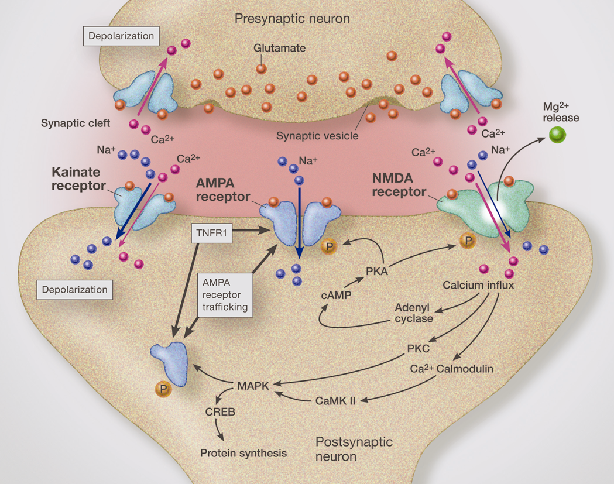
Excitotoxicity
(Biomarkers)

Slide 34
Spectrum of Immunoexcitotoxcity
Degree of Microglia Activation
Post-Concussion Syndrome
PTSD
CTE
mTBI
Concussion
Time

Slide 35
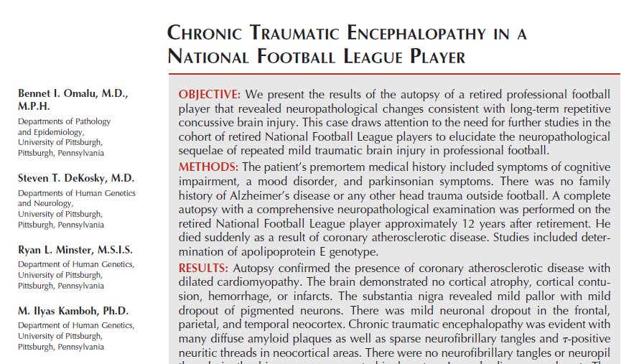
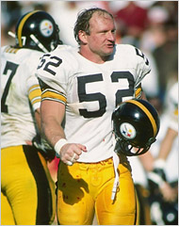
Neurosurgery 57:128-134, 2005
Mike Webster
Steelers Center
1974-88

Slide 36
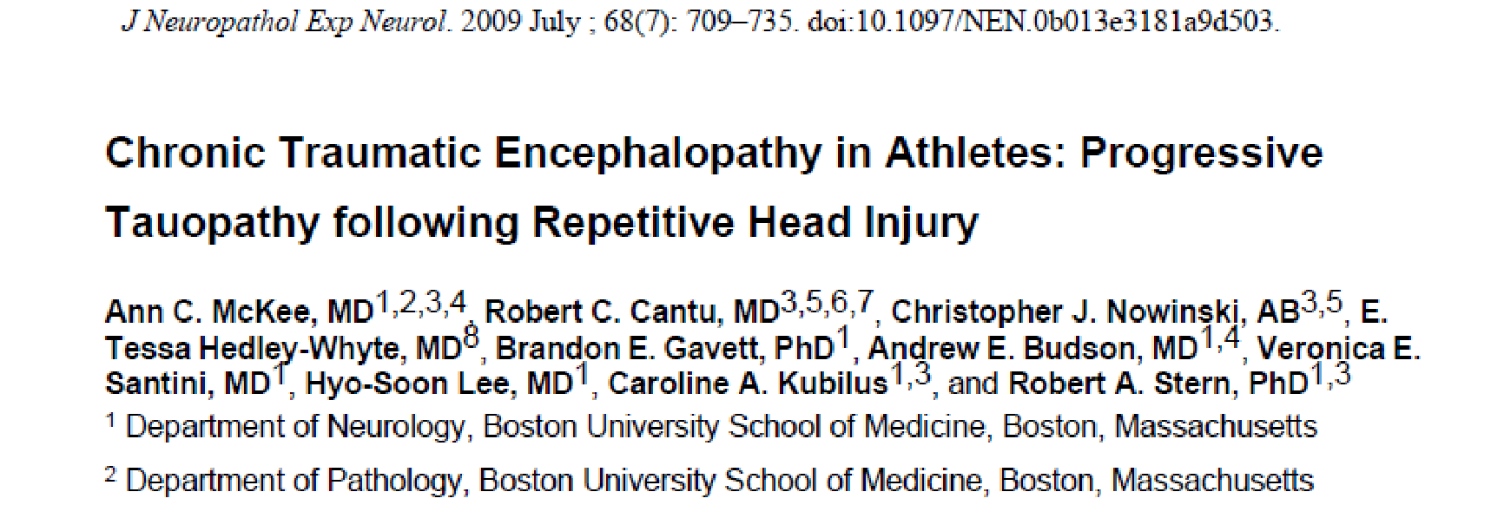
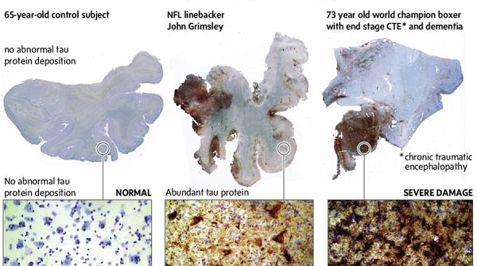

Slide 37
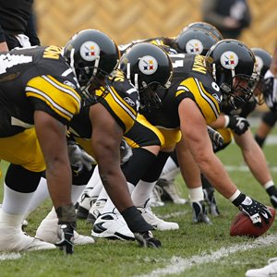
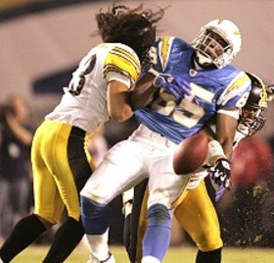
CTE- CHRONIC TRAUMATIC ENCEPHALOPATHY - ?New Agent Orange?
Subconcussive blows?
Prolonged latent period
Mean survival of 18 years after diagnosis
Early behavioral personality changes with memory loss
Progressive dementia, Parkinsonism, gait and speak disorders

Slide 38
CTE Questions?
What are the Risk Factors?
Prior “Priming” of Microglia Cells?
Severity and Frequency of Trauma?
Age?
Genetics (ApoE4)?
How to Diagnosis?
How to Treat?
How to Prevent?
What is the True Incidence?

Slide 39
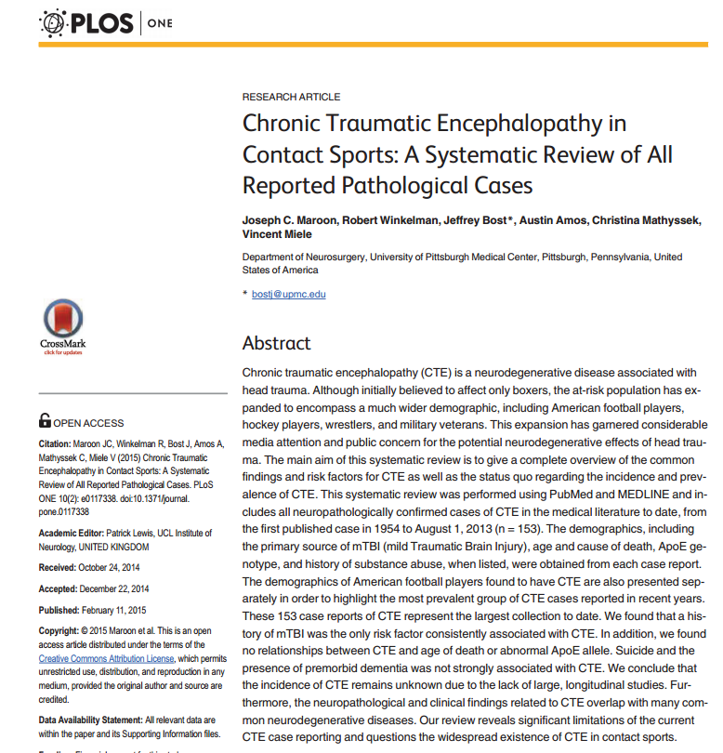
Risk Factors for Chronic Traumatic Encephalopathy
Joseph Maroon MD, FACS
Jeffrey Bost PAC
Robert Winkelman Austin Amos BS
Christina Mathyssek MS
Published: February 11, 2015
DOI: 10.1371/journal.pone.0117338

Slide 40
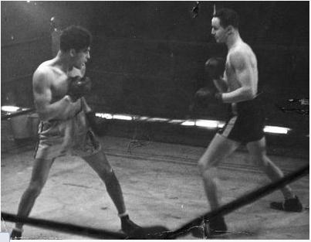
1954 to August 1, 2013 Demographic Breakdown of Neuropathologically Confirmed Cases
Total of 262 confirmed cases of CTE
113 duplicates (43%)
Total unique cases 153 (includes 4 unpublished)
69 (45%) Boxers
63 (41%) Football
6 (3.9%) Military
5 (3.3%) Hockey
3 (2.0%) Wrestling
6 (4.6%) other

Slide 41
Conclusions:
All 153 were case reports
No randomized studies
No relationship between CTE and age of death
No significant association of CTE and abnormal ApoE allele
Suicide and premorbid dementia not strongly associated with CTE.
Prior TBI only risk factor significantly associated with CTE

Slide 42
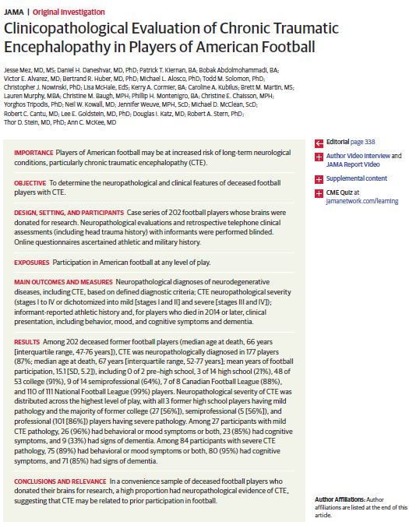
Results;
202 deceased former football players
Median age at death, 66 years
110 of 111 National Football League (99%) players had CTE

Slide 43
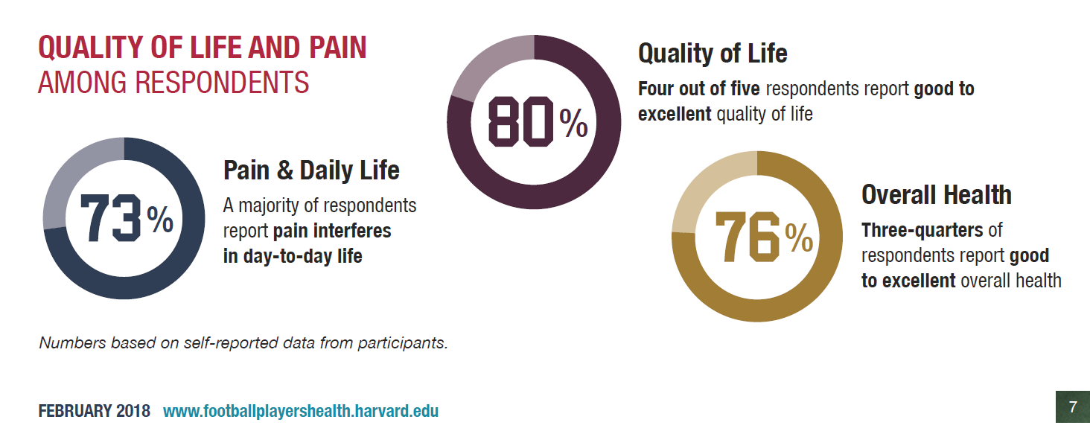
Harvard NFL Player Survey >3,500 Respondents

Slide 44
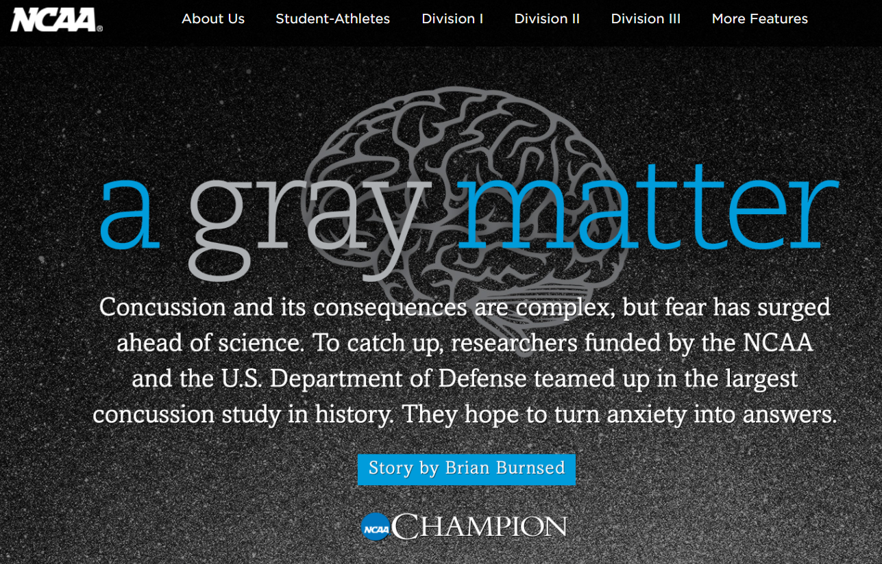
“I’m relieved to see people taking it seriously,” McKee says. “There’s a certain level of, I don’t know, it’s just sensationalism or it’s what sells. I think there are times when it’s overblown. I do think we need to be concerned. … Sometimes it goes a little far.”
Burnsed, B. "A Gray Matter." Champion Magazine. Spring 2015 (accessed on 3/18/18 at http://www.ncaa.org/static/champion/gray-matter/#sthash.fLCUdxnT.bLfliN0N.dpbs).

Slide 45
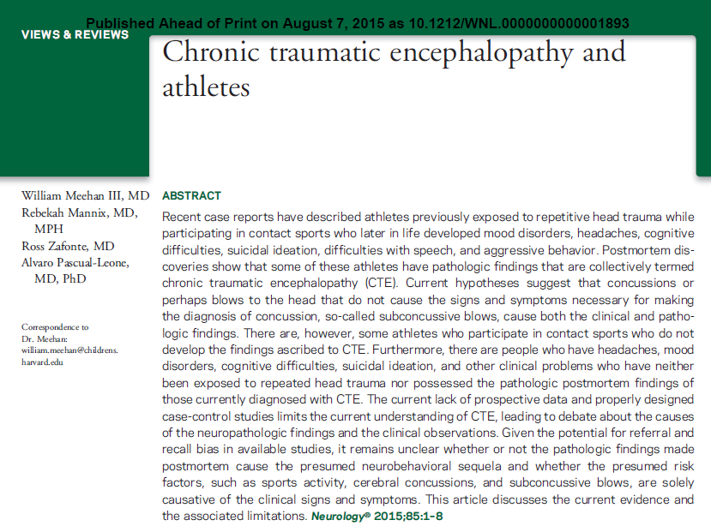
Given the potential for referral and recall bias in available studies, it remains unclear whether or not the pathologic findings made postmortem cause the presumed neurobehavioral sequela and whether the presumed risk factors, such as sports activity, cerebral concussions, and subconcussive blows, are solely causative of the clinical signs and symptoms

Slide 46
Smith, D. H. et al. Nat. Rev. Neurol. 9, 211–221 (2013);
…differentiation from other, better-characterized neurodegenerative syndromes remain elusive. Indeed, owing to the lack of large-scale controlled studies, our understanding of the pathology of CTE has advanced little since the landmark study by Corsellis et al. in 1973.
At least some pathological fea­tures are common to survival from single and repetitive TBI, raising the possibility that they represent manifesta­tions along a spectrum of common pathology, perhaps with a phenotype influenced by severity and frequency of exposure

Slide 47
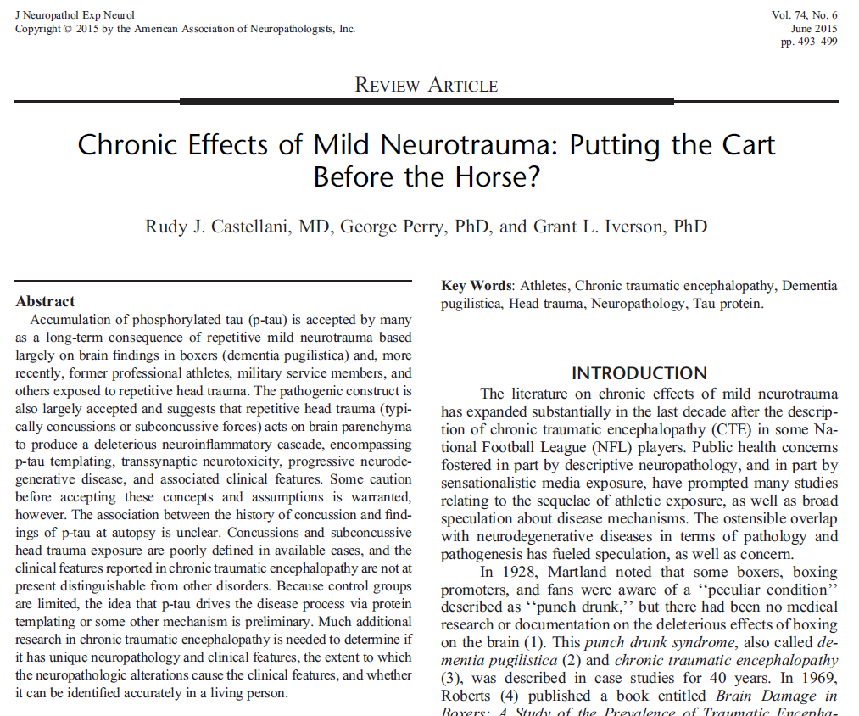
The association between the history of concussion and findings of p-tau at autopsy is unclear. Concussions and subconcussive head trauma exposure are poorly defined in available cases. Much additional research in chronic traumatic encephalopathy is needed
J Neuropathol Exp Neurol, Vol. 74, No. 6, June 2015 pp. 493Y499

Slide 48
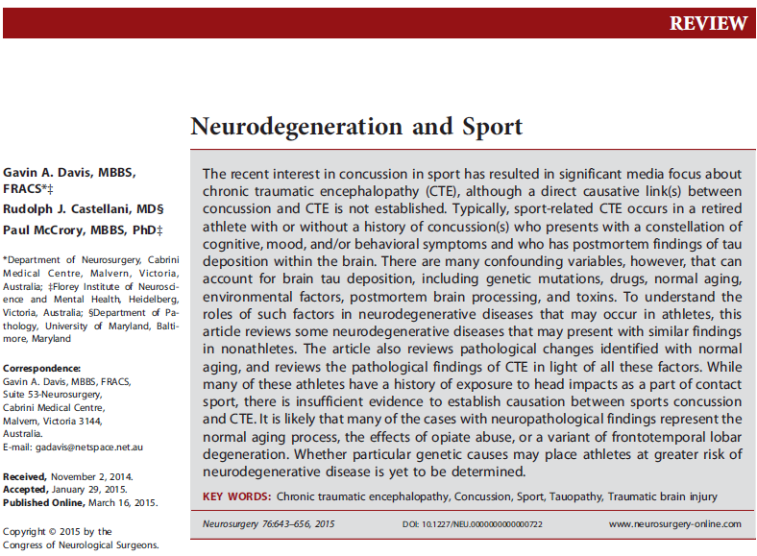
Neurosurgery 76:643–656, 2015 DOI: 10.1227/NEU.0000000000000722
……..there is insufficient evidence to establish causation between sports concussion and CTE. It is likely that many of the cases with neuropathological findings represent the normal aging process, the effects of opiate abuse, or a variant of frontotemporal lobar
degeneration.

Slide 49
Chicken or the Egg? Which Came First?
N = 6
Dementia symptoms onset = ave 64 y/o
Ave age of death with autopsy CTE = 76 y/o
Of the 6 players with CTE:
Alzheimer’s disease (N = 6)
Biomarker TDP-43 (N = 6)
Cerebral amyloid angiopathy (N = 5)
Hippocampal sclerosis (N = 2)
Corticobasal degeneration (N = 1)
Dementia with Lewy bodies (N = 1)
Vascular pathology (N = 1)

Slide 50
Suicide Over Represented in CTE ²
No established causal link between CTE pathophysiology and suicide
Case selection bias results in over representation of CTE cases with neuropsychiatric comorbidity and suicide risk factors.
10 of 52 athletes that committed suicide— 6 of 10 did not have CTE features neuropathologically ¹
Former NFL athletes are less likely to die by suicide than men in the general population (or baseball players!)
1. McKee AC, Stein TD, Nowinski CJ, et al. The spectrum of disease in chronic traumatic encephalopathy. Brain 2013;136(Pt 1):43–64.
2. J Neuropsychiatry Clin Neurosci 2016; 28:9–16; doi: 10.1176/appi.neuropsych.15070172
Iverson GL. Br J Sports Med 2014;48:162–164. doi:10.1136/bjsports-2013-092935

Slide 51
Relationship between suicide and CTE pathophysiology— “premature, overly simplistic and potentially fatalistic”.
(Iverson, GL)

Slide 52
Athletic Career Transition Stress
CTE Symptoms mimic Clinical Depression
Substance abuse
Chronic pain
Athletic Career Transition Stress
Neuro trauma
Michael Gaetz Ph.D. The Neurophysiology of Concussion, Electrophysiology, and Chronic Traumatic Encephalopathy
http://www.nbis.ca/docs/Dr.%20Michael%20Gaetz.pdf

Slide 53
Summary: Existing Data
Observational (Case-reports and small series)
Major selection bias
Methodological concerns
No firm agreement on pathologic findings

Slide 54
Conclusion
CTE Neuropathology– no comprehensively determined unique factors
Head injury– single versus multiple?
Impact versus non-impact?
Severity?
Time between injuries?
Incidence?
Clinical symptoms overlap with other neurodegenerative diseases

Slide 55
Common Myths about Football
NFL players die younger
NFL players have a greater suicide rate
A greater percent of players have cancer and heart disease.

Slide 56
Football Facts
Frank Gifford
Born: 8/16/1930
Fact: NFL veterans outlive their society peers
Fact: On average, NFL players (77.5 yr life expectancy) vs. general population (74.7 years) Fact: NFL players kill themselves at a lower rate than baseball and ½ rate as general public (59% lower)
83 y/o
Mayo clinic proceedings, April 2012, 335-339, NFL players kill themselves at a lower rate. American Journal of Cardiology, March 15, 2012, page 891. Institute for Occupational Health and Safety Study (NIOSH)

Slide 57
Facts:
“The risk of injury in youth football does not appear greater than other recreational or competitive sports”
Mayo Clinic 2002 study of 915 elementary & middle school football players
“No greater risk of dementia, PD, or ALS in 438 men who played HS football 1946-1956.” Mayo Clinic study 2012

Slide 58
Should you allow your child to:
Ride a Bike?
Drive or be a Passenger in a Car?
Use a ATV?
Ride a Horse?
No Helmets

Slide 59
PHYSICAL ACTIVITY IN U.S.
Only 1 in 3 children are physically active every day.
>80% of adolescents do not do enough aerobic physical activity to meet the guidelines for youth.
Children now spend more than 7.5 hrs/d in front of a screen (e.g., TV, videogames, computer)
1/3 Overweight or Obese
http://www.fitness.gov/resource-center/facts-and-statistics/

Slide 60
Health Benefits of Sport
Physical, psychological, academic, and social benefits
Skill mastery and development
Develop agility, coordination, endurance, flexibility, speed and strength
Enhanced CV and muscular systems
Maintain weight
(American Academy of Pediatrics [AAP] Committee on Sports Medicine and Fitness [COSMF], 2001; Beets & Pitetti, 2005; Brown, Clark, Ewing & Malina, 1998)

Slide 61
Football Intangibles
“On the fields of friendly strife are sown the seeds that on other days and other fields will bear the fruits of victory.”
General Douglas MacArthur
US WWII general & war hero
(1880 - 1964)

Slide 62
Future of Concussion Management
Biomarker – Grace Labs®
Accelerometers - Mouth guards
ImPACT Quick Test®
HBO
CBD
Omega-3
Vitamin D

Slide 63
Thank You

