Slide 1


Cardiac Surgery: a Primer for Primary Care Providers
Joseph Monfre M.D.
Wyoming Cardiac and Thoracic Surgery
Wyoming Medical Center

Slide 2
I have no relevant financial relationships to disclose.

Slide 3
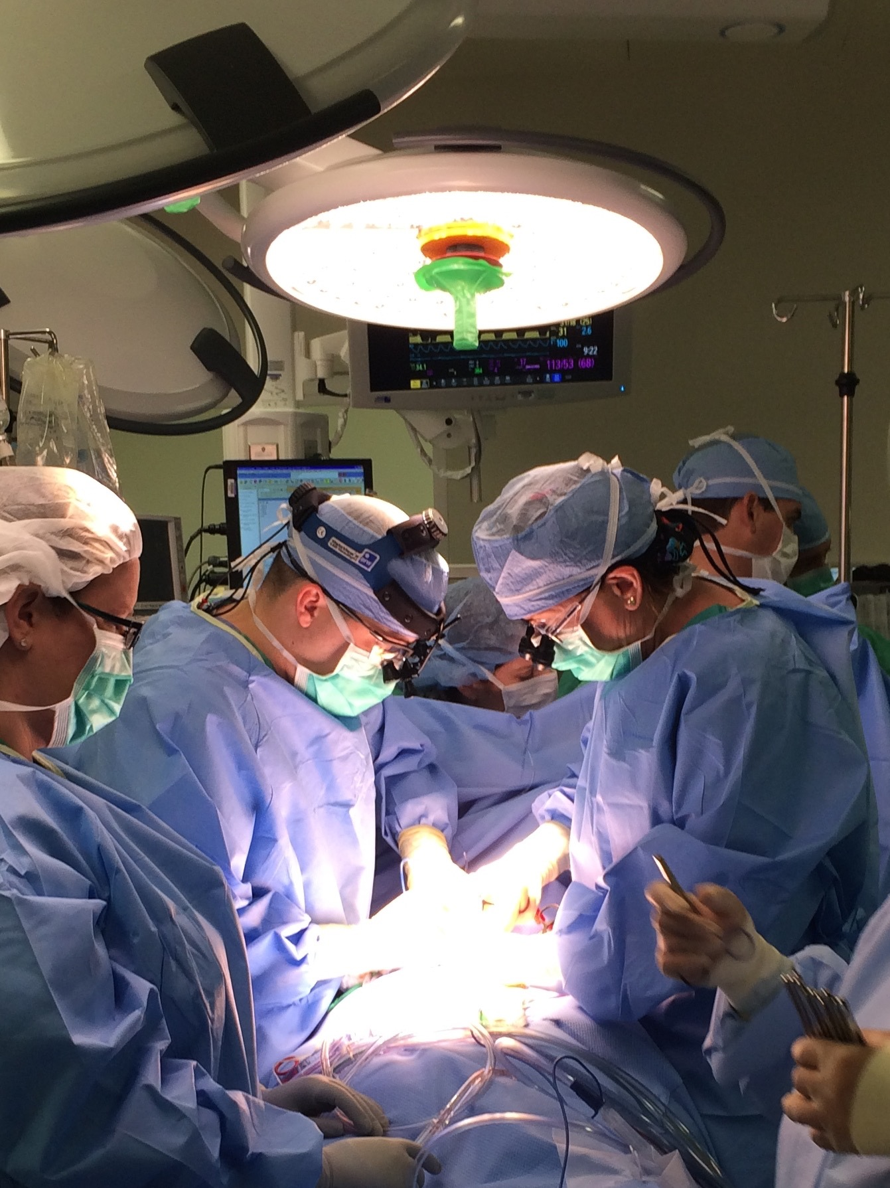
Overview
Coronary Disease
Valvular Disease
Aortic Disease
Arrhythmias
Current Trends
Our Current Capabilities
Looking Toward the Future

Slide 4
Coronary Disease

Slide 5
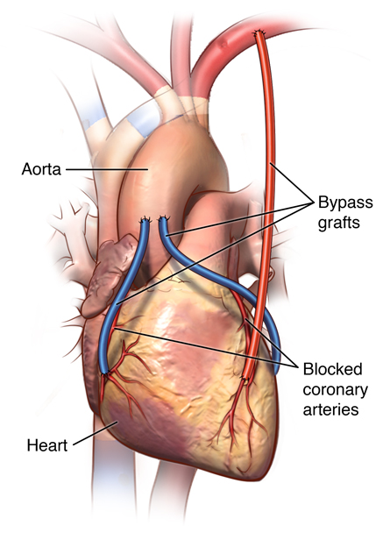
Coronary Artery Bypass Grafting
1960’s: CABG in humans
1980’s: LIMA (Loop et al.1986)
1990’s: OPCAB (ROOBY trial)
2000’s: MICS & Robotic Surgery
2010’s: Arterial grafts

Slide 6
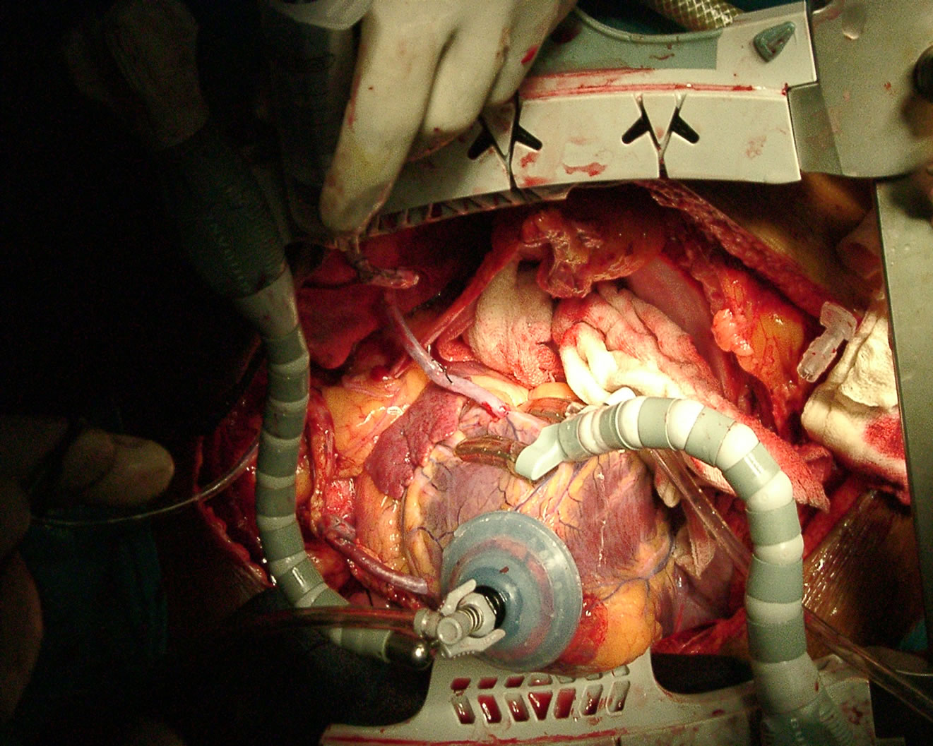
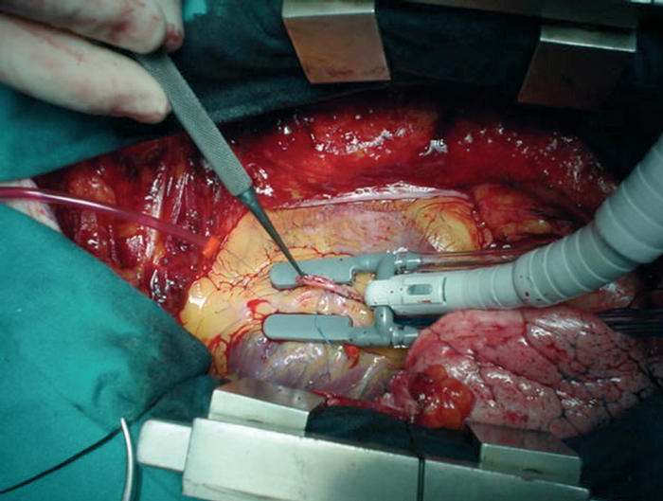
Off Pump CABG

Slide 7
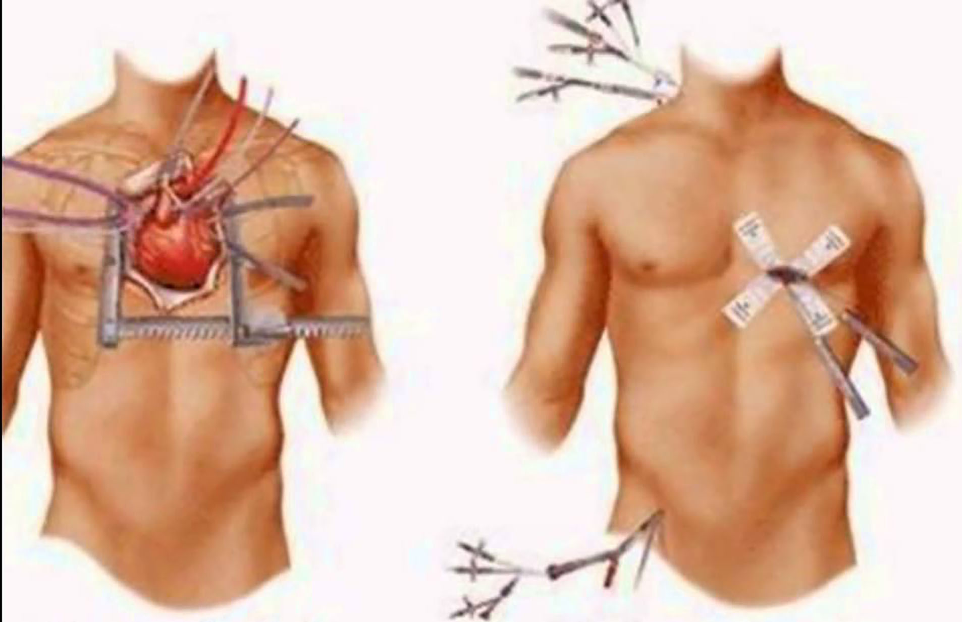
Minimally Invasive Cardiac Surgery

Slide 8
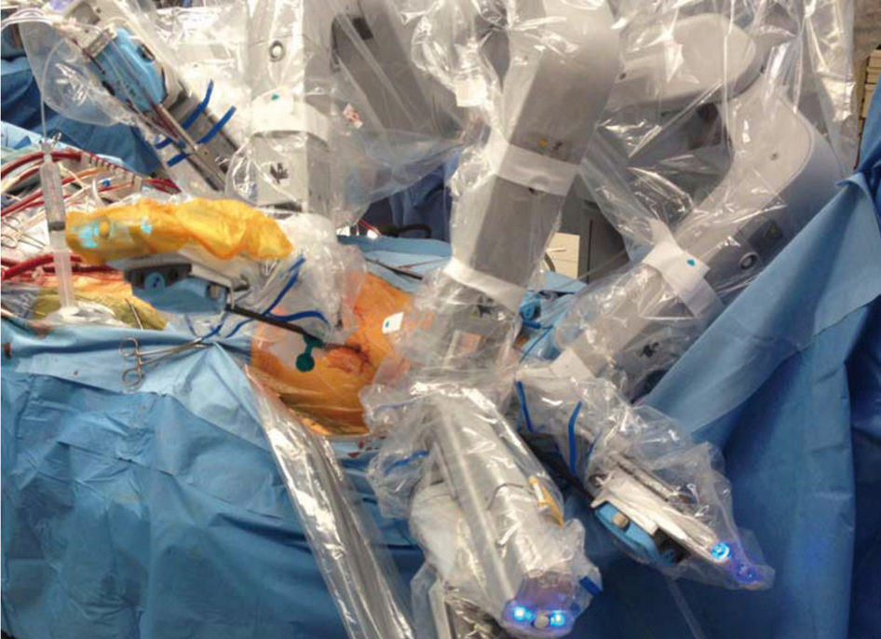
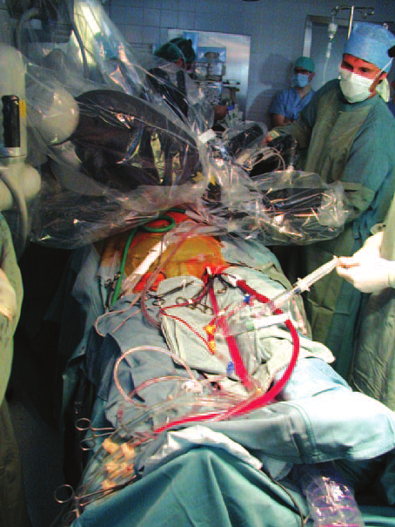
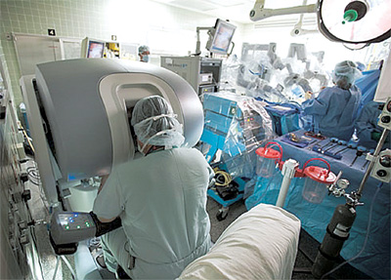

Slide 9
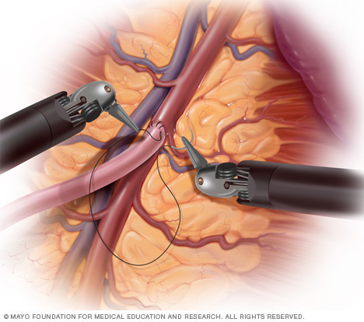
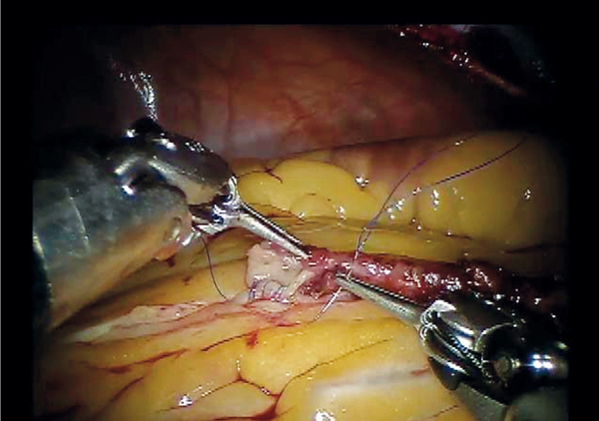
Robotic CABG

Slide 10
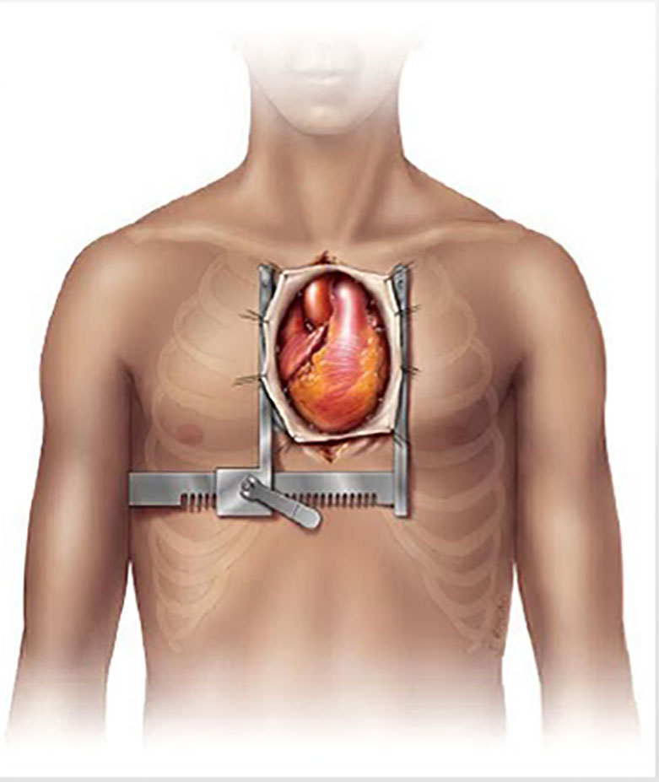
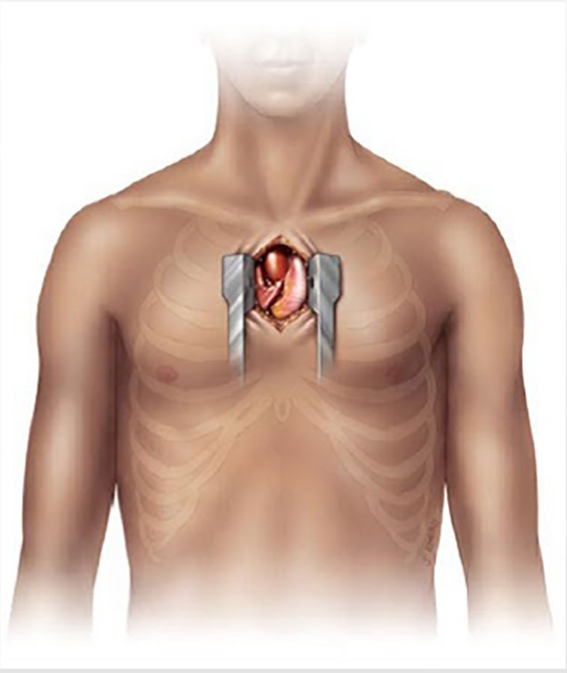
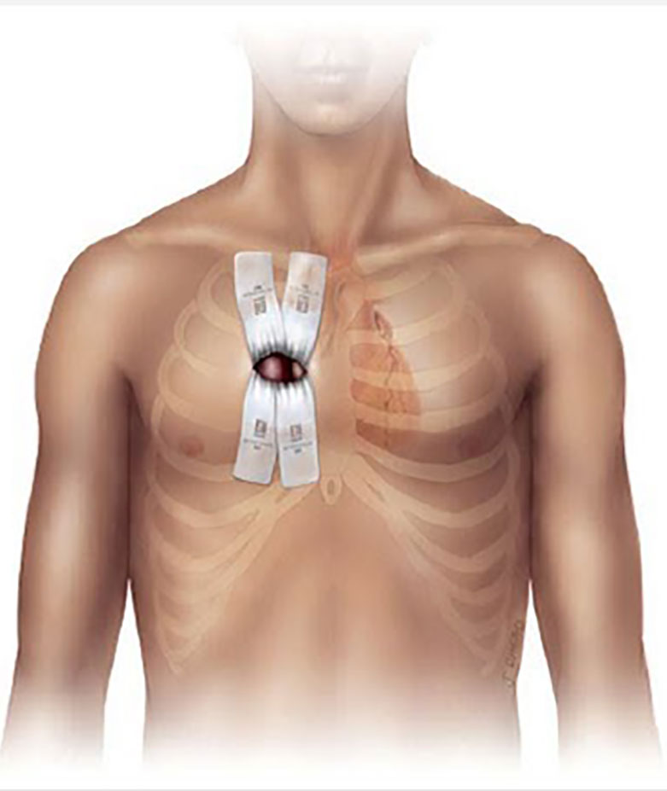
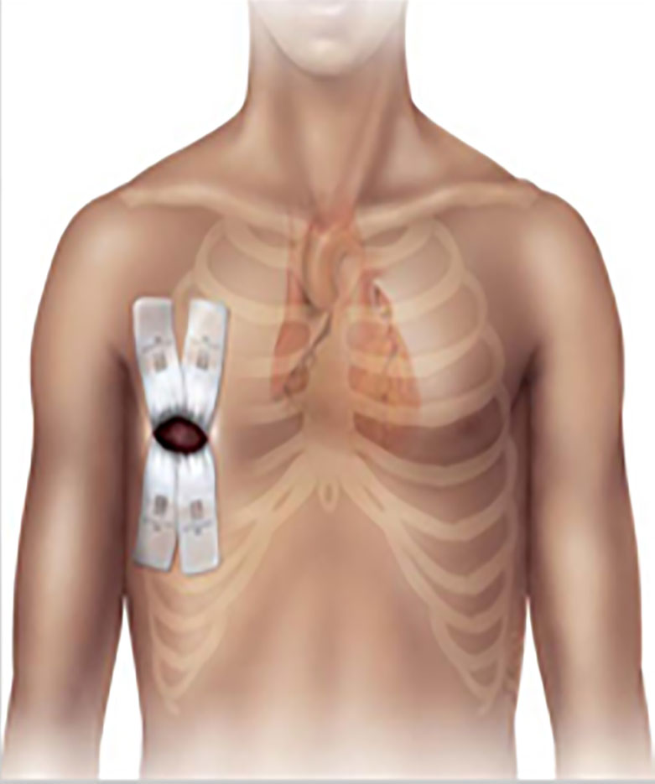

Slide 11
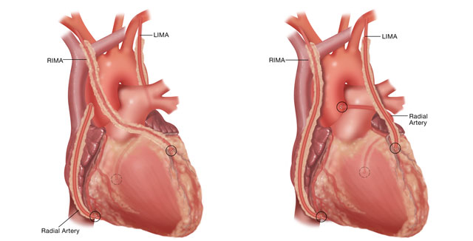
Arterial Conduits

Slide 12
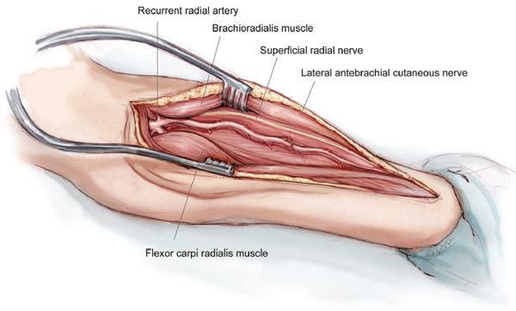
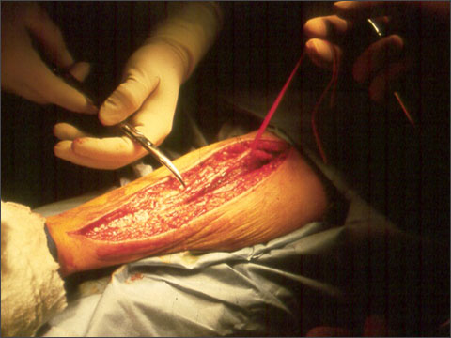
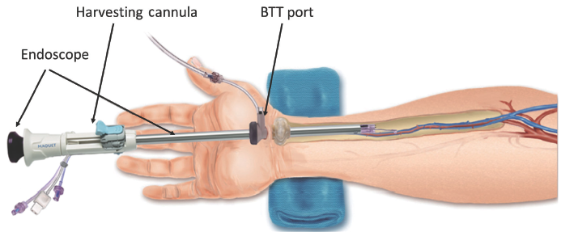
Radial Artery Conduits

Slide 13
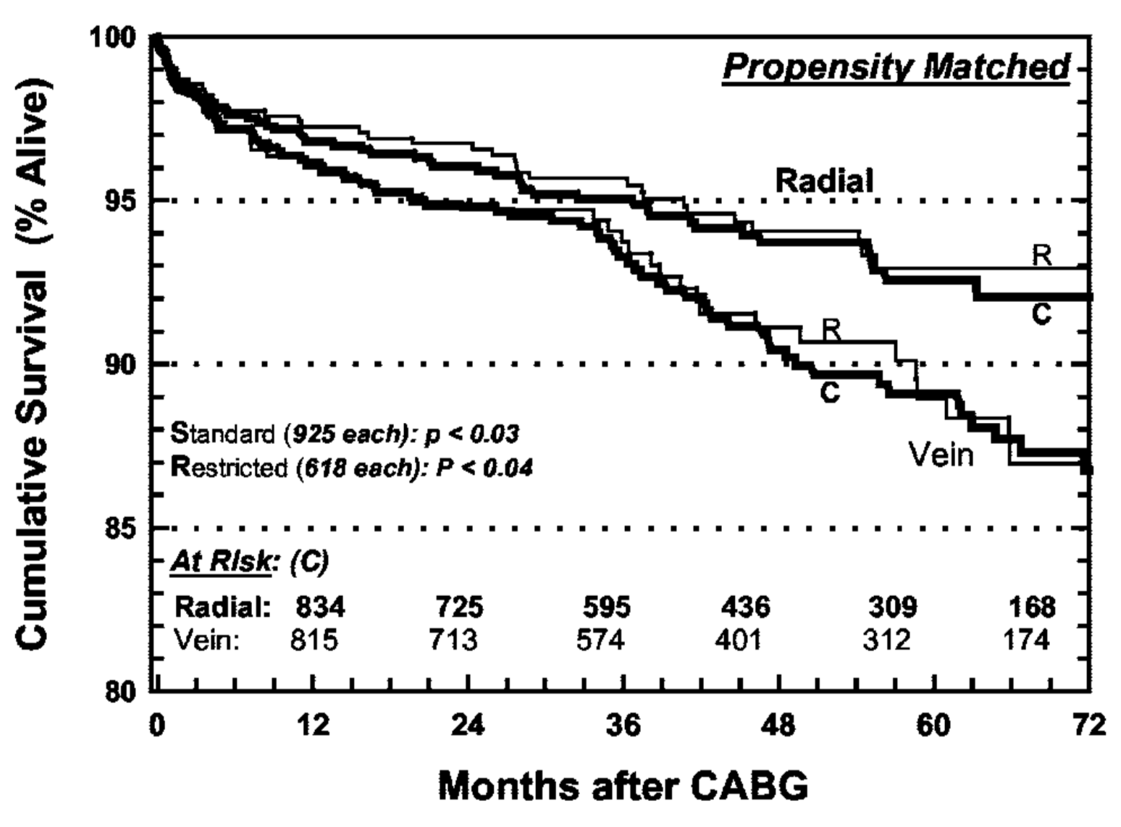
Zacharias et al. “Improved Survival With Radial Artery Versus Vein Conduits in Coronary Bypass Surgery With Left Internal Thoracic Artery to Left Anterior Descending Artery Grafting.” Circulation. 2004; 109:1489-1496.

Slide 14
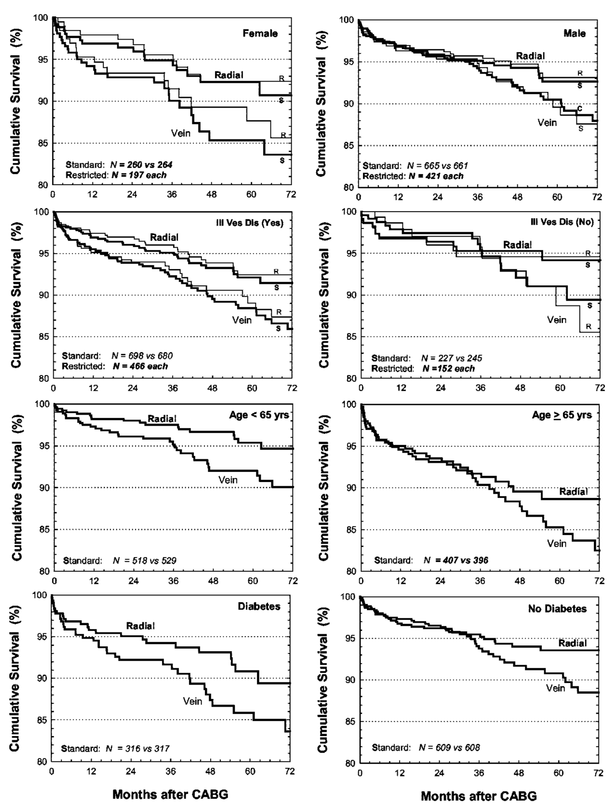
Zacharias et al. Circulation. 2004;109:1489-1496.

Slide 15
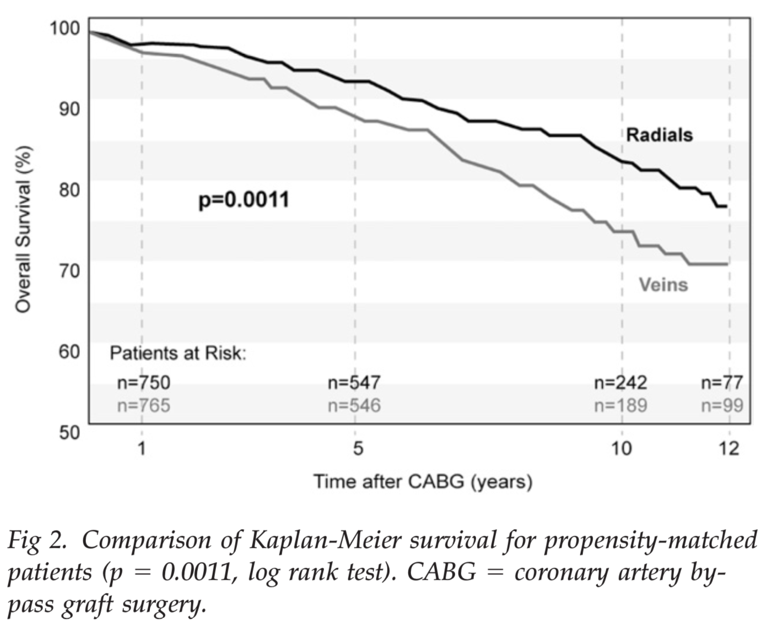
Tranbaugh et al. “Radial Artery Conduits Improve Long-Term Survival After Coronary Artery Bypass Grafting.” Ann Thorac Surg. 2010; 90:1165–72.

Slide 16
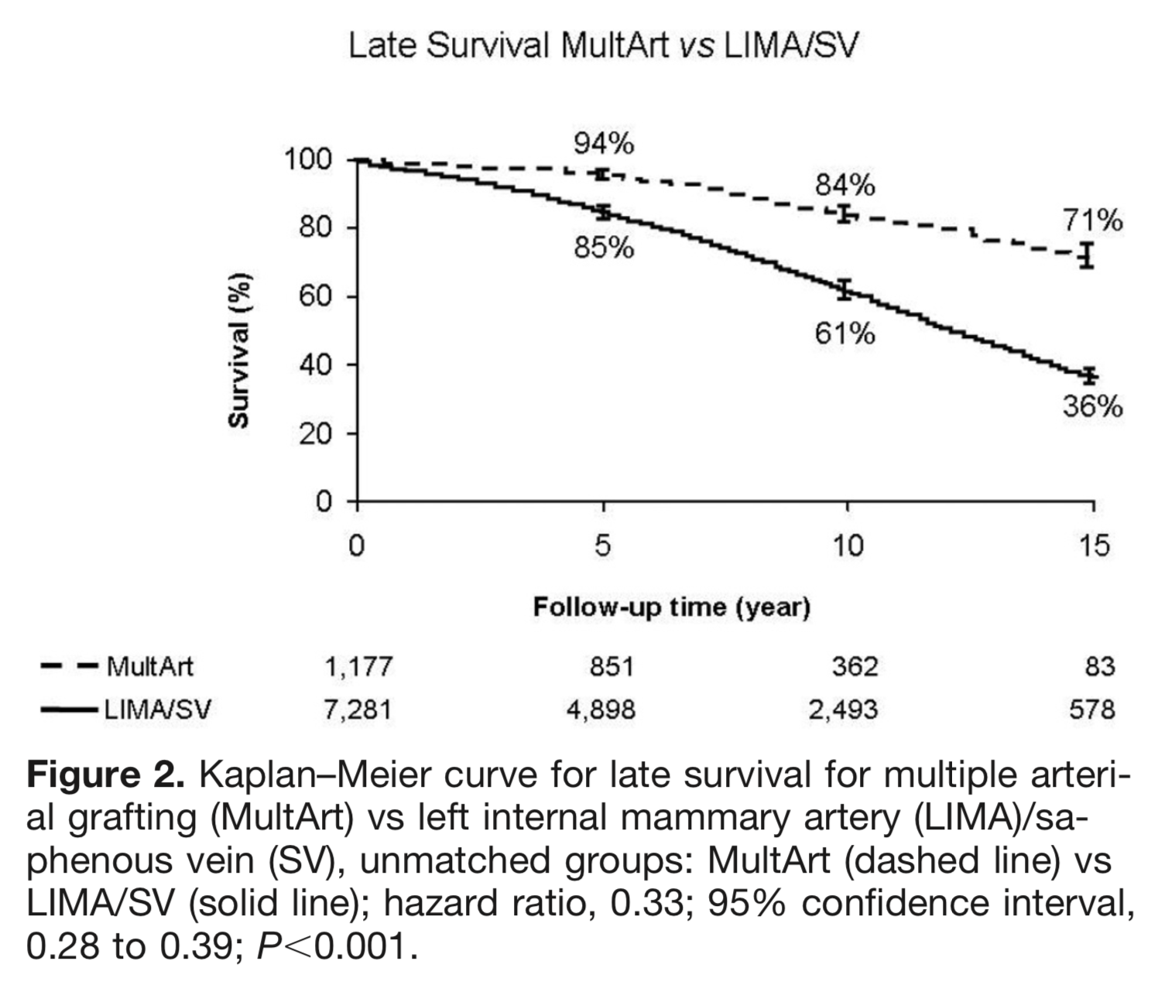
Locker et al. “Multiple Arterial Grafts Improve Late Survival of Patients Undergoing Coronary Artery Bypass Graft Surgery.” Circulation. 2012; 126:1023-1030.

Slide 17
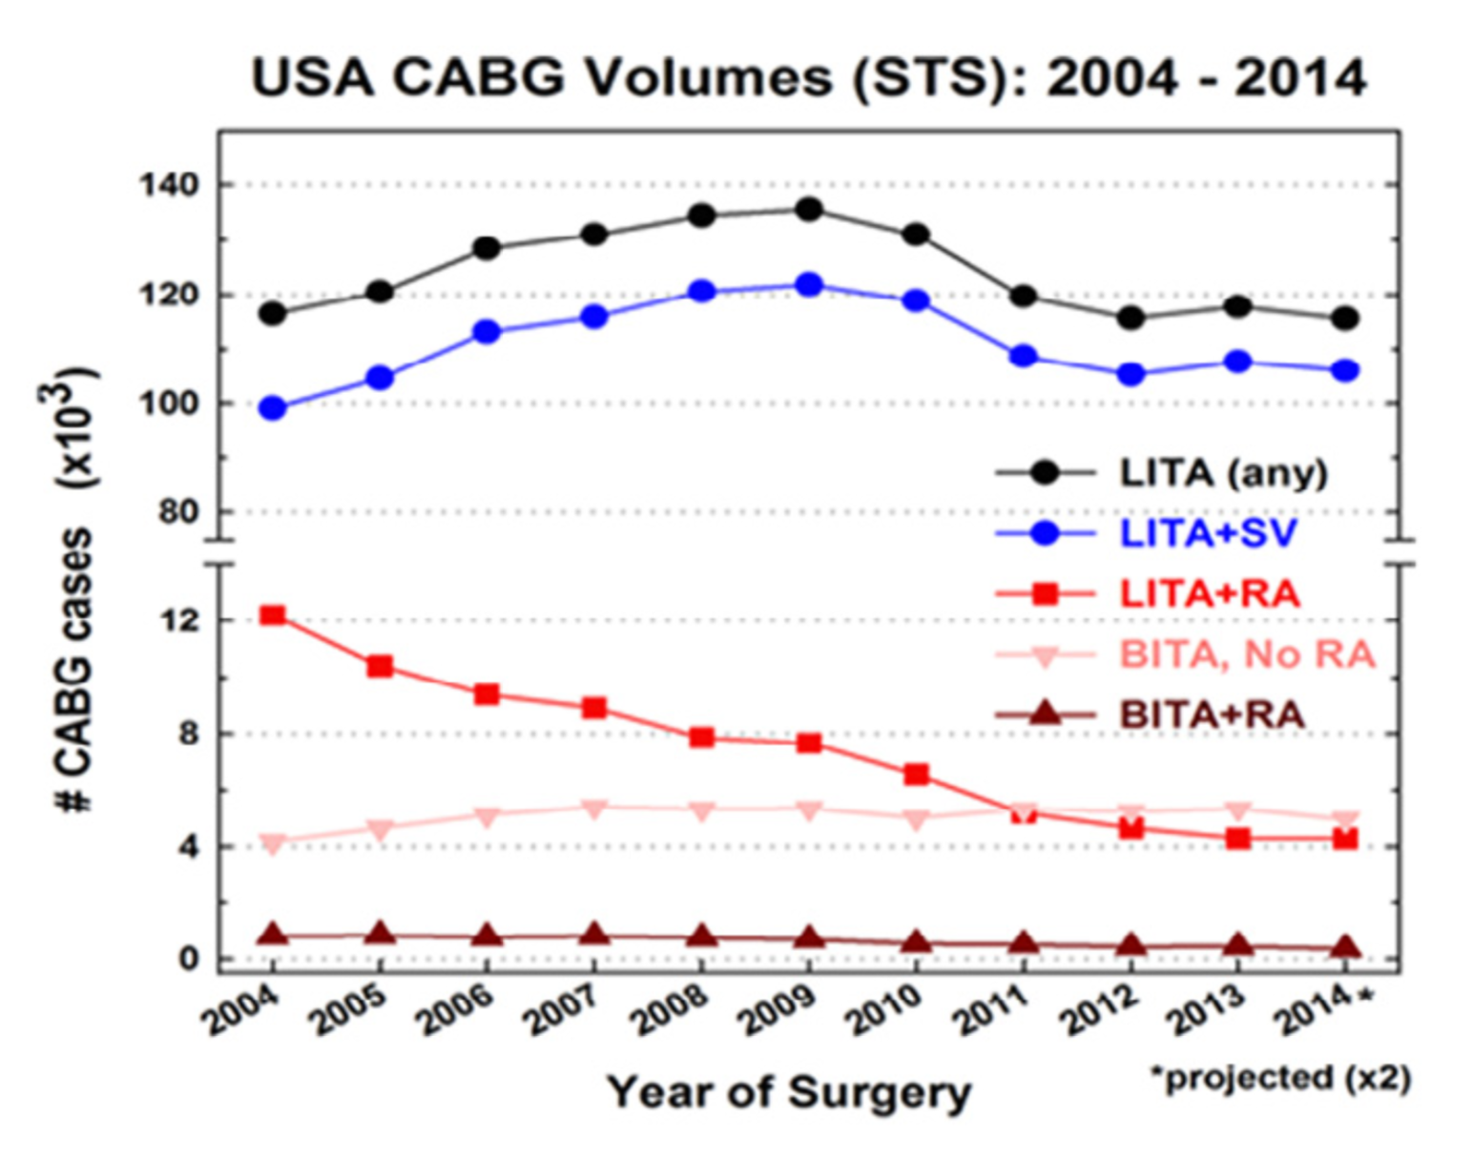
Schwann et al. “Worldwide Trends in Multi-arterial Coronary Artery Bypass Grafting Surgery 2004-2014.” Semin Thoracic Surg. 2017; 29:273–280.

Slide 18
Valvular Disease

Slide 19
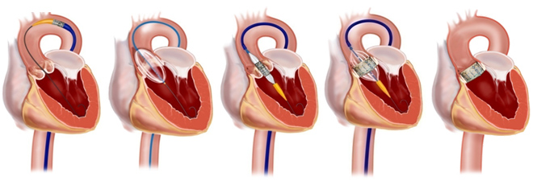
Transcatheter Aortic Valve Replacement

Slide 20
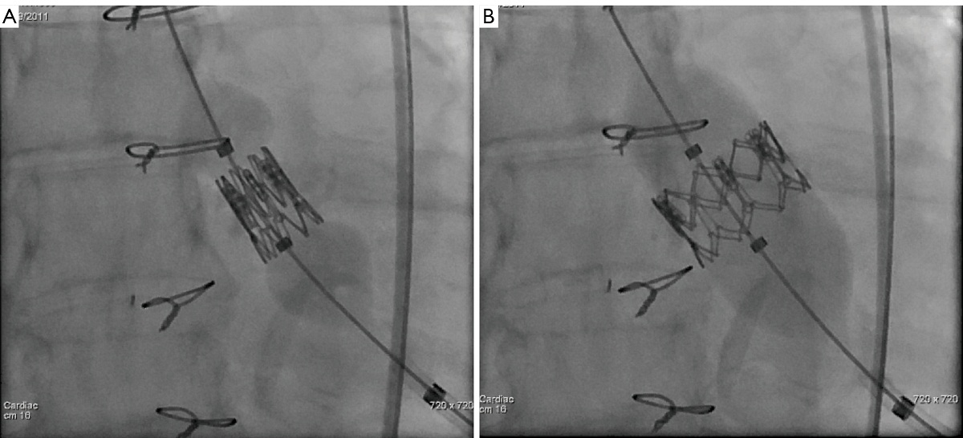
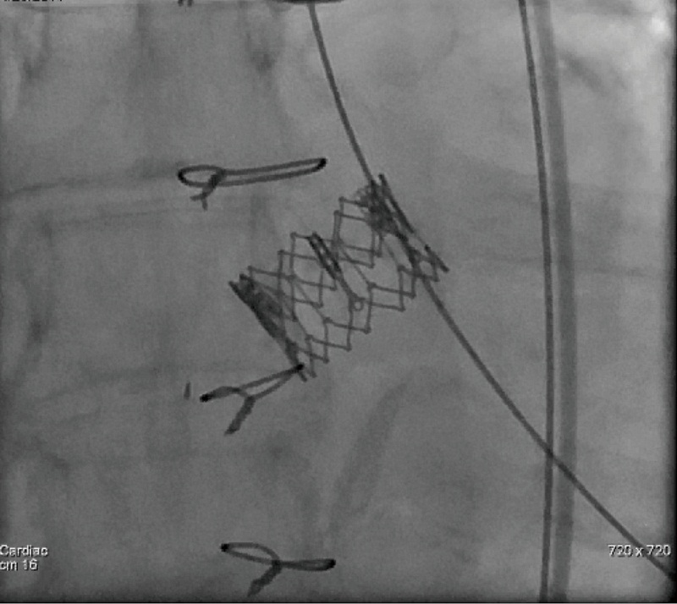
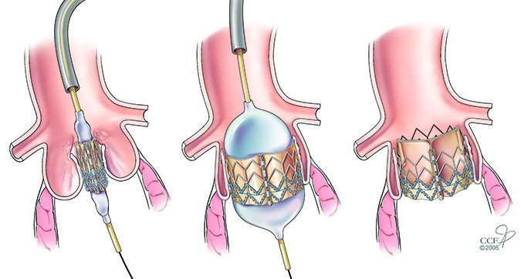

Slide 21
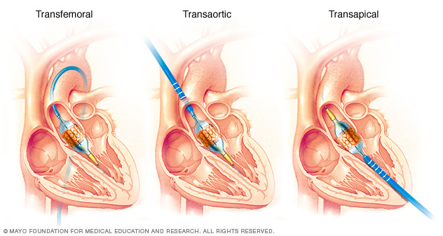
Transcatheter Aortic Valve Replacement

Slide 22
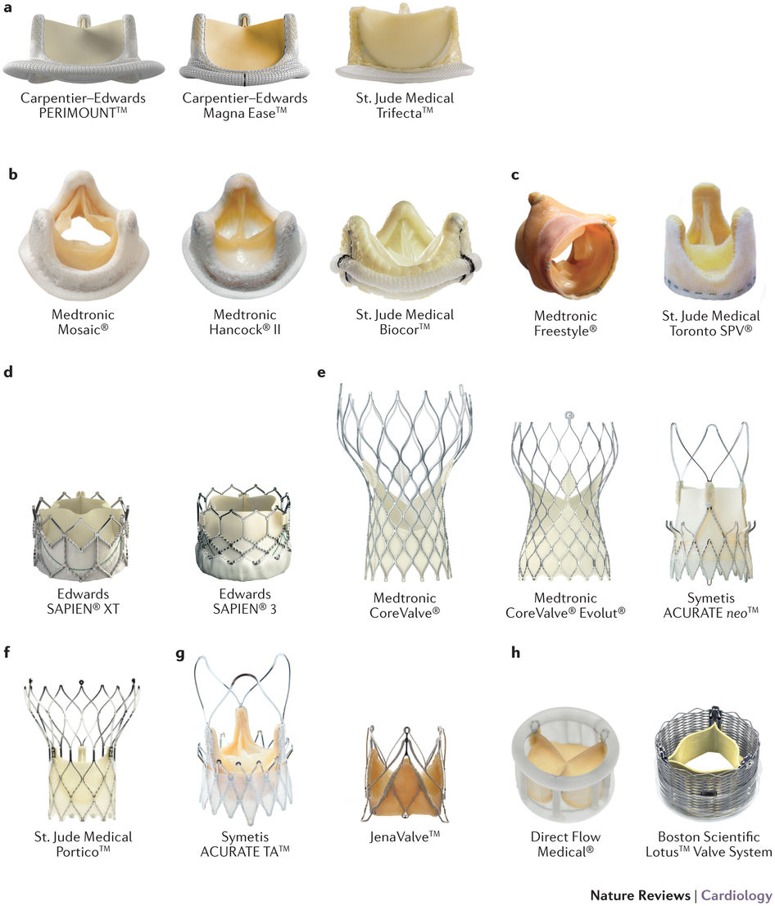

Slide 23
Three randomized controlled trials:
  PARTNER I - High Risk (STS score > 8%)
  PARTNER II - Intermediate Risk (4% - 8%)
  PARTNER III - Low Risk (< 4%)

Slide 24
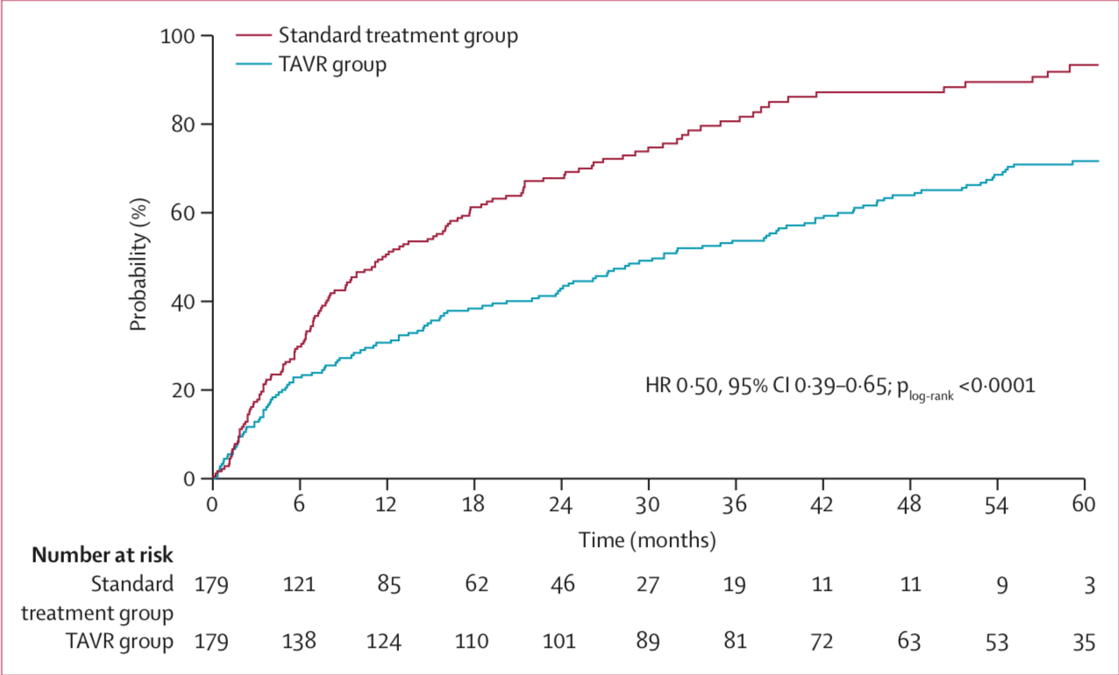
Kapadia et al. “5-year outcomes of transcatheter aortic valve replacement compared with standard treatment for patients with inoperable aortic stenosis (PARTNER 1).” Lancet. 2015; 385: 2485–91.

Slide 25
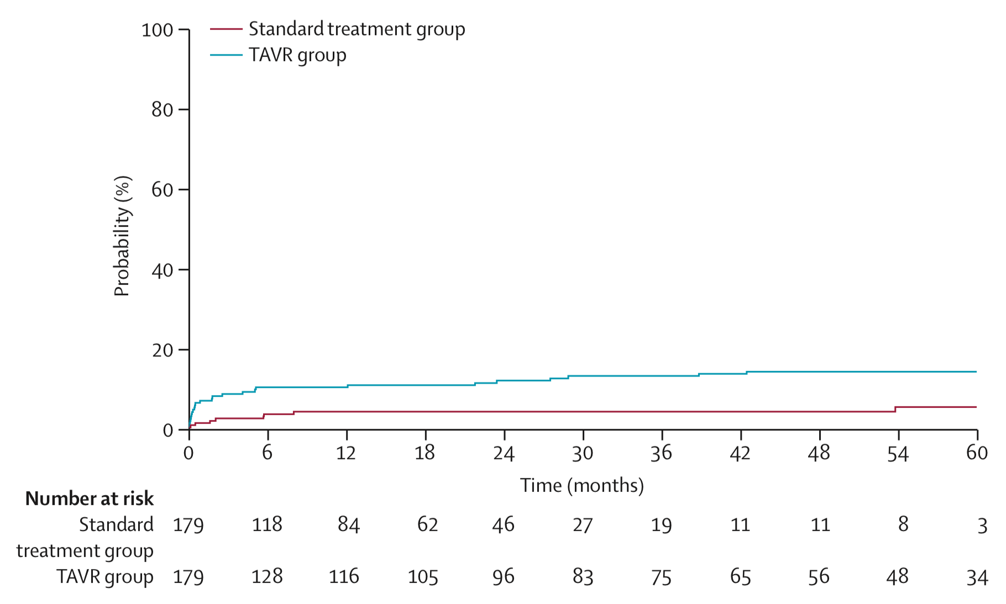
Kapadia et al. “5-year outcomes of transcatheter aortic valve replacement compared with standard treatment for patients with inoperable aortic stenosis (PARTNER 1).” Lancet. 2015; 385: 2485–91.

Slide 26
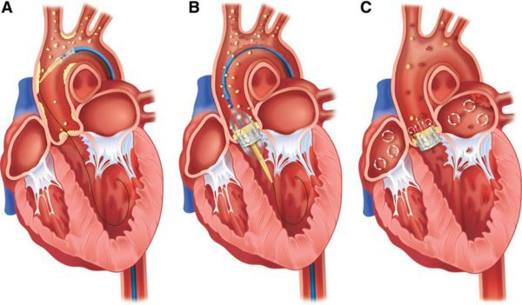

Slide 27
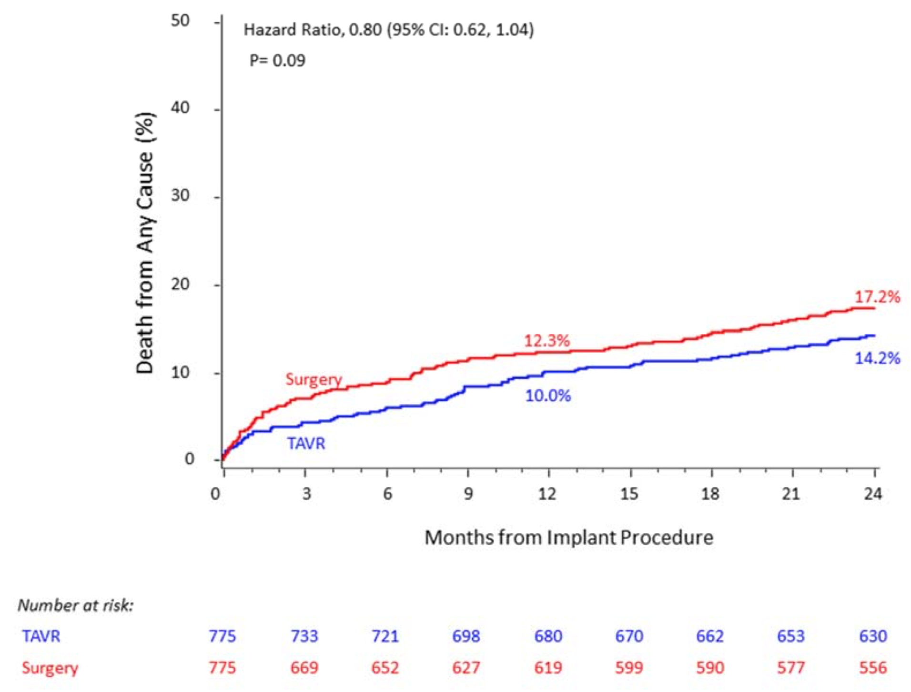
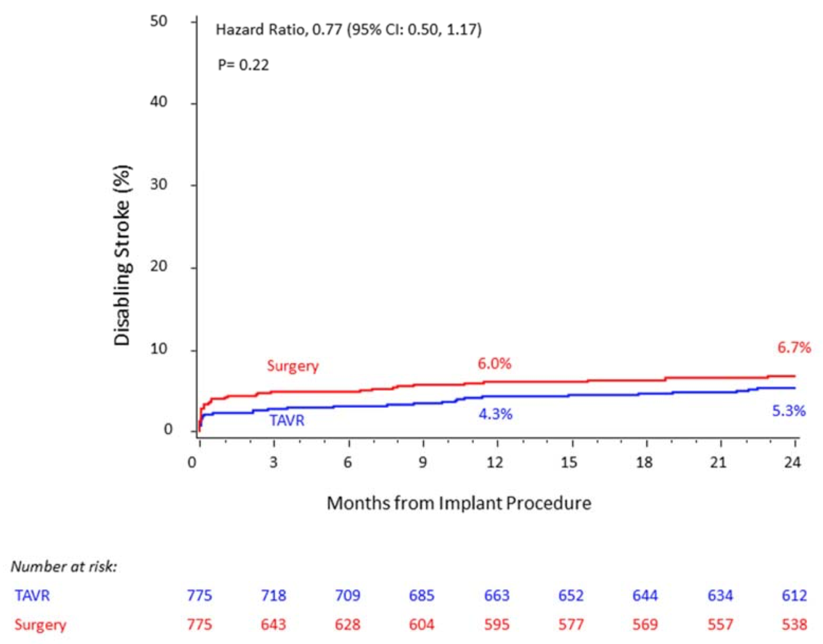
PARTNER II (Intermediate Risk)
Leon et al. “Transcatheter or Surgical Aortic-Valve Replacement in Intermediate-Risk Patients.” N Engl J Med. 2016; 374:1609-1620

Slide 28
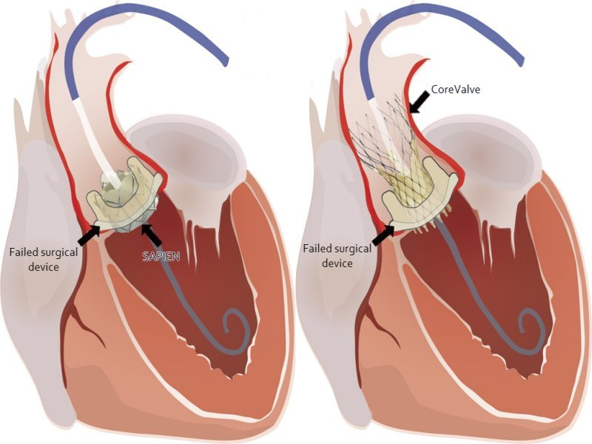
Valve in Valve TAVR

Slide 29
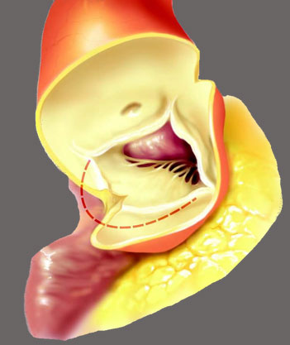
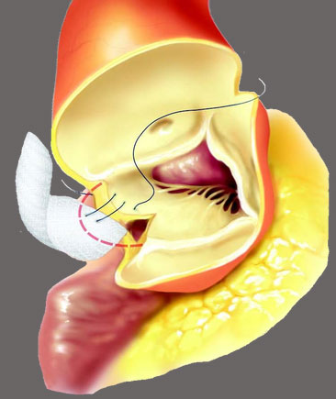
Aortic Annular Enlargement

Slide 30
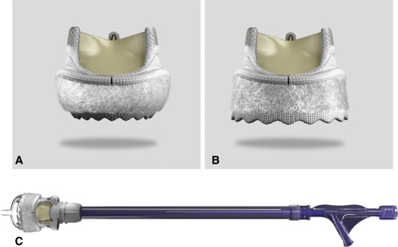
Rapid Deployment Surgical Valves

Slide 31
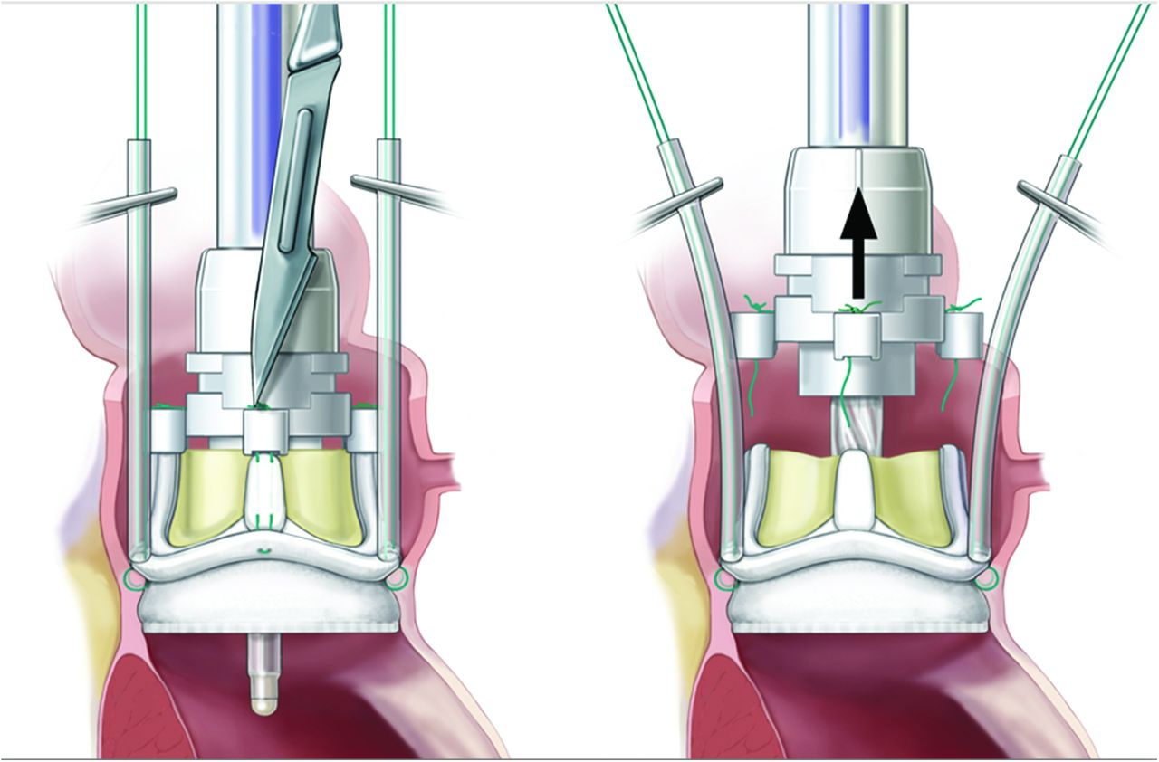
Rapid Deployment Surgical Valves

Slide 32
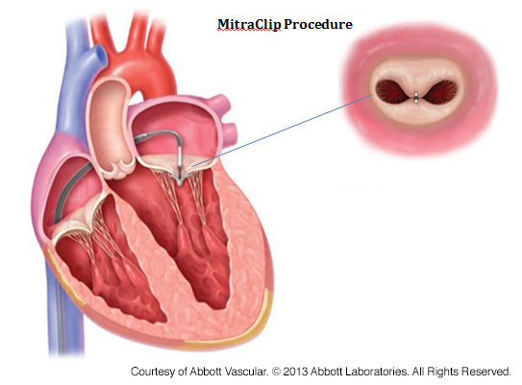
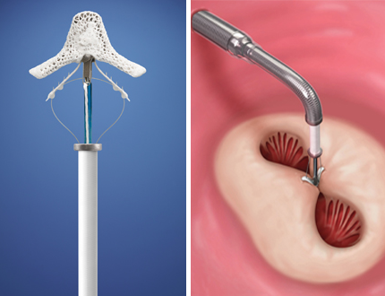
Percutaneous Mitral Clip

Slide 33
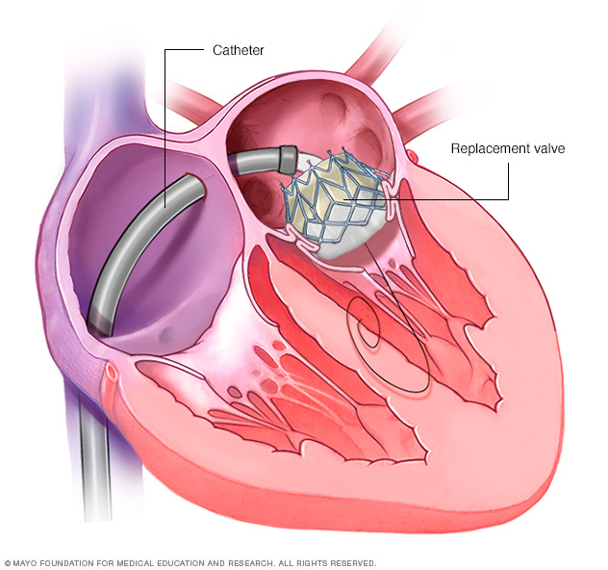
Transcatheter Mitral Valve Replacement

Slide 34
Aortic Disease

Slide 35
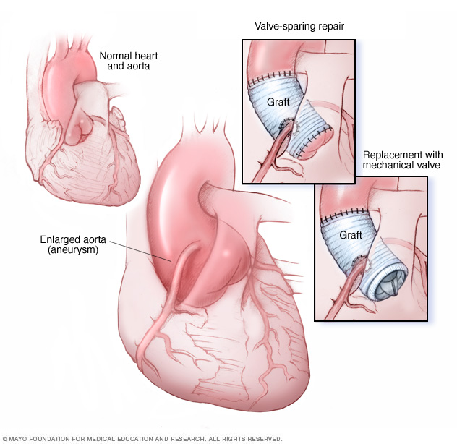
Aortic Root Replacement

Slide 36
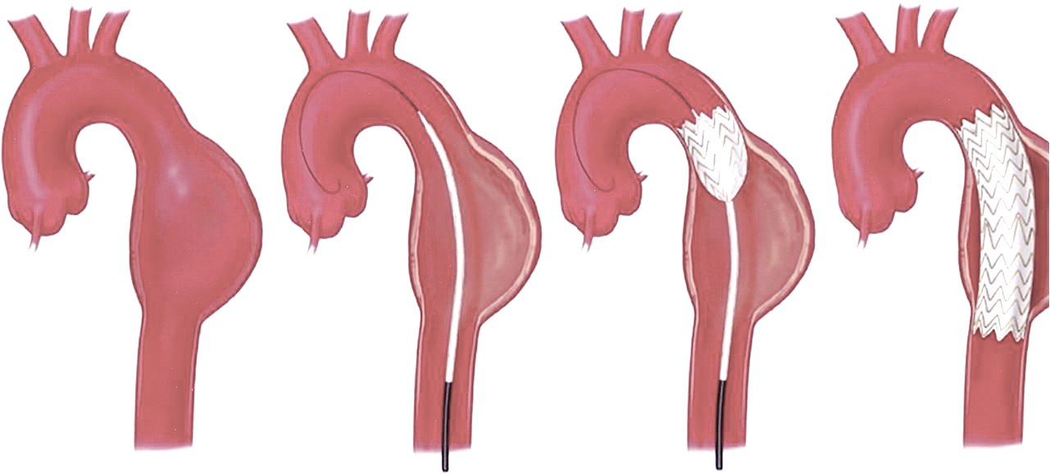
Thoracic Endovascular Aortic Repair

Slide 37
Arrhythmias

Slide 38
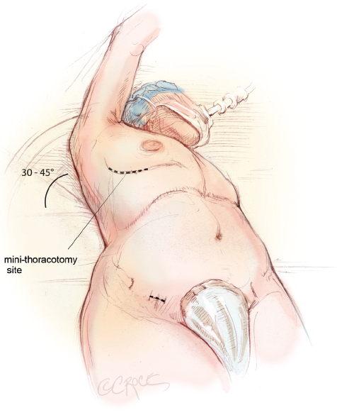
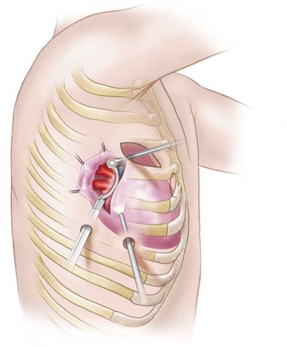
Minimally Invasive Maze

Slide 39
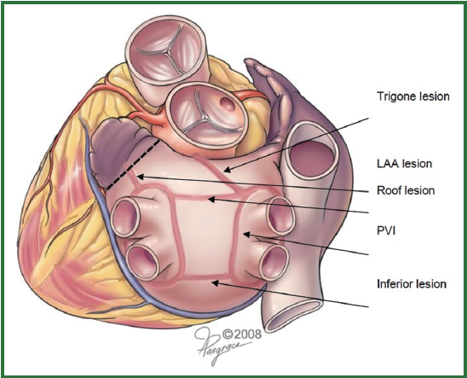
Mini-Maze Lesion Set

Slide 40
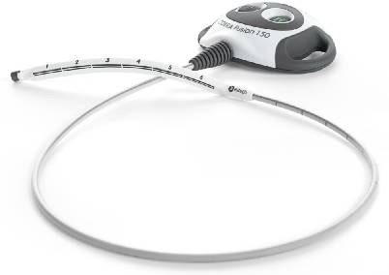
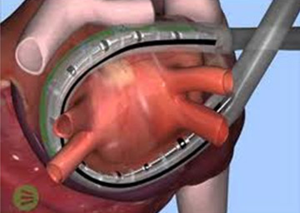
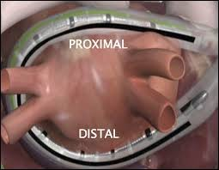

Slide 41



Left Atrial Occlusion Devices

Slide 42

Questions?
Cell: 210-569-3456

