Slide 1
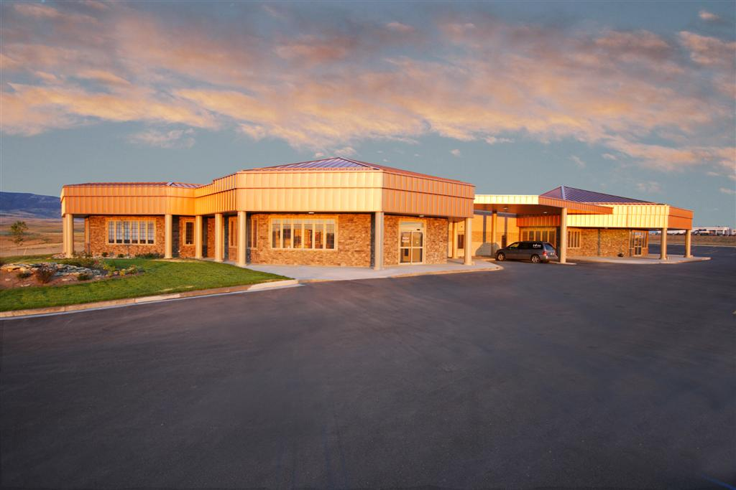
Lung Cancer Screening
John Purviance, MD
Rocky Mountain Oncology Center
April, 2018

Slide 2
Overview
Rational for Lung Cancer Screening
Data establishing screening CT scans as standard of care
Clinical Workflow and shared decision making
Management of abnormal CT scans
Future directions to improve efficacy of screening

Slide 3
Lung Cancer Screening is Effective
Detect high mortality disease
Significant prevalence (1-15 male smokers)
Risk factors allow for targeted screening
Treatment of early stage disease is more effective

Slide 4
Screening goals
Target high risk individuals (smokers)
Detection of Stage I disease
Decrease lung cancer mortality

Slide 5
Screening Modalities
CXR
Sputum
Low dose CT scan (LDCT)
Future modalities
DNA mutational analysis of blood or sputum
Not recommended

Slide 6
Screening test criteria
High sensitivity for early stage disease
High specificity (reduce false positives and invasive tests)
High positive predictive value
Low cost
Safety

Slide 7
Low Dose CT scan (LDCT)
Satisfies most screening criteria
High sensitivity for early stage disease
? Cost (<$300/scan)
When combined with PET/CT and follow up LDCT specificity improves (few false positive scans, fewer benign biopsies)
Safety
Radiation exposure modest
Low rates of adverse events with workup (<1.5%)

Slide 8
Lung Cancer- Burden of Disease
234,030 new cases of lung cancer in 2018
Leading cause of cancer deaths in US
154,050 Lung cancer deaths
25% of all cancer deaths in US
Compare this to annual mortality for next most lethal cancers
50,630 Colon cancer deaths
41,000 Breast cancer deaths
29,430 Prostate cancer deaths

Slide 9
Large population still at risk for lung cancer
~20% of US population >18 years old smokes
1 in 8 smokers will develop lung cancer

Slide 10
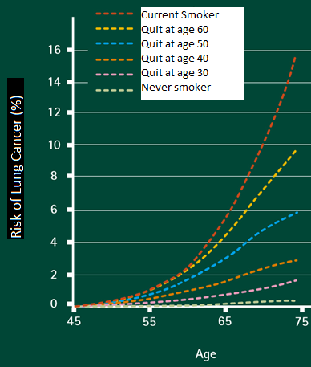
Smoking Cessation is Key to lowering lung cancer risk/mortality
Current Smokers at age 75 have almost 3x the risk of lung than someone who quit at age 50
Non Smoker

Slide 11
Identifying High risk patients for screening
Patient questionnaires are useful to identify candidates
Asbestos or uranium exposure
Exposure to second hand smoke
Age and number of pack years strong predictor of cancer risk
Age that they quit impacts risk

Slide 12
Majority of lung cancers present at late stage
Current clinical practice does not diagnose lung cancer soon enough
Symptomatic patients have late stage tumors >75%
70% of lung cancers present as Stage III/IV tumors
5 year survival of <7% overall
If you are diagnosed with lung cancer you have 18% chance of survival
20% present as Stage I

Slide 13
Late stage presentation has poor survival
5 year Survival
Stage IV <3%
Stage III 30%
Stage II -40-60%
Stage 1 >80%

Slide 14
Early detection of lung cancer does improve survival
Early stage prognosis based on size
90% 5 year survival tumor ≤ 1cm
85% 5 year survival tumor 1-2cm
80% 5 year survival tumor ≤ 3cm
Nodal disease drops survival precipitously
N1 40-50% survival
N2 20-30% survival

Slide 15
Potential Harms of Screening
Consequences of evaluating abnormal findings
Needle biopsy or surgery with associated morbidity/mortality
<1.5% in NSLT
Radiation exposure
1.4 mSv for LDCT compared to 7-9 mSv for conventional CT scan, 0.4 mSv for mammogram and 0.1 for CXR
0.05% chance of developing a radiation induced Lung cancer in screened population
Estimated that radiation would cause 1 new cancer for every 108 lung cancers found by screening
Cost
Anxiety

Slide 16
NLST trial established clear survival benefit for LDCT screening
53,454 patients high risk randomized
Annual LDCT scan versus annual CXR x 3yrs
55-74 years old, ≥30 pack/yr, current smoker or quit within 15 yrs
Positive finding ≥4mm noncalcified nodule

Slide 17
NLST showed survival benefit to LDCT screening
20% reduction in mortality with LDCT screening
Screen 256 people for 3 years to prevent 1 death
7% reduction in all cause mortality with LDCT
1.4% adverse events related to diagnostic work-up
70% of tumors detected were stage I or II
Rate of detection of lung cancer did not diminish with time
Suggest ongoing screening is necessary
High false positive rate led to a lot of additional scans, few extra surgeries or biopsies

Slide 18
NLST demonstrates cost effectiveness
Incremental cost-effectiveness ratio of $33,825 per life-year gained
Well below accept threshold <$50,000/QALY
Medicare adopted Lung cancer screening in 2015

Slide 19
Lung Cancer screening recommendations
USPSTF
Adults 55-80 with greater than 30 pack/year history of smoking
Current smoker or quit with 15 years.
Asymptomatic
Willing to undergo workup and treatment
Medicare eligibility
55-75 yo
≥ 30 pack/year
Asymptomatic
Written order (including documentation of Shared Decision Making)

Slide 20
Shared Decision Making
Conducted by physician or mid-level provider/ CNS
Discuss risks/benefits
Tobacco cessation
Tools available to identify patients who are eligible and document shared decision making
www.shouldIscreen.com
https://effectivehealthcare.ahrq.gov/decision-aids/lung-cancer-screening/home.html

Slide 21
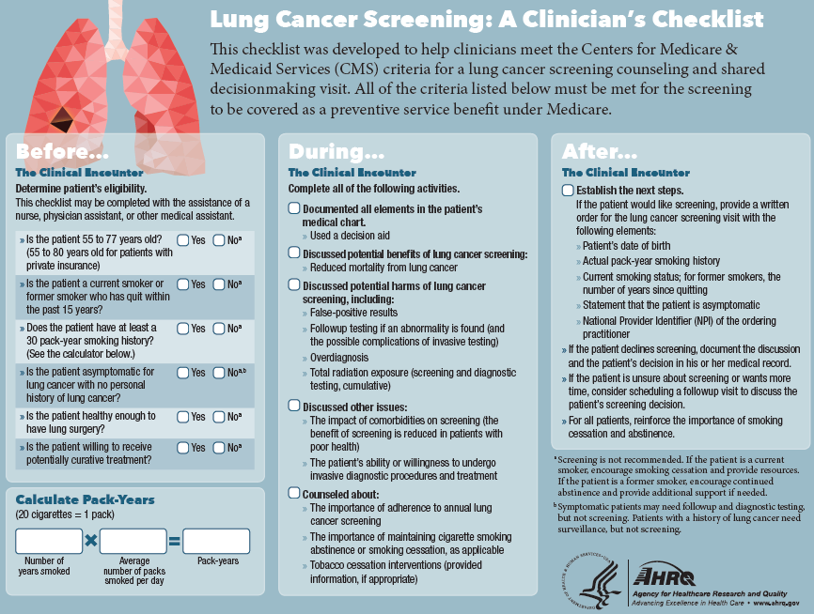
Shared Decision Making- Online tools

Slide 22
Medicare Coverage for Lung cancer screening with LDCT
HCPCS codes
G0296- Counseling visit to discuss shared decision making for LDCT screening of lung cancer with MD/PA/NP or CNS
Can be billed with office visit or consult codes
Medicare in Wyoming pays $29
Requires Documentation of eligibility, shared decision making, smoking cessation/abstinence
Online decision making tools help with documentation

Slide 23
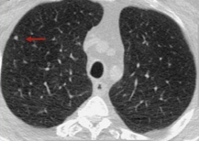
LDCT finds a 5mm nodule
What’s the next step?

Slide 24
Options for a 5mm Nodule
Repeat scan in 3 months
Continue screening with a LDCT in 1 year
Biopsy
PET/CT scan
Surgical consult

Slide 25
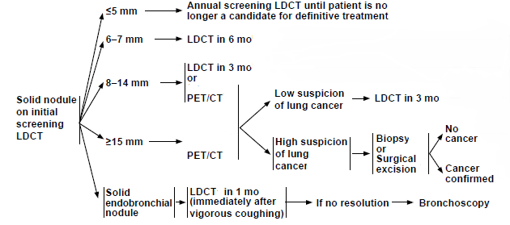
Workup for a Solid Nodule (NCCN Guidelines)

Slide 26
Follow up LDCT for pulmonary nodule found on prior LDCT
New Nodules are treated according to guidelines for solid nodules

Slide 27
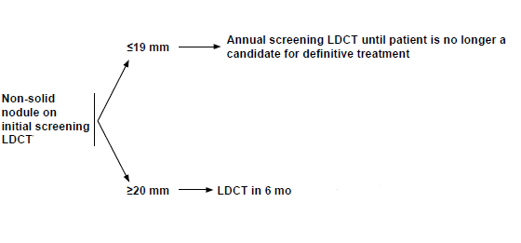
Non-solid nodule on LDCT
For partially solid nodule follow up based on size of solid component

Slide 28
PET/CT has the potential to cut down on unnecessary biopsies
PET approved for solitary pulmonary nodule
Indicated to evaluate nodule ≥8mm
PET positive nodule 90% specific in smokers >60 yo
If nodule PET negative, repeat LDCT in 3mo
No growth after 3 months has ~100% predictive power for benign

Slide 29
Managing harm reduction for screening
Raising threshold to do follow up LDCT (3-6mo) for a 6mm nodule
Fewer scans
No significant change in odds of finding early stage cancers
PET scanning can result in fewer biopsies
Excellent negative predictive value (~100% with stable follow up LDCT)
False positives ≤10% in older smokers

Slide 30
Managing harm reduction for screening
Noninvasive lung Radiosurgery achieves similar cure rates to surgery (>90%) in poor KPS patients
Candidacy for lung surgery should not be the litmus test for screening
Large body of evidence for “empiric” radiosurgery in patients unable to undergo biopsy
Ablate lesions that are high risk on serial PET scans
Risk of biopsy (pneumothorax) far outweighs risk of radiosurgery treatment

Slide 31
Poor utilization of Lung Cancer screening
Only 2-4% of eligible patients are being screened as of 2015
Recent Medicare approval should decrease the gap

Slide 32
Fear of screening
Lung cancer screening is completely covered by Medicare
Screening can lead to additional scans (which can incur out of pocket costs)
Screening can lead to invasive procedures (Bx, Surgery)
Multidisciplinary team at RMOC/WMC can decide on non-invasive workup and treatment options for poor Performance Status patients

Slide 33
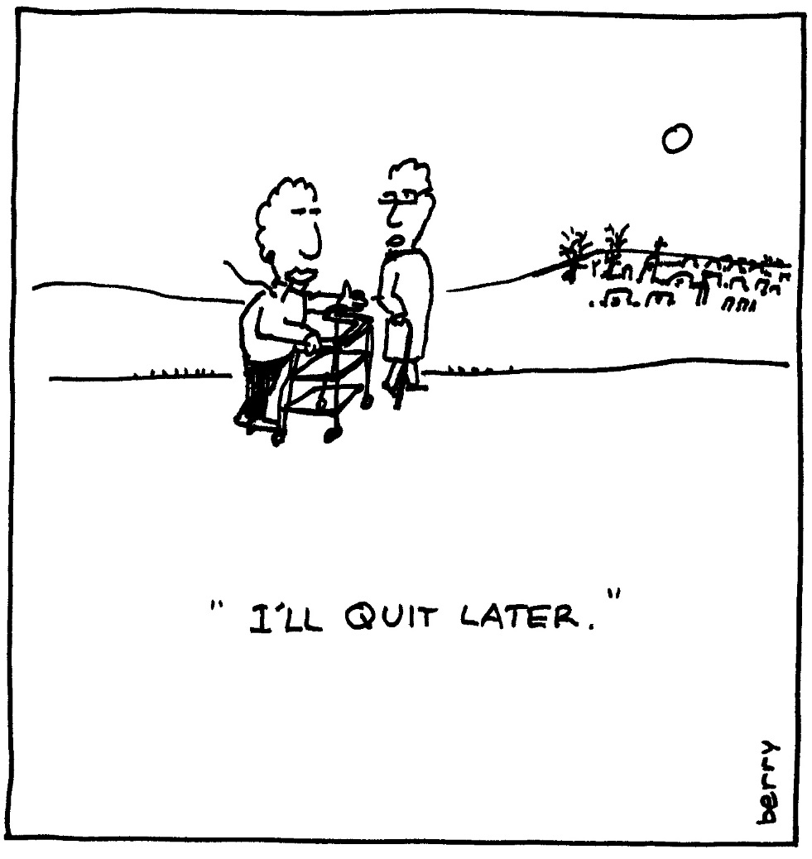
Lack of Fear with Screening
“I don’t have to quit smoking because you will detect and cure my cancer”

Slide 34
Future Directions
Identifying Highest risk patients
DNA/Mutational analysis to detect lung cancer
Improve algorithms for workup of abnormal LDCT
Better safety profiles and lower costs for Treatments
Minimally invasive surgery
Radiosurgery

