Slide 1
Non-Pharmacologic Management of Depression
David Martorano, M.D.
May 9th, 2017

Slide 2
Disclosures
I practice psychotherapy and benefit from referrals
I provide antidepressant medications and benefit from referrals
I work for a psychiatric hospital and benefit from referrals
I own a TMS machine and benefit from referrals

Slide 3
Acknowledgements
Morgan Johnson, MS-3 did much of the work on exercise and depression
Aislinn Lewis, MS-3 supplemented research on Transcranial Magnetic Stimulation

Slide 4
Pharmacologic Management of Depression
$ 9 billion dollar industry
3rd most prescribed class of medication
Safe
Effective
Proven

Slide 5
Depression is bad for Wyoming
7,500 people are depressed right now
2,500 have treatment refractory depression
2.5% a month attempt suicide
Lifetime risk of death by suicide ~10-15%
70% of deaths are MDD or MDD and comorbid SUD

Slide 6
You Have to Help
25% of completers will have seen a mental health professional in the month before death
50% will have seen their doctor
~ 25 people will die by suicide related to treatment refractory major depressive disorder this year (2 this month) without a successful referral from their doctor to a mental health professional

Slide 7
Challenges in Psychopharmacology
Stigma
Relapse
Cost
Side Effects
Approximately 40% non-responders

Slide 8
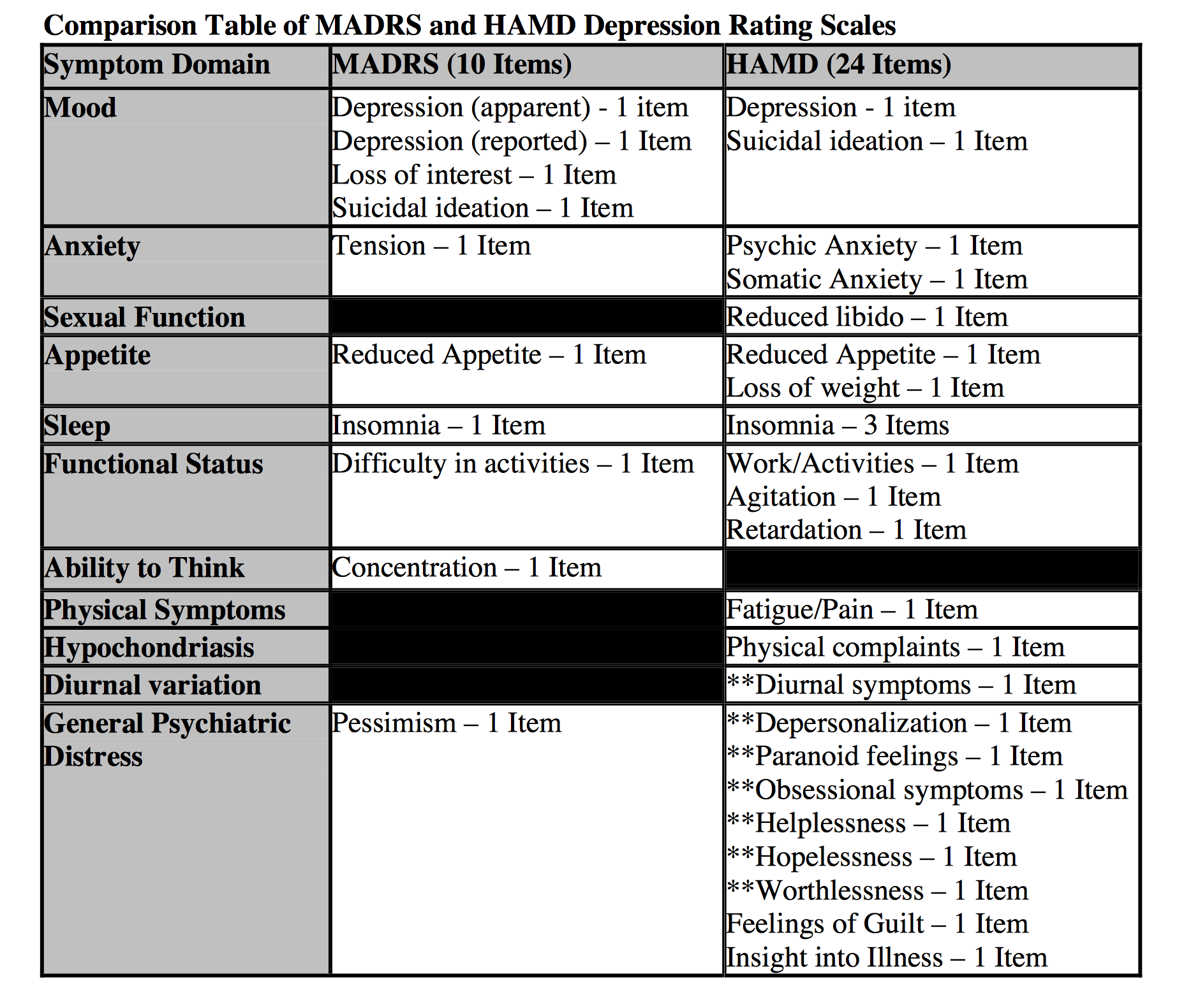
How we assess depression
https://www.fda.gov/ohrms/dockets/ac/07/briefing/2007-4273b1_04-DescriptionofMADRSHAMDDepressionR(1).pdf

Slide 9
STAR*D
Sequenced Treatment Alternatives to Relieve Depression
Multi-Center, Randomized Prospective (generally fairly treatment resistant groups)
Controversial outcomes
30% remission, 10-15% additional reached response in phase 1 mono therapy by 12 weeks
Additional 25 % reached remission rates by phase 2 (switch phase)
Huge dropout rate

Slide 10
What we learned from STAR*D
Never spend more time on picking a name then designing a study
Do not try to study too much with too many people
Depression can be successfully treated with antidepressants
Lots of people’s depression cannot be managed with antidepressants

Slide 11
STAR*D
D is for DISASTER
Enrolled
N=4,041
Citalopram
N=3,671
Buproprion
N=239
Cit + CBT
N=85
370 drop out
766 “exit”
Sertraline
N=238
CBT
N=62
Venlafaxine
N=250
Cit + Bup
N=250
Cit + BuS
N=250
432 “exit”

Slide 12
38% overall remission rate
48%
but really
29%!
12%
36%

Slide 13
Non-Pharmacologic Management of Depression
Electro Convulsive Therapy ECT
Psychotherapy
Light Therapy
Sleep Deprivation
Exercise (supplements are still pharmacotherapy)
Transcranial Magnetic Stimulation TMS

Slide 14
ECT
Gold Standard of Depression Treatments
First Line for Psychotic Depression
Expensive
High Morbidity (memory loss common)
Usually requires maintenance for recurrent depression

Slide 15
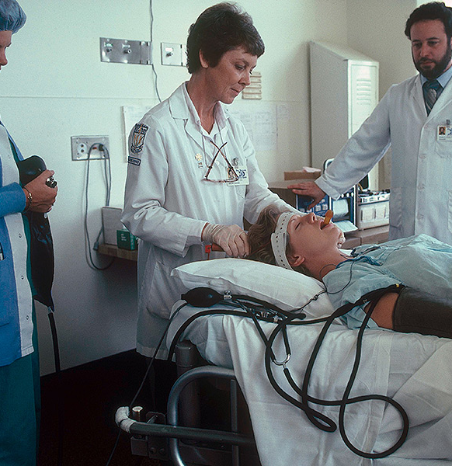
ECT
Unilateral (right) vs Bilateral
Requires paralysis and general anesthesia
MWF treatment for 20-24 sessions
70% response rates
50% remission rate
Also treats psychosis and mania

Slide 16
Psychotherapy in Depression
Talk is cheap…
Proven Psychotherapies
Interpersonal Psychotherapy
Behavioral Activation
Cognitive Behavioral Therapy
Problem Solving Therapy
Psychodynamic Psychotherapy*
Social Skill Therapy
Supportive Counseling

Slide 17
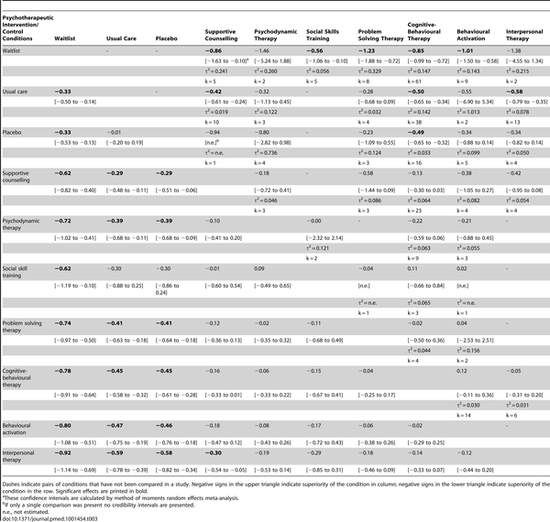
Table 3. Relative effect sizes (and 95% credibility intervals) of psychotherapeutic interventions and control conditions from conventional meta-analysis (upper triangle) and network meta-analysis (lower triangle).
Barth J, Munder T, Gerger H, Nüesch E, Trelle S, et al. (2013) Comparative Efficacy of Seven Psychotherapeutic Interventions for Patients with Depression: A Network Meta-Analysis. PLOS Medicine 10(5): e1001454. https://doi.org/10.1371/journal.pmed.1001454
http://journals.plos.org/plosmedicine/article?id=10.1371/journal.pmed.1001454

Slide 18
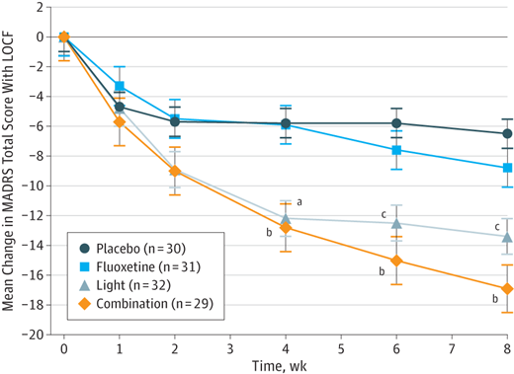
Light Therapy for MDD
“Let There be Light”
Randomized, double-blind, placebo- and sham-controlled, 8-week trial in adults (aged 19-60 years) with MDD of at least moderate depression.
Light Monotherapy, and combined Fluoxetine and light effective for depression
.
Lam RW, Levitt AJ, et al Efficacy of Bright Light Treatment, Fluoxetine, and the Combination in Patients With Nonseasonal Major Depressive DisorderA Randomized Clinical Trial. JAMA Psychiatry. 2016;73(1):56-63. doi:10.1001/jamapsychiatry.2015.2235

Slide 19
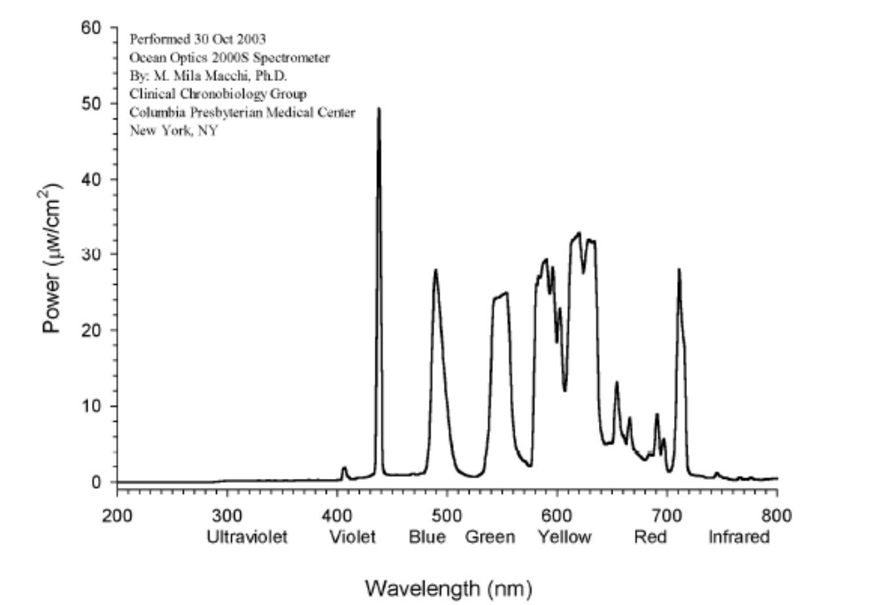
Light Therapy for MDD
10,000 Lux
Full Spectrum Lighting
30 minutes @ breakfast
Better with SSRI
Risk of Mania
Risk of Insomnia

Slide 20
How Might Exercise Help?
Physiological
Releasing neurotransmitters (5-HT, Dopamine, noradrenalin), Endorphins and endocannabinoids
Reducing perception of pain (endorphins- Beta-endorphins, beta-lipotrophins)
Increasing body temperature (calming effect)
Psychological and emotional
Increased confidence
Distraction
Social Interaction
Coping Strategy

Slide 21
TREAD- Treatment with Exercise Augmentation for Depression
122 patients who had a partial response to an SSRI, randomized into two groups
-Low- dose- 40-60 min of aerobic exercise as week
-High-dose 150 min of aerobic exercise a week
Conclusions
High-dose group were more likely to have:
-Fewer and less-severe symptoms associated
-Higher recovery rates
-Maintain longer remission
Aerobic exercise, regardless of dose, was associated with reducing blood levels of pro-inflammatory cytokines such as interleukin-1β (IL-1β) and tumor necrosis factor-α (TNF-α), which have been shown as elevated in some patients with MDD.

Slide 22
Exercise is Augmentation- Not Treatment
4 RCTs have failed to find any antidepressant effects of exercise:
DEMO (Krogh et al., 2009),
DEMO II (Krogh et al., 2012),
TREAD (Trivedi et al., 2011),
TREAD-UK (Chalder et al., 2012).
Instrument used to assess depression and the diagnosis of depression may lead to misunderstandings regarding efficacy and benefits of exercise.
Negative findings concerning the use of exercise as a treatment for depressed patients must be interpreted with caution.

Slide 23
Sleep Deprivation as Adjunct
Sleep Deprivation is effective for depressive symptoms
No RCT’s for MDD with appropriate follow up
Small Studies show sleep deprivation is most effective when combined with SSRI & Light Therapy
Sleep Deprivation is usually 5AM wake up X 3 days.
Güdücü F, Caliyurt O, Vardar E, Tuğlu C, Abay E. [Combination therapy using sertraline with sleep deprivation and light therapy compared to sertraline monotherapy for major depressive disorder]. Turk Psikiyatri Derg. 2005 Winter;16(4):245-51.

Slide 24
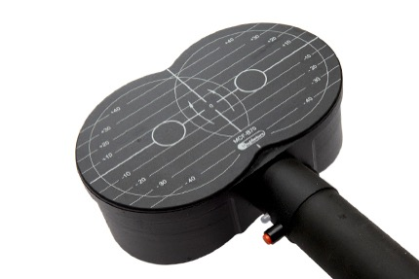
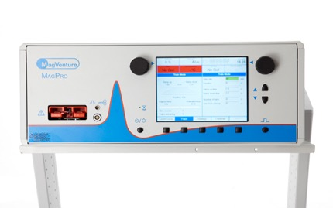
Transcranial Magnetic Stimulation
It’s not just”magnets”
Repetitive magnetic pulses to induce regional depolarization of neurons. Specially designed coils focus the area of effect to extremely local brain regions
Very low incidence of side effects, mainly headache rarely seizure, usually self-limited
FDA approved for treating MDD

Slide 25
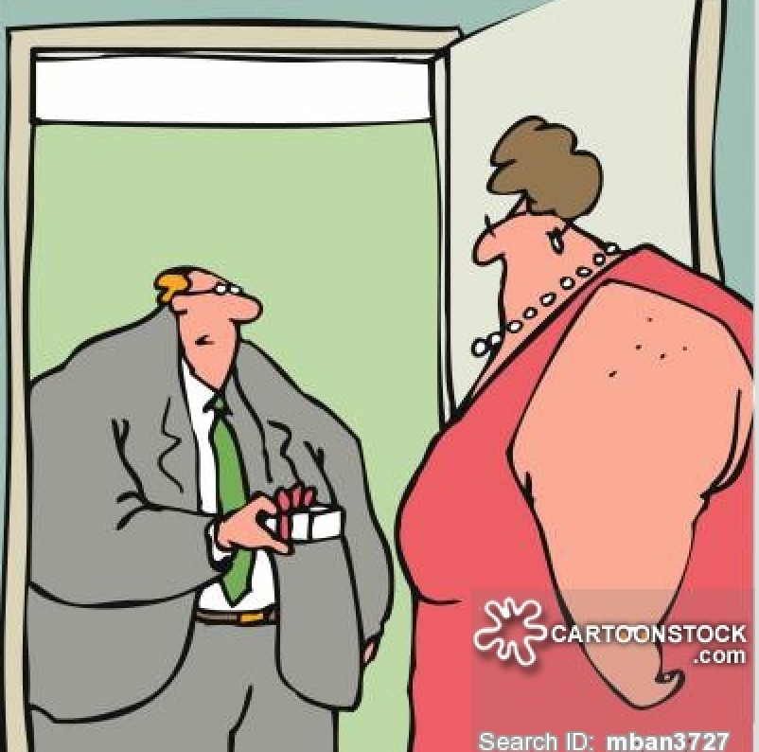
”I thought of you when I saw it.
It’s a fridge magnet.”

Slide 26
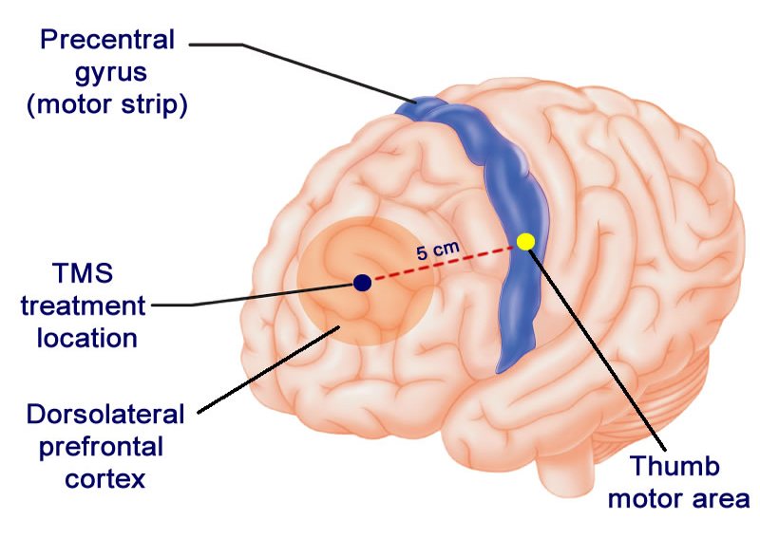
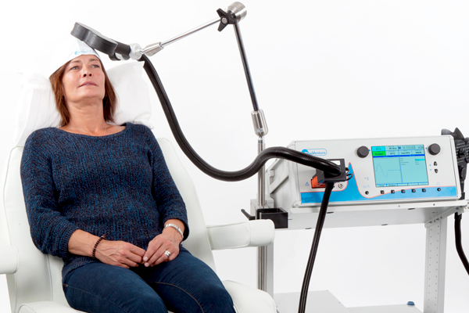
Transcranial Magnetic Stimulation
First session focused on locating Dorsolateral Prefrontal Cortex and determining the motor threshold
Neuronavigation vs motor threshold vs 10-20 system
4 different treatment protocols
Left-Sided treatments are stimulatory
Right-Sided treatments are generally inhibitory

Slide 27
TMS – Why does it work?
DLPFC has deep limbic connections
L-DLPFC is hypoactive in depression
R-RLPFC is hyperactive in depression
High frequency treatment increases regional brain activity
Low frequency treatment decreases regional brain activity
Magnetic field is small, and unlike ECT treatment is focused
1 treatment introduces up to 5,000 synchronous depolarization events regionally
Effects persist between treatment and duration of effect increases with subsequent treatments

Slide 28
TMS – How does it work?
The proposed mechanism is similar to the post-ictal activity observed in ECT.
In ECT, pyramidal neurons synchronously depolarize activating GABAergic interneurons.
In rTMS GABAergic interneurons, resulting in EEG patterns closely paralleling the post-ictal phase of ECT
rTMS has been proven to improve neural plasticity, contrary to the established inhibition of neuroplasticity associated with depression
rTMS is associated with increases in BDNF- a marker of neuroplasticity
High frequency rTMS is associated with PET and NIRS evidence of increased metabolism

Slide 29
TMS – How well does it work?
9 out of 12 sham-controlled studies showed significant improvement versus sham treatment
rTMS works best without medication
rTMS in the only published head to head trial against ECT was found to be equally effective
rTMS has largely been studied in the most treatment resistant patient populations
rTMS has reported remission rates in treatment refractory depression of between 30 and 50%, 2.5-4 times more effective than stage 3 and 4 STAR*D patients.

Slide 30
Theta Burst treatment
Theta burst is 3 pulse burst @ 50hz with some interval of rest between bursts and possibly between trains.
It is delivered below the resting motor threshold
Treatment is shorter and better tolerated due to the lower intensity
Treatment is less expensive
Treatment may be more effective
Unlike traditional rTMS, treatment may not be covered by third party payors

Slide 31
WY-Psych Data for TMS in treatment refractory depression
60 patients completed treatment for MDD moderate to severe
All were treatment refractory and had failed at least 4 antidepressants and psychotherapy
83 % remission rate BDI <20 or 50% reduction in BDI (n 50)
70 % Reduction in BDI

Slide 32
Non-Responders
Half were on high dose opiates for chronic pain or buprenorphine
75% female
Psychostimulants
Multiple SSRI / SNRI combinations

Slide 33
Who did best
Men responded better overall (lower rate of non-remission, but women who responded improved more in terms of BDI than Men who responded.)
People between the ages of 25-40 had a 100% remission rate.
Women over 45 on Benzodiazepines had the highest average reduction of BDI n5

Slide 34
Medication Effect on TMS Response
 | Drop BDI | BDI % | n
All | 22 | 63% | 80
Bup | 19 | 57% | 12
Opiate | 19 | 60 | 13
no opiate | 23 | 65% | 55
SSRI | 23 | 62% | 19
SNRI | 24 | 63% | 19
2 meds | 20 | 68% | 9
3 meds | 24 | 64% | 10
<4 meds | 22 | 66% | 38
>3 meds | 23 | 62% | 26
5 meds | 28 | 73% | 6
1 med | 22 | 65% | 19
0 med | 19 | 57% | 16
stim | 15 | 57% | 4
Benzo | 25 | 69% | 26
Wellbutrin | 17 | 65% | 10
<40 + benzo | 26 | 81% | 7
SSRI + SNRI | 14 | 41% | 2
<45 female + benzo | 33.8 | 78% | 5
muscle relax | 29 | 73% | 9
comorbid substance | 20 | 61% | 10
Bipolar II | 22 | 65% | 4

Slide 35
Demographics TMS Response
Female | 23 | 66% | 41
Male | 16 | 58% | 21
Gender not specified | 25 | 62% | 18
Age < 45 | 23 | 65% | 35
Age >45 | 21 | 62% | 45
Age <35 | 26 | 70% | 17
Age <33 | 26 | 71% | 16
25…34 | 25 | 76% | 11
<25 | 29 | 61% | 6

Slide 36
The Dorsolateral Prefrontal Cortex
Executor, Decider, Evaluator
Unwinding a complex region of emotional regulation

Slide 37
Working Memory – How many things can you hold in your head at once?
Cognitive Flexibility – How do you transfer knowledge from one learned task and apply it to another?
Planning - Taking a series of problems , holding them in memory, ordering a solution, and using information from memory to execute a solution to the problem.

Slide 38
if two items must be compared from memory, the involvement of DLPFC is required. People with damaged DLPFC are not able to identify a picture they had seen, after some time, when given the opportunity to choose from two pictures
Wisconsin Card sory as they lose track of the currently correct rule and persistently organize their cards in the previously correct rule
DLPFC deals with waking thought and reality testing, it is not active when one is asleep
DLPFC is most frequently related to the dysfunction of drive, attention and motivation. Patients with minor DLPFC damage display disinterest in their surroundings and are deprived of spontaneity in language as well as behavior
Patients may also be less alert than normal to people and events they know Damage to this region in a person also leads to the lack of motivation to do things for themselves and/or for others

Slide 39
Hypoactivity in the left DLPFC during both unattended and attended emotional judgment
Hyperactivity in the right DLPFC during attended emotional judgment.
Hyperactivity in the right DLPFC correlated with depression severity.

Slide 40
LEFT DLPFC hypoactivity = negative emotional judgment rather thanwith emotional perception or attention while RIGHT DLPFC hyperactivity affects attentional modulation.
Left–right DLPFC imbalance is characterized in neuropsychological regard, which bridges the gap from resting metabolism and therapeutic repetitive transcranial magnetic stimulation effects to functional neuroanatomy of altered emotional– cognitive interaction in MDD.

Slide 41
References
Bakker, N., Shahab, S., Giacobbe, P., Blumberger, D. M., Daskalakis, Z. J., Kennedy, S. H., & Downar, J. (2015). RTMS of the Dorsomedial Prefrontal Cortex for Major Depression: Safety, Tolerability, Effectiveness, and Outcome Predictors for 10 Hz Versus Intermittent Theta-burst Stimulation. Brain Stimulation, 8(2), 208-215. doi:10.1016/j.brs.2014.11.002
Berlim, M. T., Eynde, F. V., & Daskalakis, Z. J. (2013). EFFICACY AND ACCEPTABILITY OF HIGH FREQUENCY REPETITIVE TRANSCRANIAL MAGNETIC STIMULATION (rTMS) VERSUS ELECTROCONVULSIVE THERAPY (ECT) FOR MAJOR DEPRESSION: A SYSTEMATIC REVIEW AND META-ANALYSIS OF RANDOMIZED TRIALS. Depression and Anxiety,30(7), 614-623. doi:10.1002/da.22060
Desmyter, S., Duprat, R., Baeken, C., Autreve, S. V., Audenaert, K., & Heeringen, K. V. (2016). Accelerated Intermittent Theta Burst Stimulation for Suicide Risk in Therapy-Resistant Depressed Patients: A Randomized, Sham-Controlled Trial. Frontiers in Human Neuroscience, 10. doi:10.3389/fnhum.2016.00480
Downar, J., Giacobbe, P., Salomons, T., Geraci, J., Bakker, N., Dunlop, K., . . . Flint, A. (2013). 1565 – Safety, efficacy, and tolerability of intermittent theta-burst rtms of the dorsomedial prefrontal cortex for refractory major depression. European Psychiatry, 28, 1. doi:10.1016/s0924-9338(13)76570-2
Duprat, R., Desmyter, S., Rudi, D. R., Heeringen, K. V., Abbeele, D. V., Tandt, H., . . . Baeken, C. (2016). Accelerated intermittent theta burst stimulation treatment in medication-resistant major depression: A fast road to remission? Journal of Affective Disorders, 200, 6-14. doi:10.1016/j.jad.2016.04.015
Fitzgerald, P. B., & Daskalakis, Z. J. (2013). Repetitive transcranial magnetic stimulation treatment for depressive disorders: a practical guide. Heidelberg: Springer.

Slide 42
References
Gaynes, B. N., Lloyd, S. W., Lux, L., Gartlehner, G., Hansen, R. A., Brode, S., . . . Lohr, K. N. (2014). Repetitive Transcranial Magnetic Stimulation for Treatment-Resistant Depression. The Journal of Clinical Psychiatry, 75(05), 477-489. doi:10.4088/jcp.13r08815
Jung, N. H., Gleich, B., Gattinger, N., Hoess, C., Haug, C., Siebner, H. R., & Mall, V. (2016). Quadri-Pulse Theta Burst Stimulation using Ultra-High Frequency Bursts – A New Protocol to Induce Changes in Cortico-Spinal Excitability in Human Motor Cortex. Plos One, 11(12). doi:10.1371/journal.pone.0168410
Nordenskjold, A. (n.d.). Randomised controlled trial of electroconvulsive therapy (ECT) with pharmacotherapy or pharmacotherapy alone in relapse prevention of depression. Http://isrctn.org/>. doi:10.1186/isrctn40355220
A. (2012). Treatment-resistant depression: therapeutic trends, challenges, and future directions. Patient Preference and Adherence, 369. doi:10.2147/ppa.s29716
Diagnostic and Statistical Manual of Mental Disorders: DSM-5. Washington, D.C.: American Psychiatric Association; 2013
Simone Grimm, Johannes Beck, Daniel Schuepbach, Daniel Hell, Peter Boesiger, Felix Bermpohl, Ludwig Niehaus, Heinz Boeker, and Georg Northoff Imbalance between Left and Right Dorsolateral Prefrontal Cortex in Major Depression Is Linked to Negative Emotional Judgment: An fMRI Study in Severe Major Depressive Disorder, biological Psychiatry, in press.
https://www.nimh.nih.gov/health/topics/depression/index.shtml

Slide 43
References
http://www.mayoclinic.org/diseases-conditions/depression/in-depth/depression-and-exercise/art-20046495
http://psychnews.psychiatryonline.org/doi/full/10.1176/appi.pn.2014.6b5
http://www.ncbi.nlm.nih.gov/pubmed/16895046
http://www.ncbi.nlm.nih.gov/pubmed/21658349
http://www.ncbi.nlm.nih.gov/pmc/articles/PMC3613866/
http://discovery.dundee.ac.uk/portal/files/778709/Mead_2010.pdf
http://www.health.harvard.edu/mind-and-mood/exercise-and-depression-report-excerpt
http://emedicine.medscape.com/article/88648-overview

Slide 44
References
http://www.exerciseismedicine.org/support_page.php/healthcare-providers/
http://www.exerciseismedicine.org/assets/page_documents/HCP_Action_Guide(3).pdf
http://www.ncbi.nlm.nih.gov/pmc/articles/PMC4264809/
https://www.healthypeople.gov/2020/topics-objectives/topic/physical-activity/objectives
http://www.ncbi.nlm.nih.gov/pmc/articles/PMC474733/
http://www.ncbi.nlm.nih.gov/pubmed/8571000
http://www.alzheimersanddementia.com/article/S1552-5260(16)31525-4/abstract
https://www.ncbi.nlm.nih.gov/pmc/articles/PMC4558786/
http://www.ncbi.nlm.nih.gov/pubmed/6091217

