Slide 1
Prostate Cancer Screening- Update
Brandon Trojan, MD
Central Wyoming Urological Associates

Slide 2
Case Scenario
53 yo neighbor and husband of your wifes best friend - Randy presents to your backyard to discuss PSA screening. Randy is an engineer and nervous about dying of prostate cancer as well as many other medical conditions. He states that he has no family history of prostate cancer and no issues voiding-etc.
He also has a fellow engineer- Ricky- that he works with who's father had prostate cancer diagnosed at age 53. He had a successful RALP and is cancer free 12 years later. Randy wants to know what to tell Ricky what he needs to do about cancer screening. Ricky is 50.

Slide 3
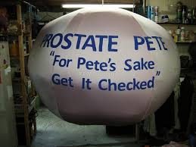
PSA
Prostate Specific Antigen

Slide 4
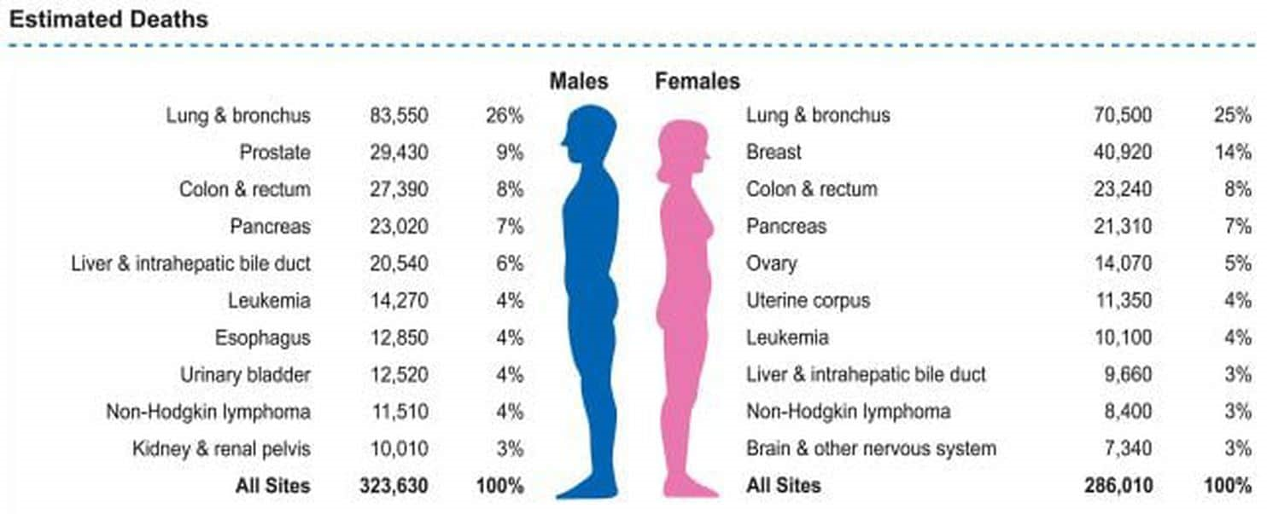

Slide 7
United States Preventative Services Task Force Recommendations
US Preventative Services Task Force recommendations:
2008: Against PSA screening for men >75 years
October 2011: Draft recommendations against screening in all asymptomatic men
May 2012: Final recommendations of Grade D for PSA screening in all asymptomatic men
Why: Harms of Screening Outweigh the Benefits

Slide 8
What was the USPSTF’s Evidence?
PLCO Trial
- Randomized 76,693 men 50-74
- Showed no decline prostate cancer death in screening arm at 13
years.
- Usual care control arm- 50% underwent PSA screening during study
- 44% pts in trial pre screened with PSA
- Overall 86% of control arm-usual care received PSA testing before or
during trial
- 30% men in screening arm with abnormal PSA underwent biopsy.

Slide 9
What was the USPSTF’s Evidence?
ERSPC
- 182,160 men 50-74- 13 yr fu
- Showed statistically significant decrease decline prostate cancer
death in the screening arm
- Adjusted analysis- 781 screened/ 27 diagnosed to prevent one
prostate cancer death.
- Relative Reduction PC mortality w screening by 27%

Slide 10
What was the USPSTF’s Evidence?
Goteberg- Swedish arm ERCP
- 20,000 men 50-74- 13 yr fu
- Adjusted analysis- 293 screened/ 12 diagnosed to prevent one
prostate cancer death.
- Relative Reduction PC mortality w screening by 44%
- Pre screening before initiation was ony 3%, compared to 20% ERSCP
and possibly 86% in the PLCO trial.

Slide 11
USPSTF’s Current Recommendation’s
April 11, 2017- Update
Men age 55-69 – screening changed from grade D to C
Risks and benefits of screening in the overll population are balanced
Screening in this age goup shoud be a patient’s decision based on their preferences and values
Still recommend against screening in men > 70
< 54 years old screening previously grade D, update did not give a screening recommendation
No recommendation high risk population

Slide 12
USPSTF’s 2012 Ramification’s
Decline PCa incidence from 540.8 to 416.2 per 100,000 between 2008 and 2012
2016 29% reduction TRUS biopsies and 16% reduction in radical prostatectomy numbers
Artifact active surveillance?
Reverse stage migration?
Higher rates metastatic disease at diagnosis?
Increased PCa mortality?

Slide 13
AUA- Guidelines
Index patient 1 – men under 40
Recommendation against PSA screening
Low prevalence of clinically significant detectable prostate cancer, no evidence demonstrating benefit of screening.
None of the prospective trials evaluating benefits screening included men under the age of 40 years

Slide 14
AUA- Guidelines
Index patient 2- Age 40-54
Routine screening not recommended
For men at higher risk (positive family hx/ African American) decisions regarding prostate cancer screening should be individualized.
The “absence of evidence does not constitute evidence of absence” in this age group

Slide 15
AUA- Guidelines
Index patient 3- Age 55-69
Strong recommendation shared decision making with regards to PSA screening and proceeding based on men’s values and preferences
The greatest benefit to screening is within this age group
To reduce harms of screening, a routine screening interval of two years or more may be preferred over annual screening in those men that have participated in shared decision-making and decided on screening

Slide 16
Shared Decision Making
Should include a discussion of
mortality risk from other co-morbid conditions
individual risk for prostate cancer
The degree to which screening might influence his overall life expectancy and chance of experiencing morbidity from prostate cancer or its treatment.

Slide 17
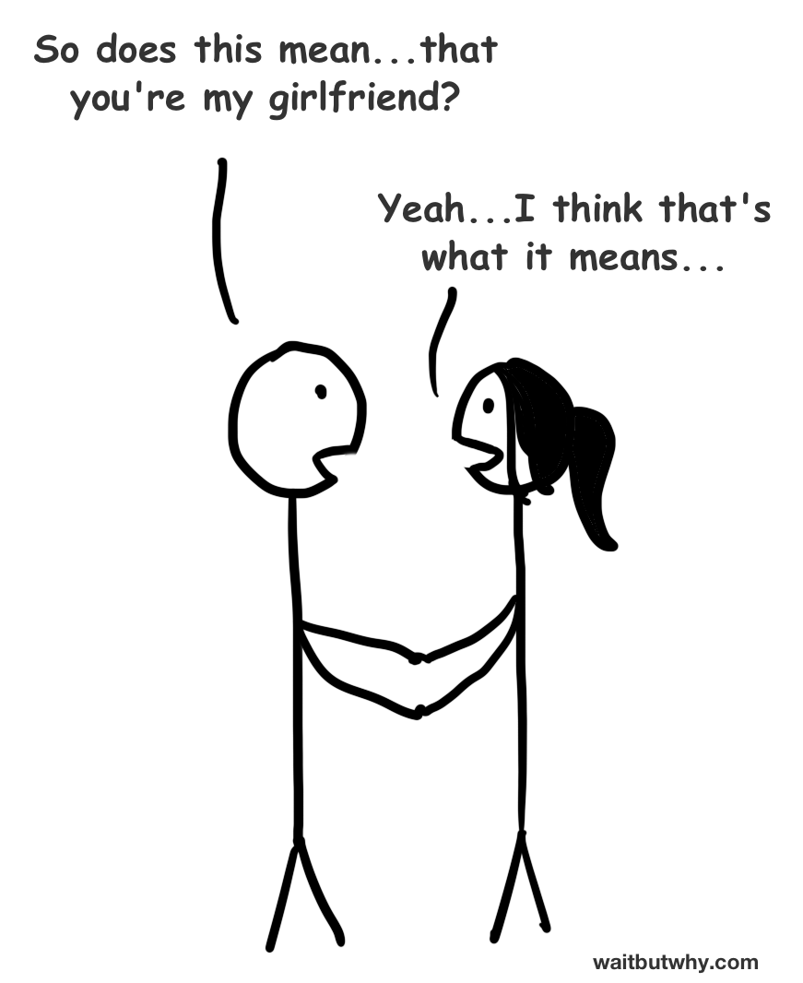
Shared Decision Making

Slide 18
AUA- Guidelines
Index patient 4- Age 70+
Routine screening not recommended
Some men in excellent health with life expectancy >10-15 years may benefit from PSA screening –evidence extremely limited
Men who choose to be screened should be counseled strng ratio of harm to benefit with high likelihood over diagnosis low- risk disease .
In older men panel recommends
1) Increase biopsy threshold to 10 ng/ml
2) Discontinuation PSA screening among men PSA < 3 ng/ml

Slide 19
Additional Tests
Digital Rectal Examination
Free and total PSA- 4-10 ng/ml
PCA3 ( Prostate Cancer Gene 3)- Urine marker after DRE
Select MDx- Urine after DRE
Prostate Health Index
4K score
Risk Calculators
MRI

Slide 20
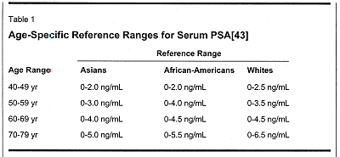
Revisiting PSA
PSAD
PSAV

Slide 21
Randy
53 yo male with no risk factors
Routine screening not recommended
For men at higher risk (positive family hx/ African American) decisions regarding prostate cancer screening should be individualized.
The “absence of evidence does not constitute evidence of absence” in this age group

Slide 22
Ricky
50 yo male with risk factors
Routine screening not recommended
For men at higher risk (positive family hx/ African American) decisions regarding prostate cancer screening should be individualized.
The “absence of evidence does not constitute evidence of absence” in this age group

