Slide 1
Surgical Management of Obstructive Sleep Apnea
Caleb Wilson MD

Slide 2
Overview
Definitions
Why treat OSA
Risk factors and screening
Nonsurgical treatment
Surgical treatment

Slide 3
Definitions
Apnea: >90% decrease in airflow for at least 10 seconds
Hypopnea: >50% decrease in airflow or 30% with 3% O2 desat
AHI: The average number of these combined events per hour

Slide 4
Definitions
Normal: AHI<5
Mild sleep apnea: 5≤AHI<15
Moderate sleep apnea: 15≤AHI<30
Severe sleep apnea: AHI≥30

Slide 5
Why Treat OSA?
Improve symptoms:
Somnolence/fatigue
Poor work/school performance
Headaches
Mood disorders
Prevent morbidity/morality:
Auto accidents
Hypertension
Cardiac events
Death

Slide 6
http://jcsm.aasm.org/viewabstract.aspx?pid=30917
Notes:
Korean study significant change in life expectancy – particularly for pts in severe category. Some put the estimate at 8-12 years in decrease in life expectancy – similar to smoking

Slide 7
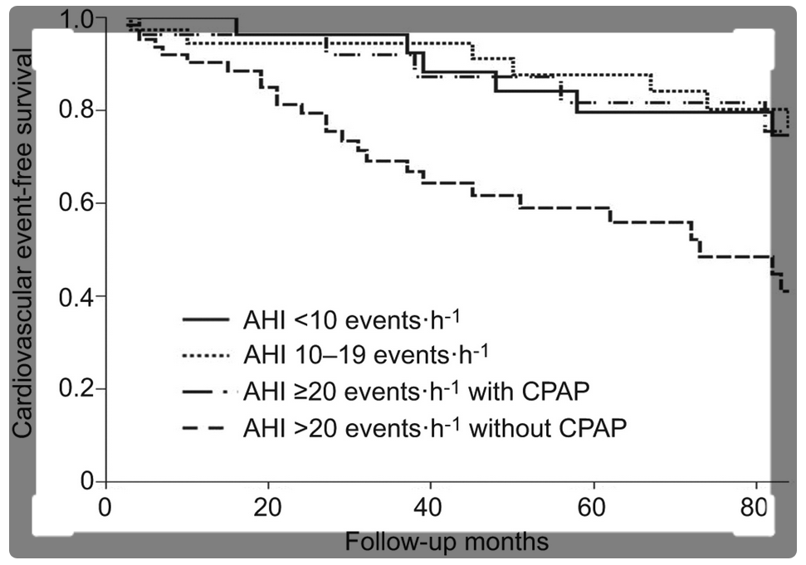
adsfg

Slide 8
Screening
STOP Questionnaire
Snoring
Tiredness
Observed Apnea
Pressure (Hypertension)
BANG
BMI >35
Age >50
Neck Circumference >16” (40cm)
Gender = Male

Slide 10
Testing
Pulse oximetry
Home sleep study
Attended sleep study

Slide 11
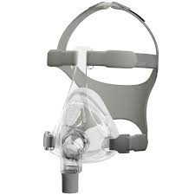
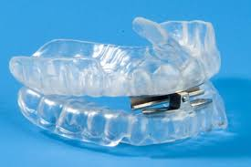
Nonsurgical Treatment
Lifestyle Modification/Weight Loss
Positive Airway Pressure (First Line)
Oral Appliance Therapy
Cpapamerica.com
TNISleep.com

Slide 12
Pediatric OSA
Sleep study difficult to obtain
Refer based on symptoms
Adenotonsillectomy 1st line therapy
CPAP 2nd line (Obesity, craniofacial abnormalities)

Slide 13
T&A for Pediatric OSA
90% success rate in non-obese children (AHI<5)
60% in obese children

Slide 14
Tonsillectomy in Adults
Large tonsils
AHI <30 – greater success rate
Notes:
Meta-analysis 216 patients.

Slide 15
Multilevel Obstruction
sciencebasedmedicine.org

Slide 16
Endoscopy
Asleep vs Awake
Soft palate closure pattern
Tongue – obstruction, tonsillar hypertrophy
Epiglottic collapse

Slide 17
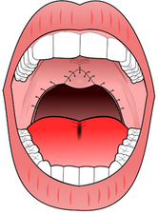
Uvulopharygopalatoplasty (UP3)
en.wikipedia.org/wiki/Uvulopalatopharyngoplasty

Slide 18
Lingual Tonsillectomy vs Tongue Base Reduction

Slide 19
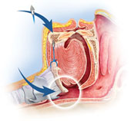
Suspension Procedures
medtronic.com

Slide 20
Nasal Surgery
Septoplasty
Turbinate Reduction
CPAP Compliance

Slide 21
Other Procedures
Maxillomandibular Advancement
Tracheostomy

Slide 22
Questions?

