Slide 1
Hot ID cases
Mark E. Dowell MD FACP
Rocky Mountain Infectious Diseases
2018

Slide 2
Mexican Holiday
A fairly healthy 63 year old white man with a history of prior tobacco abuse, obesity, hypertension and at least moderate alcohol use went to Playa del Carmen for rest and relaxation. He had been to this same all-inclusive resort 8 previous times without incident. He was drinking, eating, snorkeling, and being a bum for the first 3 days when…

Slide 3
The patient developed intractable nausea and vomiting, up to several times per hour for the first 24 hours. No diarrhea noted. Moderate cramps. He simply stayed in his room and tried to keep up his fluid intake. This lasted another 12 hours when…

Slide 4
He began experiencing profuse, non-bloody diarrhea. He may have had a low-grade fever? He had no appetite and was very weak. His wife requested medial evaluation at the resort. A physician attempted to place an IV for fluids but was unsuccessful. He suggested evaluation at a local hospital: “The best in the region”.

Slide 5
Upon arrival, the patient’s wife was told she must pay $6500 up front since it was obvious he would be hospitalized. Initial labs revealed WBC 12,000,no shift, BUN 65, creatinine 3.0 and mild LFT elevation. IVF were initiated and stool studies ordered.

Slide 6
He was hospitalized 4 days, was marginally better and decided to fly back to Casper. He had >5 stools on the trip back. In total, he had lost >10 pounds. The patient was told that the only positive stool test revealed Rotavirus.

Slide 7
Upon arrival in Casper, he went to the ER at WMC. Initial vital signs revealed 107/74, 110, normal RA 0₂ saturation, and an afebrile state. WBC 12.09, Hgb 17.3, creatinine 1.8, and minimal LFT elevation.

Slide 8
His wife stated to me that everyone else in their party of 8 was well.

Slide 9
On PE, chronically ill. Pustules, decent sized noted on left lateral wrist, distal left finger, and right 4th digit. An old IV site on the dorsal left hand displayed diffuse erythema and mild edema, but no pus. It was warm. The only other PE finding was that of essentially normal abdominal exam.

Slide 10
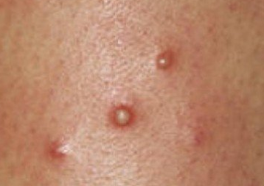
Yum

Slide 11
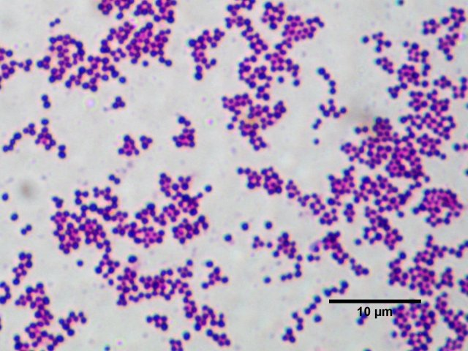
Pustule

Slide 12
I placed him on ancef after I incised 2 pustules and found the gram stain to reveal gram-positive cocci in clusters. Blood cultures were drawn upon admission.

Slide 13
Questions?
Thoughts?

Slide 14
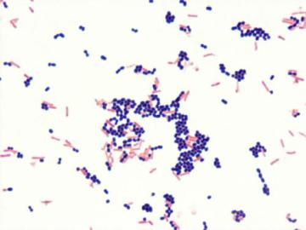
Blood culture

Slide 15
Levofloxacin was added to the antibiotic approach. So….

Slide 16
Over the next 24 hours the sh*t hit the fan!
Blood cultures revealed MSSA
Blood cultures revealed gram-negative rods too.
Stool culture revealed non-lactose fermenting gram-negative rods.

Slide 17
His blood cultures grew both MSSA and Salmonella group B.
His stool culture grew Salmonella group B.
Any other tests you might like?

Slide 18
A TEE revealed a tricuspid valve vegetation.

Slide 19
Final Diagnoses
Salmonella group B Bacteremia
Salmonella group B enteritis
MSSA left hand abscess with septic thrombophlebitis.
MSSA bacteremia
Tricuspid valve IE due to Salmonella, MSSA, or both!

Slide 20
Currently doing well on Ancef plus P.O. levofloxacin for a planned 6 week course.

Slide 21
Points
Less than 5% of Salmonella enteritis features bacteremia.
Of these, 5-10% develop distant infection.
Salmonella likes endovascular locations including aneurysms, atherosclerotic plaques, and vascular grafts.

Slide 22
Salmonella IE
0.01% of IE cases
87 cases in literature : 1976-2014
Mitral valve 33%
Tricuspid valve 2/87 cases.

Slide 23
Is this the take-home message?
YOU PLAY YOU PAY ?!?!

Slide 24
Multipathogen Nucleic Acid Amplification Tests
Detect viral, parasitic, and bacterial pathogens.
Able to identify norovirus, ETEC, EPEC, EAEC.
Goal is to decrease inappropriate antibiotic use.

Slide 25
Issues
May detect >1 pathogen. What does it mean?
Must correlate with clinical picture.
Detection does NOT prove presence of viable organisms.
Systems do NOT quantify nucleic acid present.

Slide 26
Public Health Implications
Must have system in place to confirm results in potential outbreaks.
Must not impede detection and investigation.
Need access to antimicrobial susceptibility testing.
May require serotyping/subtyping.
Does it pay to have some media in lab?

Slide 27
Are You Pulling My Leg?
A 62 year old Caucasian male, nonsmoker, construction worker developed soaking night sweats and temperatures to 104º in March 2017. He thought he had the “flu” and toughed it out until late April. During this time, he was weak and anorexic. He slowly lost weight.

Slide 28
He sought medical evaluation and was found to have a medium-sized left pleural effusion. He denied SOB previously but now had progressive DOE. There was no history of sputum production or chest pain. A chest CT displayed the effusion with ? loculations.

Slide 29
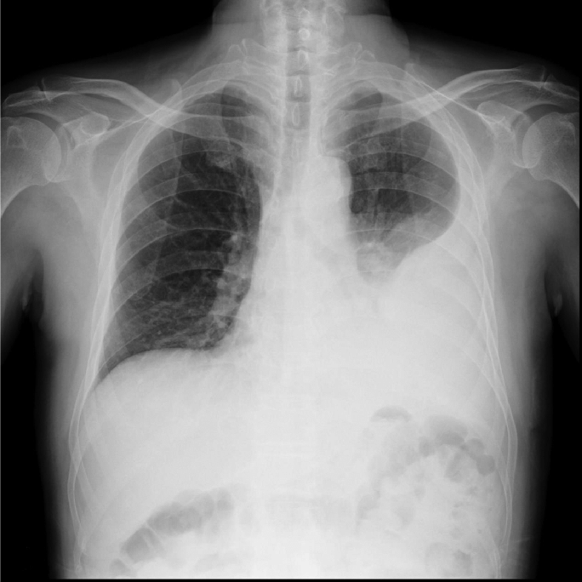

Slide 30
The patient was prescribed cefdinir and azithromycin for 10 days. There was no improvement. He continued to have temperatures to 102º and felt “lousy”.

Slide 31
After the course of antibiotics, he underwent thoracentesis: 3846 WBC (82% mononuclear cells). The gram stain was negative for organisms. His peripheral WBC was 12.9 with 64 segs.

Slide 32
Questions?

Slide 33
No insect bites. Owns a horse. Prior to becoming ill, his cat brought in a fresh baby rabbit leg and placed it on a carpet runner inside the house. The patient picked it up and placed it in the kitchen trash. His wife vacuumed the runner.

Slide 34
The pleural fluid culture grew Francisella tularensis.

Slide 35
He received a 3 week course of gentamicin and recovered clinically and radiographically.

Slide 36
Diagnosis
Chronic Tularemia with isolated left pleural effusion.

